Slide 1
Update on the work of ICRP TG120 on radiation emergencies and malicious events
NERIS Workshop 2024
11 November 2024
Rome
Anne Nisbet
ICRP Committee 4 (member)
ICRP TG120 (chair)

Slide 2
Outline
Overview of previous ICRP recommendations for radiation emergencies & malicious events
Overview of work of ICRP Task Group120
  Mandate & membership
  Scope and case studies
  Public protection in event of a nuclear detonation
  TG120 report - content
  Communicating with the public during a radiation emergency
  TG120 progress
  TG120 timeline

Slide 3
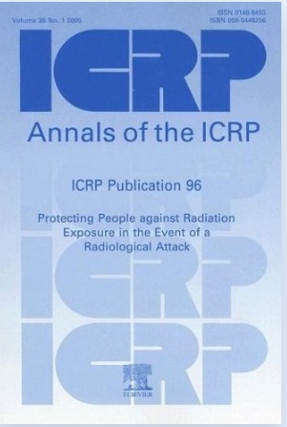
ICRP Publication 96
Prompted by terrorist attacks in 2001
Published in 2005
Focus on radiological attacks (RDDs)
Based on 1990 recommendations from ICRP Pub 60
  Practices & intervention
  Averted dose for urgent actions
Refers to ICRP Pub 82 (1999) for prolonged exposure situations
  Generic criteria for intervention
  Exclusion levels for commodities

Slide 4
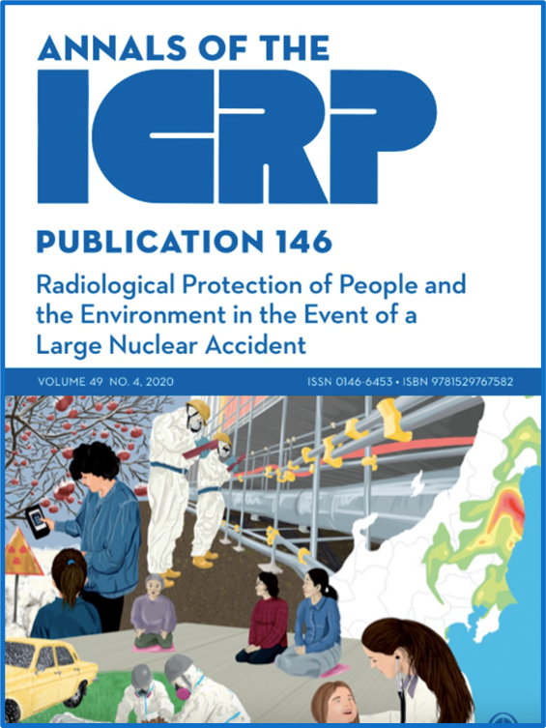
ICRP Publication 146
Published in 2020
Focus on large nuclear accidents (NPP)
Prompted by learning from Fukushima NPP accident in 2011
Supersedes ICRP Pub 109/111 (2009)
Based on 2007 recommendations from ICRP Pub 103
  Exposure situations
  Dose criteria for optimisation of protection
  Stakeholder engagement

Slide 5
ICRP TG120: Mandate
The Task Group will develop ICRP recommendations for radiation emergencies and malicious events*. These recommendations will complement those given in Publication 146 for large nuclear accidents.
* Since September 2022, this now includes nuclear detonation

Slide 6
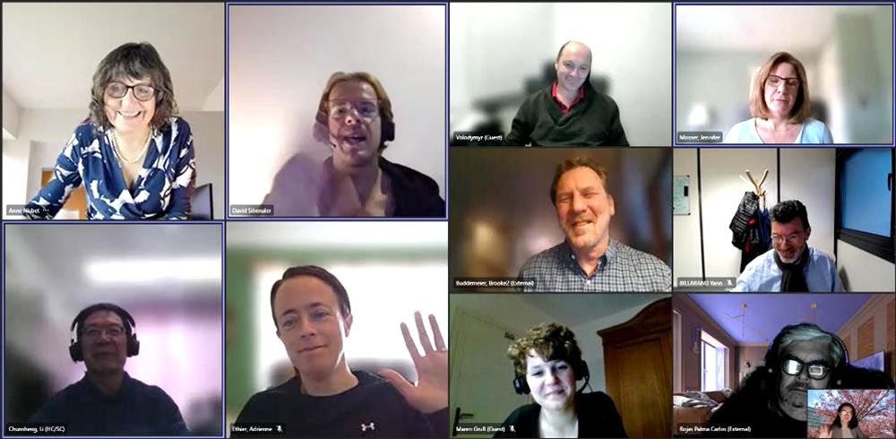
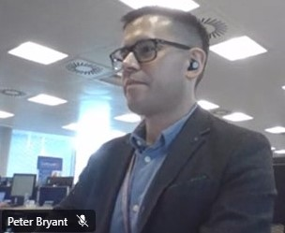
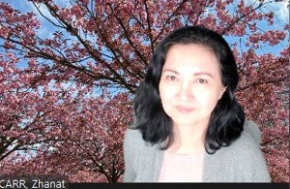
Membership
Anne Nisbet (Chair), C4, UK
Chunsheng Li, Canada
Jennifer Mosser, USA
Peter Bryant, UK
Yann Billarand, C4, France
Volodymyr Berkovskyy, C2, Ukraine
Brooke Buddemeier, USA
Zhanat Carr (WHO)
Mentees (communication):
Maren Gruß, Germany
David Sibenaler, Australia
C4: Critical reviewers:
  Julie Burtt, Eduardo Gallego, John Takala
MC: Critical reviewers:
  Werner Rühm, Michiaki Kai
ICRP Scientific secretariat:
Adrienne Ethier, Win Thuzar (intern)

Slide 7
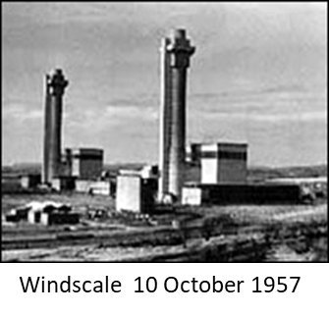
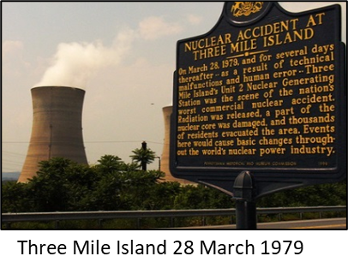
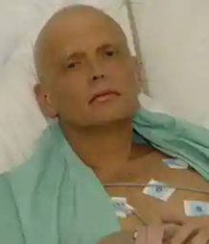
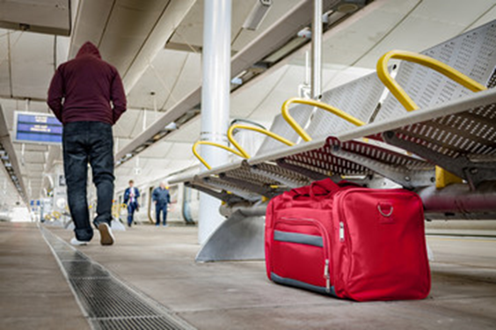
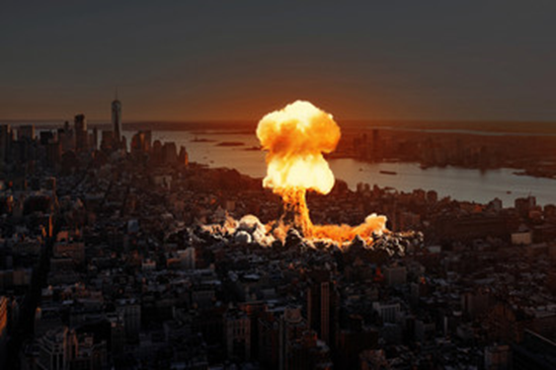
Scope
Radiation accidents
Accidents at nuclear facilities
  Criticalities
  Operating faults
  Fires/explosions
Transport (plane, train, road, satellite, sea)
Lost, damaged or stolen sources
Nuclear medicine isotopes
Malicious events
Radiation Exposure Device (RED)
Radiological Dispersal Device (RDD)
  Explosive
  Covert
Contamination of food & drinking water
Sabotage of nuclear facilities
Nuclear weapon detonation

Slide 8
Case studies & hypothetical scenarios
Scenario type | What/where | Cause | Specifics
Accident | Nuclear facility | Criticality | Tokaimura, Japan (1999)
 |  | Operating fault | Three Mile Island (1979)
 |  | Fire/explosion | Windscale (1957)
 |  |  | Kyshtym (1957)
 |  |  | Techa River (1961)
 |  |  | Hanford (1976)
 | Inadvertent theft, damage, loss of sources. Orphaned sources | Theft | Goiania (1987)
 |  | Damage to sealed source | Harborview (2019)
 |  | Lost/orphaned | Chile (2005)
 | Transport | Satellite | Cosmos 954 (1978)
 |  | Plane | Palomares (1966)
 | Other | Nuclear medicine isotopes | Birmingham hospital (2018)
Malicious | Sabotage | Nuclear facility | Hypothetical Military attack
 | Nuclear weapon detonation | Explosive (airburst) | Hiroshima (1945)
 |  | Explosive (ground burst) | Hypothetical 10kT
 | RDD | Explosive | Hypothetical RDD
 | RED | Covert | Hypothetical RED
 | Poison Individuals | Food and drink | Litvinenko (2006)

Slide 9
Scenario summary template
Topic | Sub-headings
Description | What happened; radionuclides; type of release - airborne/aquatic; HASS; affected environments; scale
Timelines & duration | Phases: response (threat, early and intermediate); recovery (long-term)
Exposure pathways | External exposure; Internal exposure; direct exposure
RP criteria & protective actions | Dose criteria applied; protective actions implemented; if/how protection decisions were justified; if/how protection was optimised; SDGs considered?
Consequences: Human and society | Radiation-induced health effects: tissue reactions, cancer & heritable diseases; Non-radiological impacts: mental health, psychological, other. Societal impact
Consequences: Affected biota | Radiation-induced effects: direct damage, changes in biodiversity; Impact on ecosystem services, pets and livestock;
Stakeholder engagement | How, when and who
Communication | When, what, how, impact
Lessons learned | What worked well and why. What could be improved

Slide 10
Prompted by war in Ukraine
ICRP TG120 was asked to prepare general advice for public protection
More detailed guidance covering much broader range of topics, including protection of responders will be published in ICRP TG120 report
Public protection in case of a nuclear detonation

Slide 11
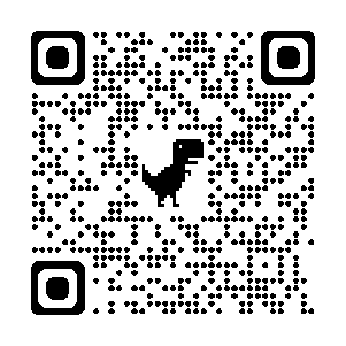

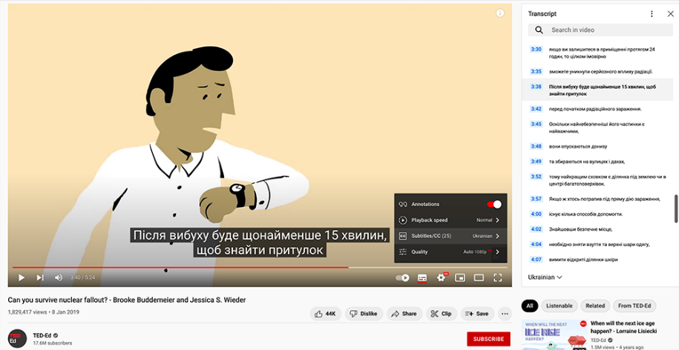
www.icrp.org/protection-nuclear-attack.html
Advice for the Public on Protection in Case of a Nuclear Detonation
Clear instructions & information
THE FIRST 10 MINUTES
THE FIRST 24 HOURS
THE NEXT 48 HOURS
UNDERSTAND THE HAZARDS
HOW TO BE PREPARED FOR A NUCLEAR DETONATION
RESPONDING TO ALERTS
Link to 5 min TedEd video
“Can you survive nuclear fallout?”

Slide 12
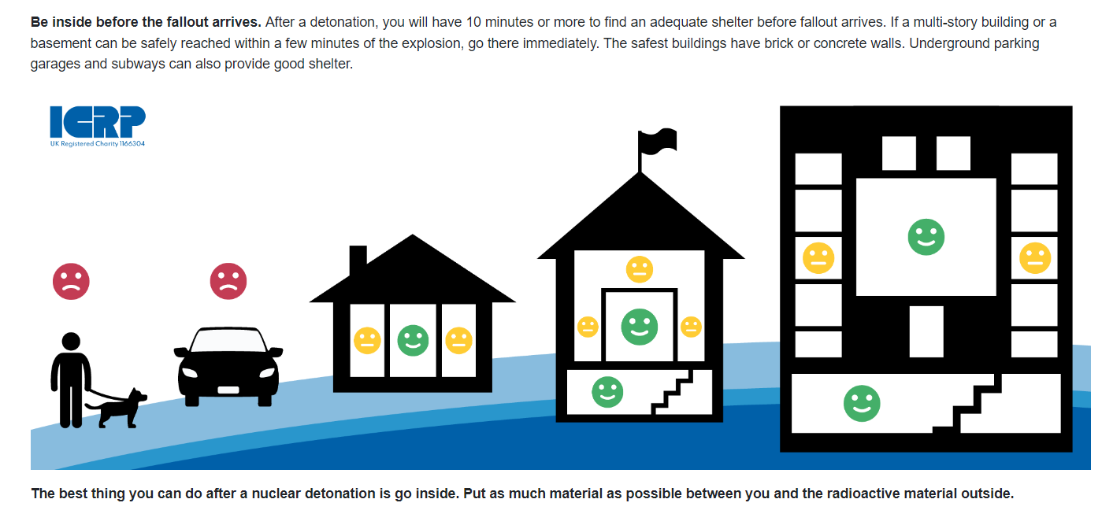
First 10 minutes

Slide 13
First 24 hours
If exposed to fallout:
  Remove outer layers of clothing
  Wipe or wash exposed skin
Tune in to any available media
Remain inside, unless threatened by an immediate hazard or informed by authorities that it is safe to leave
  If, you are an essential worker, you may be released for short period to perform critical duties
Five minute video is available (subtitles in many languages) on how to prepare
for and survive, a nuclear detonation

Slide 14
Next 48 hours
If told to remain in shelter
  Stay inside, unless life-threatening injury or other serious threat or hazard
    Do not go outside to collect loved ones
  Consume stored food and water sparingly. Do not harvest/eat food from outside
  Support care of vulnerable people – set up a first aid station in protected shelter
  Only request help, if life threatening medical condition
If told to evacuate (from home)
  Take medicine, change of clothes, mobile phone, medical/legal papers
  Take disaster supplies (torch, radio, first aid kit, food & water, cash, cards)
  Do not return home, until told to do so
  For pets, bring cage, leash, food, medication

Slide 15
TG120 Report
Section 2: General considerations
Section 3: Emergency response
Section 4: Recovery
Section 5: Preparedness & planning

Slide 16
Section 2: General considerations
Subsection | Detail
Scenarios | Accidents (4 categories)) Malicious events (5 categories)
Timelines | Response: early response; late response; recovery; transition to normal living
Exposure pathways | Direct external; airborne; aquatic
Consequences: people | Affected populations (members of the public, responders) Radiation induced health effects Non-radiological health effects Impact on society and economy
Consequences: environment | Affected biota (flora, fauna, soil, groundwater Radiation induced health effects on biota Non-Radiological Effects and sustainable decision making
Goals and objectives of RP in emergencies | Goals and objectives Principles of protection (justification, optimization & reference levels; dose limits) Application of dose criteria (emergency exposure, existing exposure)
Stakeholder engagement & communication | Processes for engagement Role of communication

Slide 17
Section 3: Emergency response
Activity | Imminent release | Early response phase First hour – first days | Late response phase Days – weeks
Assessment against radiological criteria
Monitoring, dosimetry
Modelling
Rescue, life saving
Triage, decontamination
Medical countermeasures
Protective actions
MHPSS
Environmental protection
Communication
Stakeholder engagement

Slide 18
TG120 recruited mentees
To develop simple, and effective social media messages
To support the drafting of the communication section of the Task Group’s Report
Communicating with the public during a radiation emergency

Slide 19

Social media – benefits and challenges
Benefits
Challenges
Fast distribution of information
Increased outreach
Two-way dialogue
Monitoring of social media
Increased visability
Too many voices
Conflicting information
Misinformation & disinformation
Polarization & politisation
Resource-intensive
Acknowledgement: Maren Gruß

Slide 20
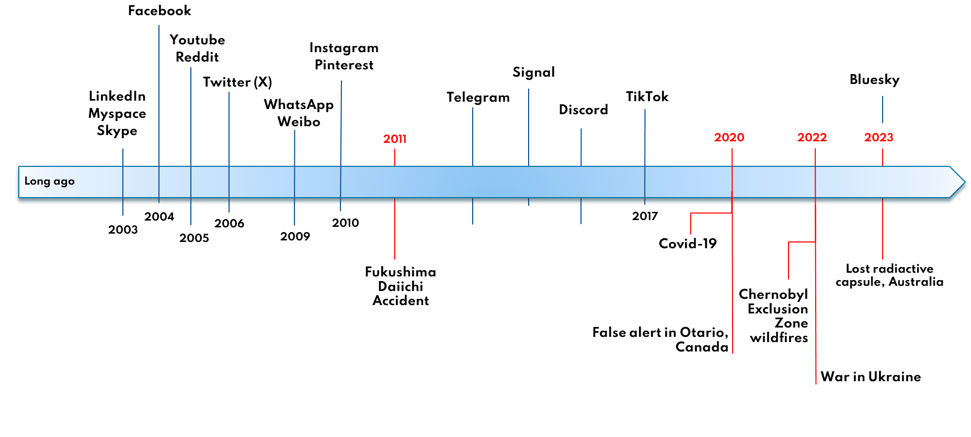
Social media communication: history
2006
2014
2013
2015
Litvinenko
Pre 2003
Windscale (1957); Palomares (1966); TMI (1979); Chernobyl (1986);
Goiania (1987); Tokai mura, (1999)
Acknowledgement: Adapted from Maren Gruß

Slide 21
Learning from past radiation emergencies
TG120 examining communication strategies used in the past to derive social media templates for a wide range of emergencies
Series of topical meetings:
  Litvinenko (2006)
  Goiania (1987)
  Harborview (2019)
  Birmingham hospital (2018)
  Australian lost capsule (2023)
  US Radiological Assistance Programme (RAP) terrorist scenarios
‘Communication in radiation emergencies’ – already covered by IAEA, WHO, IRPA etc. Therefore, ICRP advice must add value

Slide 22
TG120 Progress
Critical review of Pub 96 and Pub 146
Populated detailed templates for 15 case studies, 3 still to complete
Webpage on ‘Public Protection in case of Nuclear Detonation’ (Oct 22)
Drafted Chapter 2 on ‘General Considerations’ of TG Report
Convened 11 TG meetings (mix F2F and online)
Convened 8 online ‘topical’ meetings (e.g. ND, RP criteria, communication)
Significant outreach 2023/24:
  ConRad (Munich), REMPAN (Seoul), ERPW (Dublin), ICRP Symposium (Tokyo). SRP (Eastbourne); IRPA (Orlando)
Recruited 2 mentees to provide input on communication (Mar 23-Feb 26)
Workshop planning (Apr 2025)

Slide 23
TG120 Timeline
Phase 1 (Oct 21 – Mar 25):
  Preparation of materials
Phase 2 (Apr 25 – Sep 25):
        Workshop(s) and continue preparation of materials
Phase 3 (Oct 25 – May 26):
              Draft report for SLO & public consultation
Phase 4 (Dec 26):
Publish final report

Slide 24
Thank you for listening
Any questions?
Contact me:
annenisbet0@googlemail.com

