Slide 1

Model comparison and validation using data of the 1950s nuclear weapon tests
PREDICT Task 3.1
Sarah Millington (UK Met Office) on behalf of
PREDICT Task 3.1 collaborators

Slide 2
Aim of the task
To identify and select a number of 1950s tests
Produce cases for verification of model outputs
First model intercomparison performed
  Areas for potential improvement identified
  Output from other tasks and work packages
Second model intercomparison performed
Changes made to model parameters, set-up, inputs

Slide 3
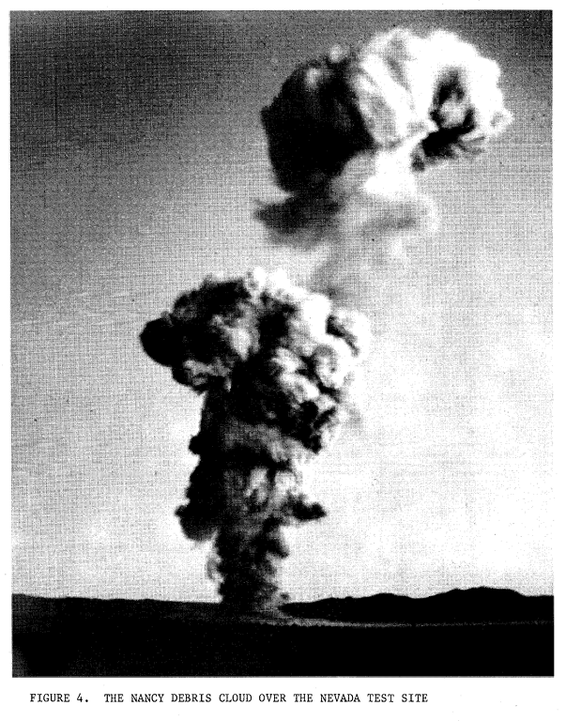
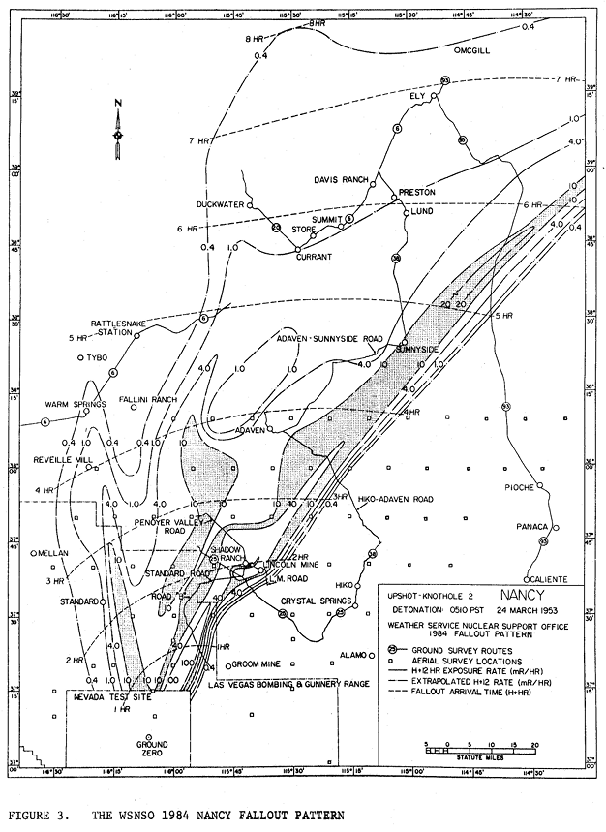
Use of 1950s test data
Many nuclear tests reviewed
Upshot-Knothole Nancy
24th March 1953, 24 kt
Using ECMWF’s ERA-5 data
Simulations for a 12-hour period with outputs visualised on a map and compared with monitor data
1984 reanalysis 12-hour fallout pattern​
Notes:
Top 5 tests:
Upshot-Knothole Nancy ​
Upshot-Knothole Harry​
Dominic II/Sunbeam Small Boy​
Trinity​
Plumbbob Smoky​
Participants will run their atmospheric dispersion models as they would for an emergency response incident. Runs will be 12 hours in duration from the detonation time,. 1310 UTC March 24 1953.
Outputs should include air concentration, deposition and dose data for fixed monitoring locations and on a grid for comparison with time-of-arrival and equivalent dose contours from the Upshot-Knothole Nancy test.

Slide 4
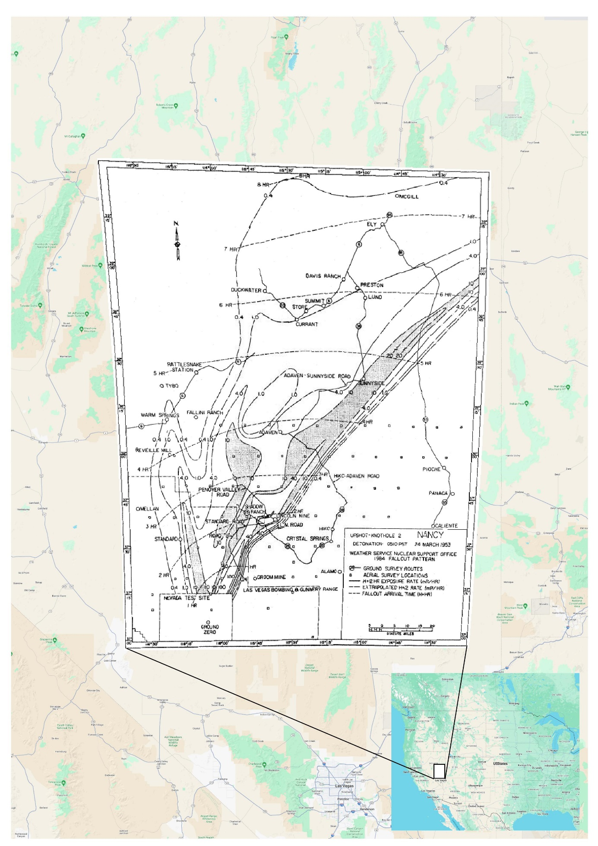
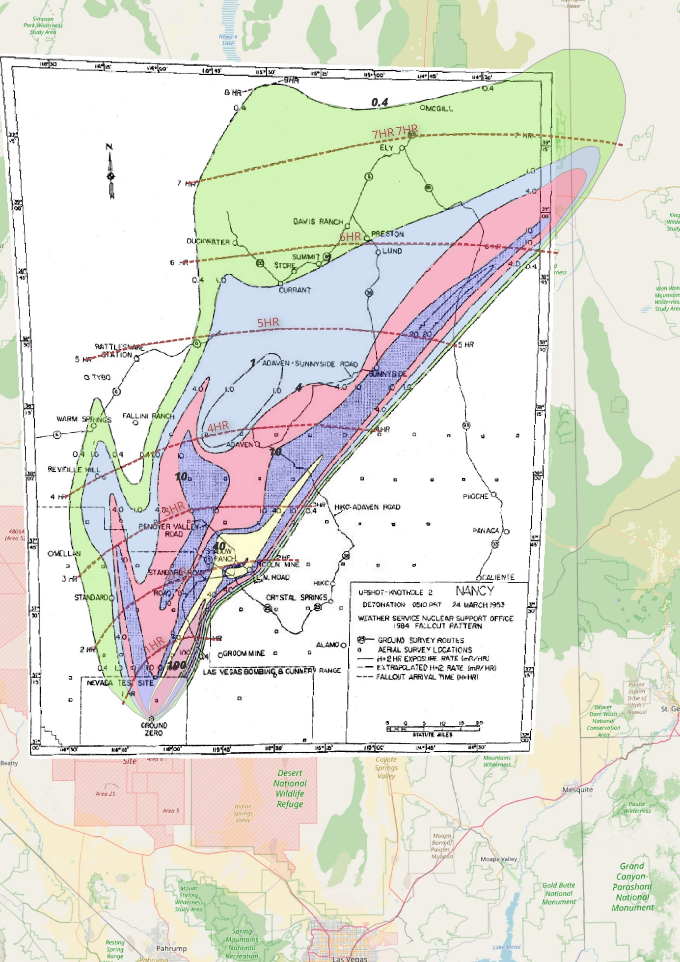
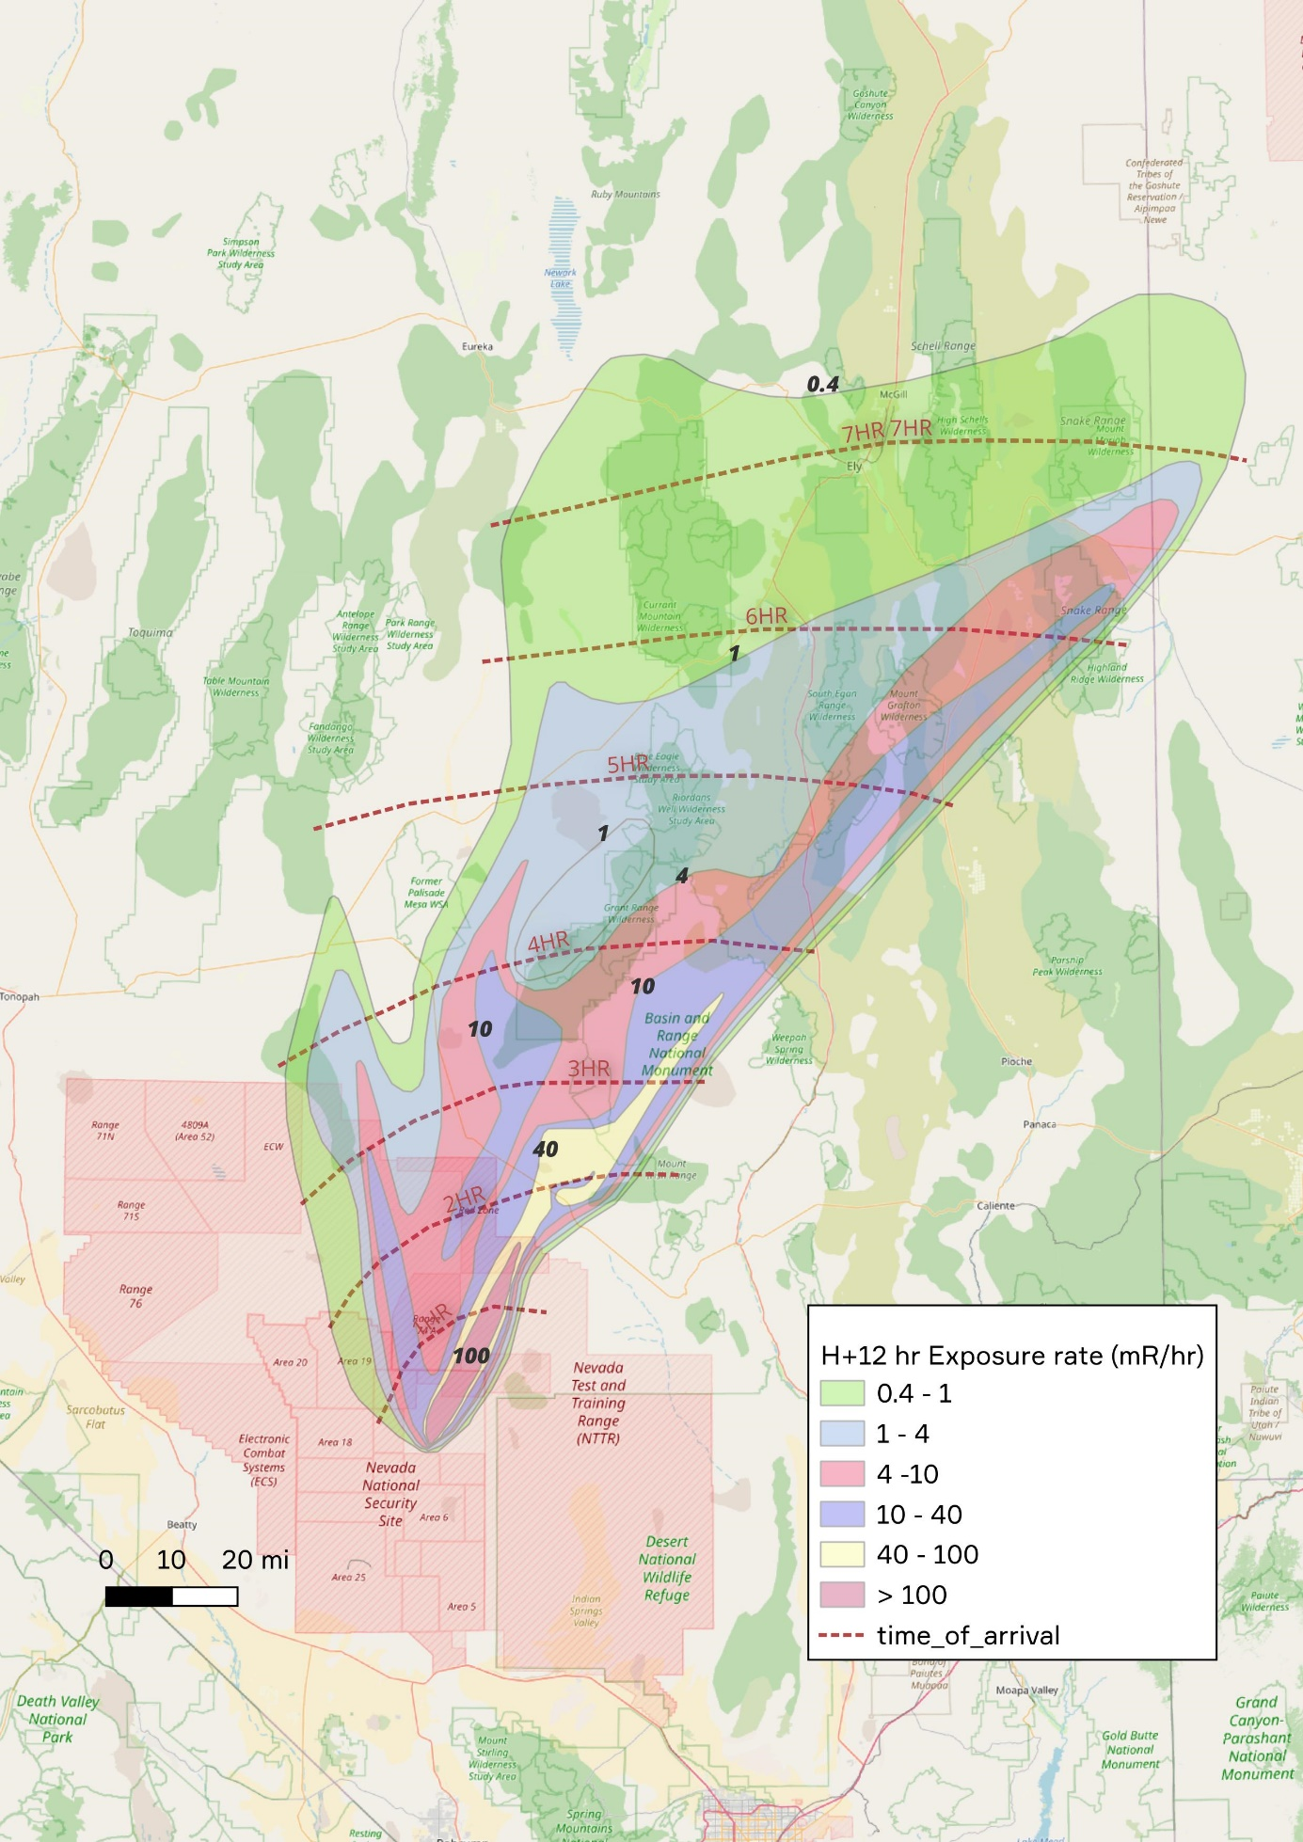
Georeferencing published information - Nancy
Georeferenced WSNSO 1984 NANCY FALLOUT PATTERN (Figure 3 from Steadman et al., 1984)
Georeferenced WSNSO 1984 NANCY FALLOUT PATTERN (Figure 3 from Steadman et al., 1984) with exposure rate polygons traced.
Traced exposure rate polygons (original WSNSO 1984 NANCY FALLOUT PATTERN map removed) with Time of Arrival.
Notes:
A digitized image was taken from the report : Steadman Jr, C.R., Kennedy, N.C. and Quinn, V.E., 1984. Analysis of Operation Upshot-Knothole nuclear test NANCY radiological and meteorological data (No. NVO-282). National Oceanic and Atmospheric Administration, Las Vegas, NV (USA). Weather Service Nuclear Support Office.
We have used QGIS for georeferencing :
Essentially taking the scanned image showing the spatial distribution of various features and binding this to a coordinate reference system in the GIS by coordinate transformation.
This is achieved in practice by identifying common points/locations that are observable on both maps - for example roads, highway junctions, villages – and then linking one to the other using the georeferencing tool.

Slide 5
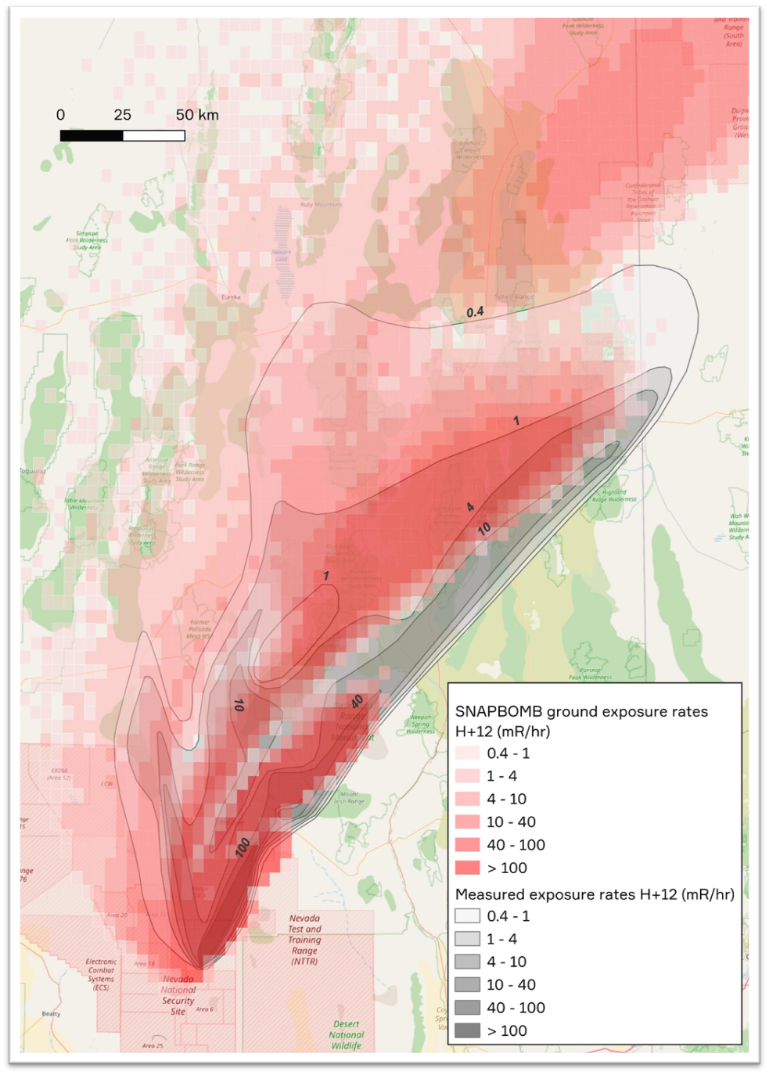
Nancy simulation – Norwegian Meteorological Institute/DSA
Work in progress
Model = SNAP (Severe Nuclear Accident Programme)
Initial assessment
  Exposure rates (mR/h) from model runs and measured data correspond quite closely
  Red and pink squares from the model output delineate all exposure rates > 4 mR/hr
    these more or less fall within the measurement contours for 0.4 mR/hr apart from small areas to the west and to the north of the main plume.
  Some of the measured high exposure rates to the northeast of the detonation site are not captured by the model.

Slide 6
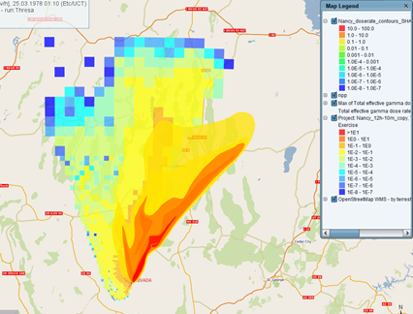
Nancy simulation – KIT
Work in progress
Model = JRODOS with default settings
  43 nuclides based on Kraus and Foster 2014
  Geometry of source term based on
  Rolph at al. 2014
  Particle size distribution based on Glasstone and Dolan 1977
Initial assessment
  Max dose rates and shapes similar but shifted by about 20 degrees
dose rates and shapes similar but shifted by about 20 degrees

Slide 7
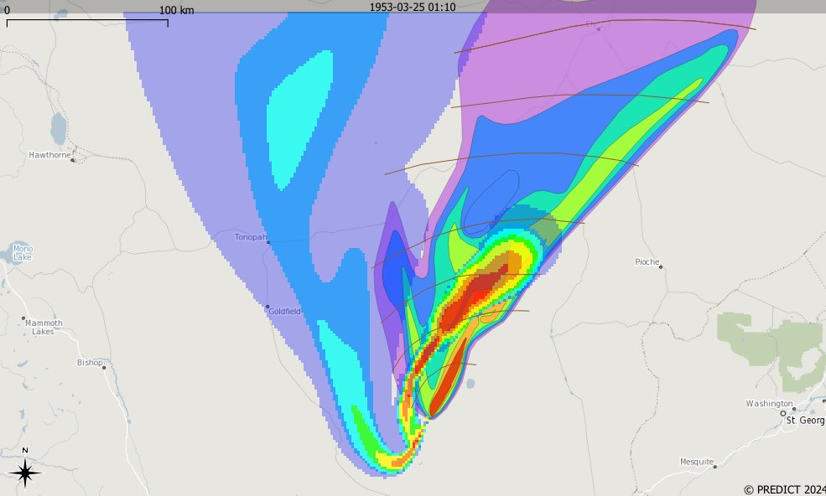
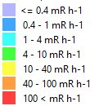
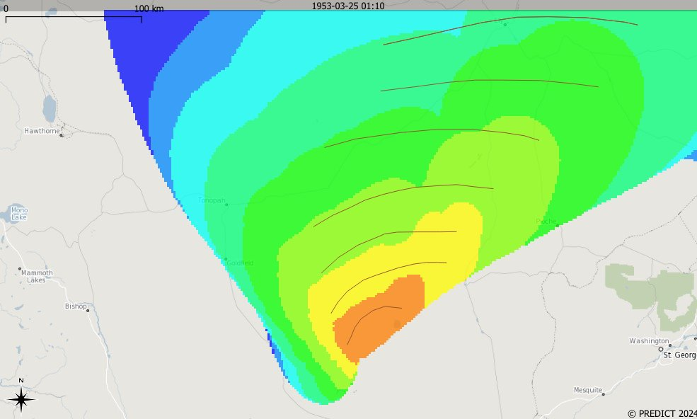

Nancy simulation – RIVM
Work in progress
Dose rates
Model = IRIS (in-house model)
  Based on KDFOC3
  Particles density and size: (Ledger, 2014; Baker, 1987)
  Source term from SSM; Axelsson et al. (2023)
Initial assessment
  Simulated output is too far west
  Top of the release and
  base disperse in different
  directions
  se rates and shapes similar but shifted by about 20 degrees
Time of arrival
Each line is 1 hour

Slide 8
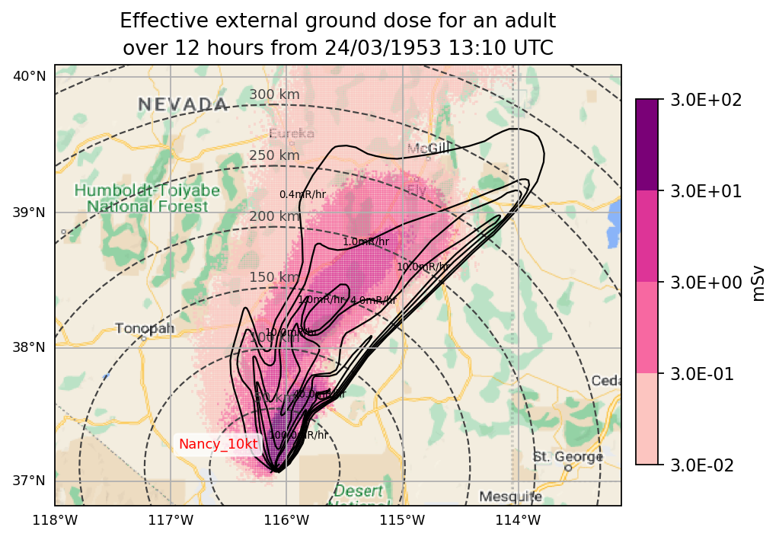
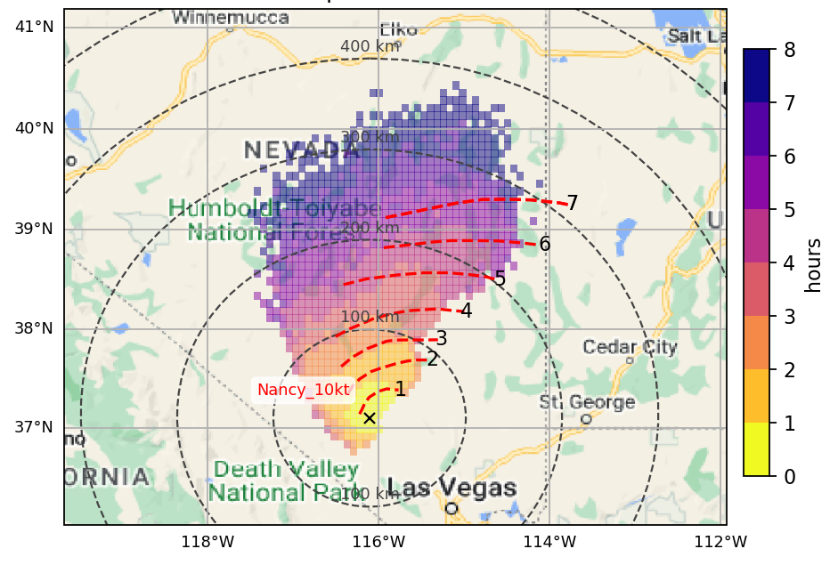
Nancy simulation – UK Met Office
Work in progress
Model = JAM-IntND
  69 nuclides based on Kraus and Foster 2014
  Particle size distribution based on Glasstone and Dolan 1977
Initial assessment
  Areas correspond quite well
  Conversion of dose units still required
  Travel time matches well
Time of arrival

Slide 9
Summary
Digitised nuclear test data
Model intercomparison and validation
ERA-5 met data – accuracy of these data crucial to assessment
Next steps:
  Analysis of simulations
  Visual comparison and statistical if possible
  Repeat with other test data
  Draw conclusions

