Slide 1

PREDICT WP3: model comparison
PREDICT WP 3 overview
Wolfgang Raskob – KIT consultant

Slide 2
Objectives of the WP3
Work Package 3 aims at quantifying model uncertainties resulting on the one hand from current limited understanding of key model parameters and on the other hand by exploring the consequences of critical weather conditions on the model results such as high precipitation events and weather conditions with changing wind directions and frontal passages
The WP consists of 4 tasks and Sarah will present the status of the first task on model intercomparison

Slide 3
Tasks of WP3
Model comparison and validation using historic events
Sensitivity analysis of key model parameters
Sensitivity analysis for key weather conditions
Recommendations from the exercises

Slide 4
Task 3.1: model comparison and validation
Comparison with historic data has limitations
  Historic weather data may not have the quality as well as time and spatial resolution as current numerical data
  Dose rate measurements – the typical data that has been collected at that time – were monitored at different locations and times
  Typically, data were adjusted to 12 hours after the release
  Arrival time were also adjusted to hourly values
Nevertheless, we expect insight into model performance
Tests will be repeated with updated models (parameters)

Slide 5
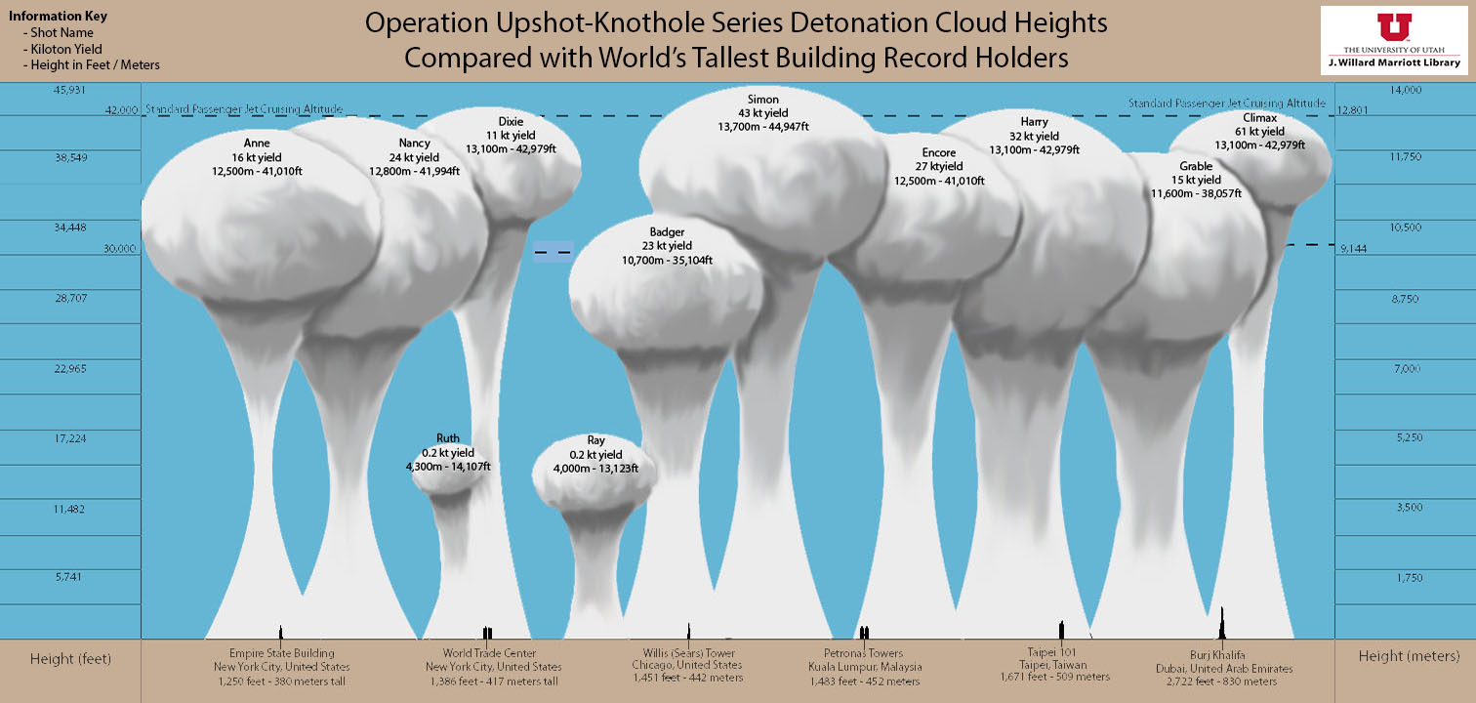
Task 3.2: Sensitivity analysis of key model parameters
Perform statistical analysis to identify key sensitive model parameters based on recommendations from WP1 and WP2, e.g.
  Plume dimensions
  Activity versus height
J. Willard Marriott Library
https://lib.utah.edu/discover/?search=nuclear%20detonations

Slide 6
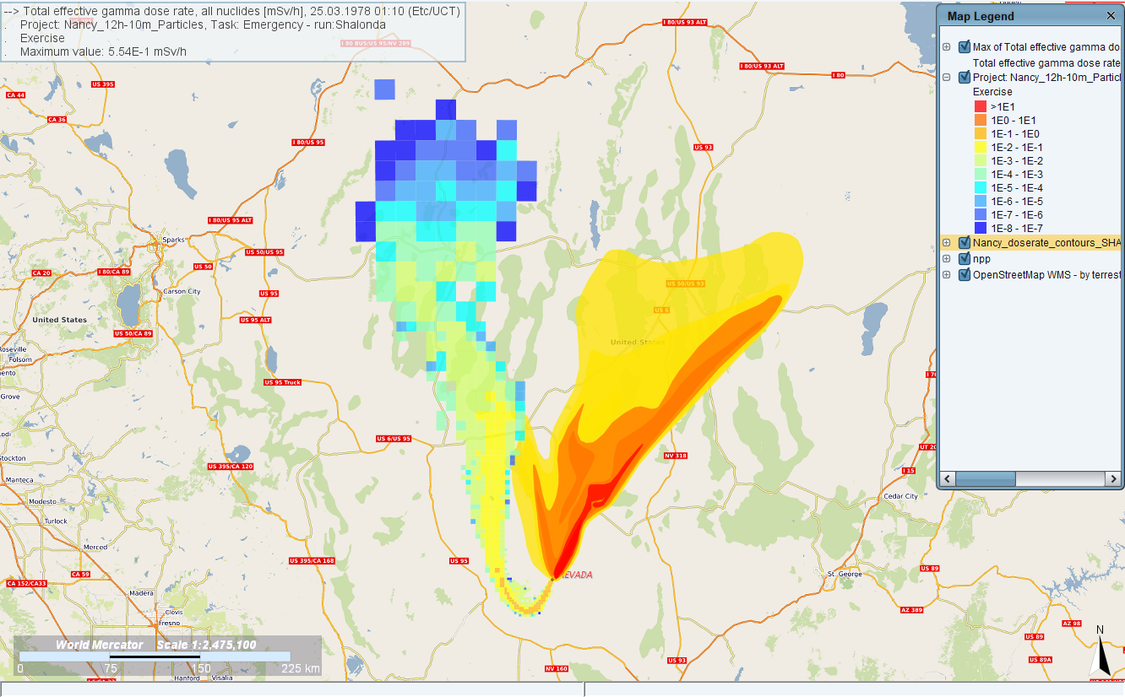
Task 3.2: Sensitivity analysis of key model parameters
Perform statistical analysis to identify key sensitive model parameters based on recommendations from WP1 and WP2, e.g.
  Plume dimensions
  Activity versus height
  Particle size distribution
  Shape of particles
Methodology has to be defined
Limitation of resources for full probabilistic analysis?
Nancy:
JRODOS with smaller particle size

Slide 7
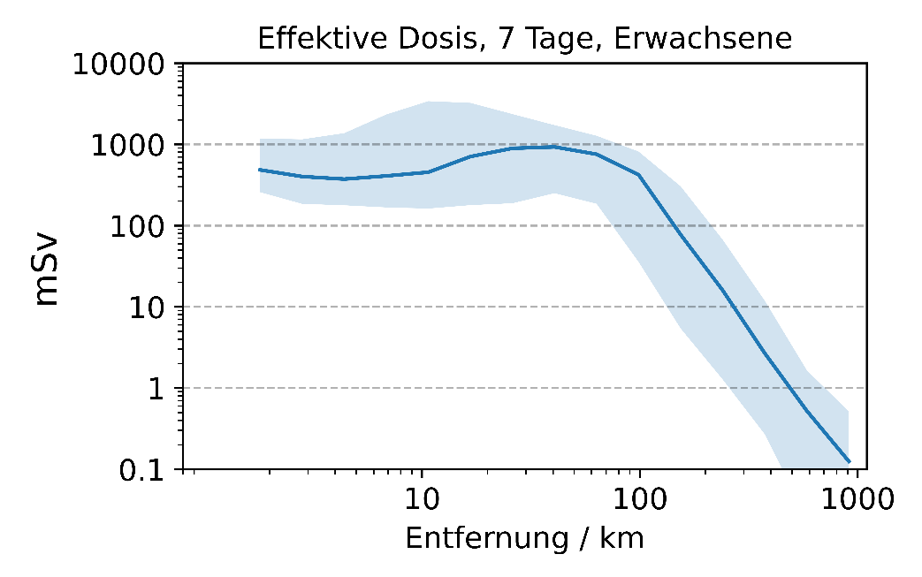
Task 3.3: Sensitivity analysis for key weather conditions
This task will explore the sensitivity and uncertainty of model results related to variable weather conditions
  simple or complex weather,
  changing wind directions,
  situations with or without precipitation
Example: 10 kT Explosion: BfS with LASAT and 365 weather scenarios shows possible variability of results

Slide 8
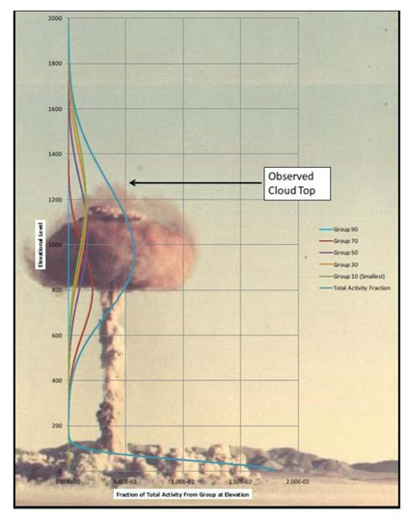
Task 3.4: Recommendations from the exercises
Based on the findings from Tasks 1-3,
a report will be developed that provides recommendations for model parameter settings dependent on the prevailing conditions.
Further a default set is provided in case of knowledge is limited
Results will be open to all, also outside the project

Slide 9
Conclusions
The consortium is aware that current simulation models need improvements
Due to limitation in budget, the project will mainly improve model parameters
With our tests and validation exercises we aim to improve national and supra-national DSS (e.g. ARGOS, JRODOS, JAM-IntND (UK))
Results will provide a database for all interested modellers

