Slide 1



PREDICT Work Package 2: Preliminary progress with the improvement of atmospheric dispersion and radiological dose assessment models applied to nuclear detonation scenarios
Monday 11th November 2024
Peter Bedwell Contributions from: Helen Webster
Peter.Bedwell@ukhsa.gov.uk Justin Brown

Slide 2
Determine the current (baseline) modelling capability
Current (baseline) capability of each organisation in respect of modelling & provision of radiological protection advice in the event of a nuclear detonation scenario (were such an incident to happen in early 2024)…
  Includes contributions from: Denmark (DEMA & DTU), Germany (BfS and KIT), Netherlands (RIVM), Norway (DSA and NMBU), Sweden (SSM) and UK (MO and UKHSA).
  Topics covered:
    Atmospheric dispersion modelling
    External gamma dose from material deposited on surfaces
    Food-chain transfer models
  Details:
    the approach and parameterisations applied, inputs employed and assumptions made.
  Value:
    facilitate the identification of gaps & aspects for improvement in models
    a baseline - such that recommended improvements will have context & figure prominently.

Slide 3
Task 2.1: Improvements in atmospheric dispersion modelling following a nuclear detonation
UKMO (lead), DEMA, DSA, DTU, Met No, NMBU, RIVM, SSM
  Improvements will include enhanced model input parameters & advanced modelling approaches.
Recommendations will be guided by
  Outcomes of WP1 (source term description)
  Experience & modelling techniques developed for radiological assessment studies
    Including planning for accidents and responding to accidents, such as the incidents at the Chernobyl and Fukushima Nuclear Power Plants
  Knowledge garnered and modelling developed for parallel applications
    e.g., volcanic ash studies
  Requirements for dose and food-chain modelling (Tasks 2.2 & 2.3)
July 24: Work starts
Feb 25: WP1 report available
Jul 25: Work mainly complete
Aug 24: Kick off meeting
Dec 24: Progress meeting

Slide 4
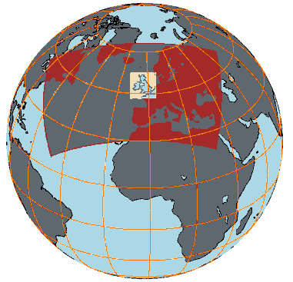
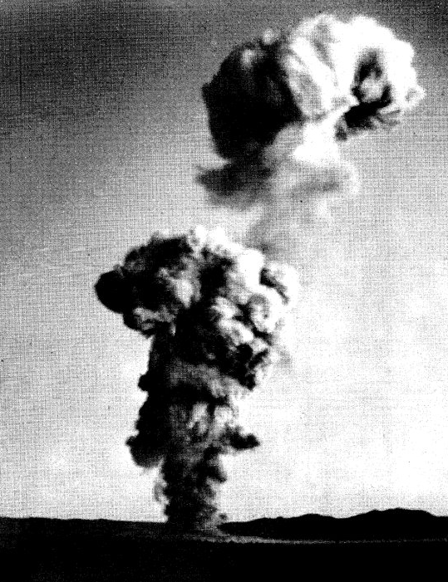
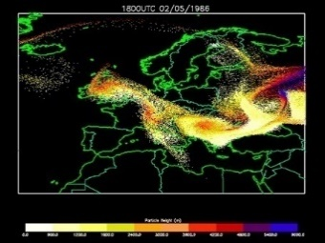
Improvements in atmospheric dispersion modelling
Improvements to
  Source term description
    Radionuclides, particle properties (size distribution, density, shape, sphericity, solubility), activity, source shape, spatial distributions,…
  Input meteorological data
    Resolution (temporal & spatial), meteorological fields
  Atmospheric dispersion model setup and parameterisations
    Wet & dry deposition, sedimentation, turbulence, convection, radioactive decay,…
  Output produced
    Quantities, spatial and temporal resolution, processing (averaging, instantaneous, etc.)
Meteorological Data
Forecast Output
Dispersion Model
Source Data

Slide 5

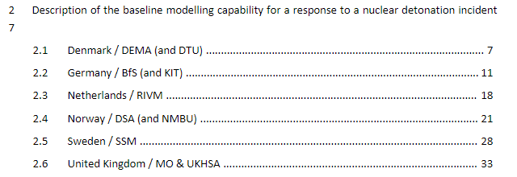
Atmospheric dispersion modelling reviews
Baseline modelling capability
Literature
  Nuclear detonations
  Radiological assessment studies
  Nuclear power plant incidents
  Parallel applications
Identify atmospheric dispersion modelling
  Commonalities & differences
  Recommendations
  Limitations
  Sensitivities
Review paper?

Slide 6

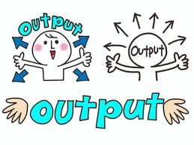
Interactions with other WPs
WP1: Characterization of the source term description for the stabilised cloud
  How to represent the source term accurately for different blast conditions
WP2 (tasks 2.2 & 2.3):
  How to produce the optimal atmospheric dispersion output for dose & food-chain modelling
WP3: Model comparison and validation using historic events & sensitivity analysis
  Identify atmospheric dispersion modelling improvements
    Recommended model parameters / parameterizations, set-ups
    Model parameter distributions / ranges
  Identify future longer-term improvements

Slide 7
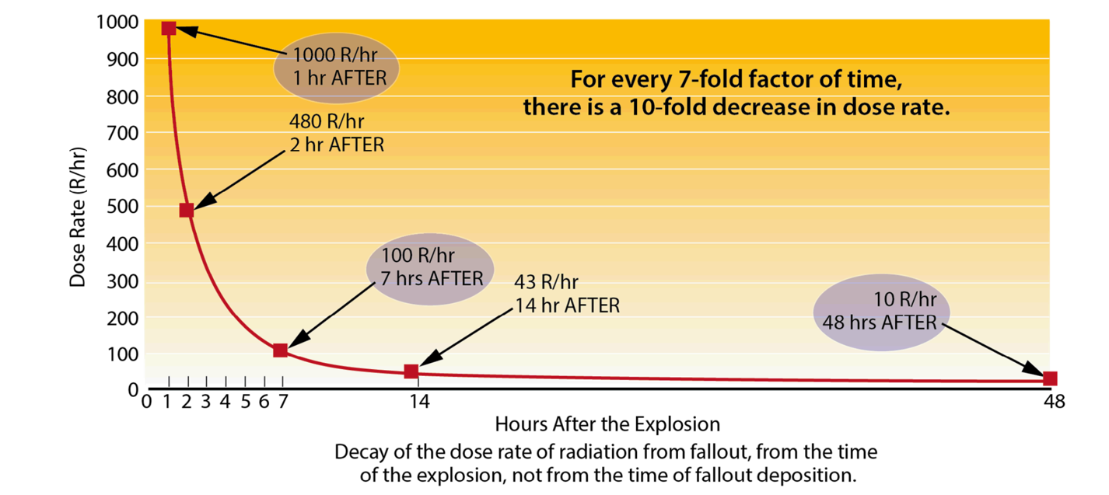
Task 2.2 Improvement in external dose & dose rate modelling in the context of nuclear detonation scenarios
(UKHSA Lead, BfS, DEMA, DSA, DTU, EPA, KIT, NMBU, PDC-ARGOS, RIVM & SSM)
External irradiation from deposition on surfaces tends to contribute most to dose;
Model improvements to the assessment of dose from this exposure pathway provide the greatest gains;
Therefore the external irradiation from deposition on surfaces exposure pathway is the focus for Task 2.2 (and not external irradiation from the plume nor inhalation from the plume).
https://remm.hhs.gov/nuclearfallout.htm
Notes:
What is optimal and what is practical.

Slide 8
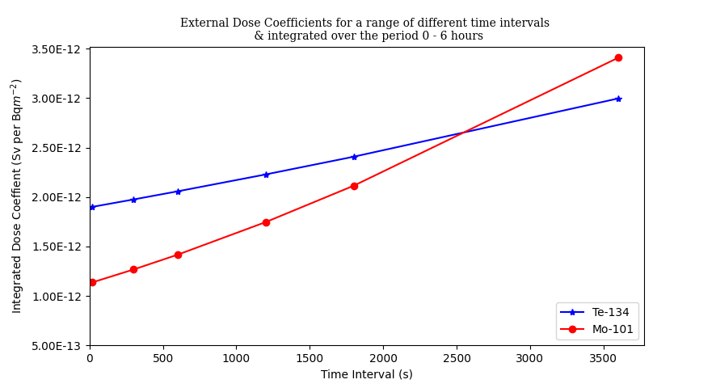
Improve modelling capability in respect of the application of external dose coefficient data
  Deposition Modelling:
    Some modelling approaches assume all deposition occurs @ time = 0 for an instantaneous or short duration release.
    Approach not pragmatic for ND scenarios.
    A suitable approach will be sought & recommended.
  Identify & collate representative & practical external dose coefficients:
    Use the radionuclide list developed in Task 1.1
    Use ICRP 144
    Suitably describe dose rate as function of time
    Ensure the contribution from daughters is captured.
    Soil migration (as a function of particle size?)?
  Review novel approaches for assessing the dose from external exposure, for example RIVM’s single cocktail dose coefficient approach.

Slide 9
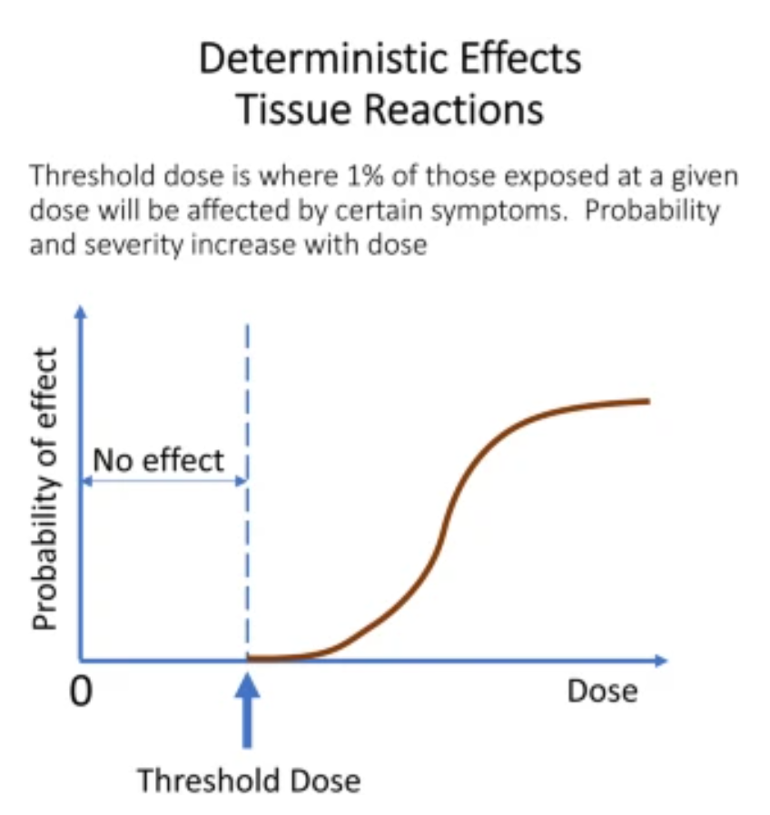
Improve the assessment of deterministic health effects (DHE)
Currently a simplistic & minimal approach is applied in ARGOS & RODOS:
  Total effective dose and one or more equivalent dose to organ(s) for comparison with threshold values.
Dose criteria to the foetus (embryo, foetus brain) in IAEA GSR part 7 is low; the foetus is relatively sensitive compared to adult organs.
Neither ARGOS nor RODOS estimates foetus dose (RODOS infers from uterus dose).
Undertake a review:
  determine the approaches
  recommend one or more method(s) for application in DSS.
  recommend one (or more) model(s) for the foetus.

Slide 10
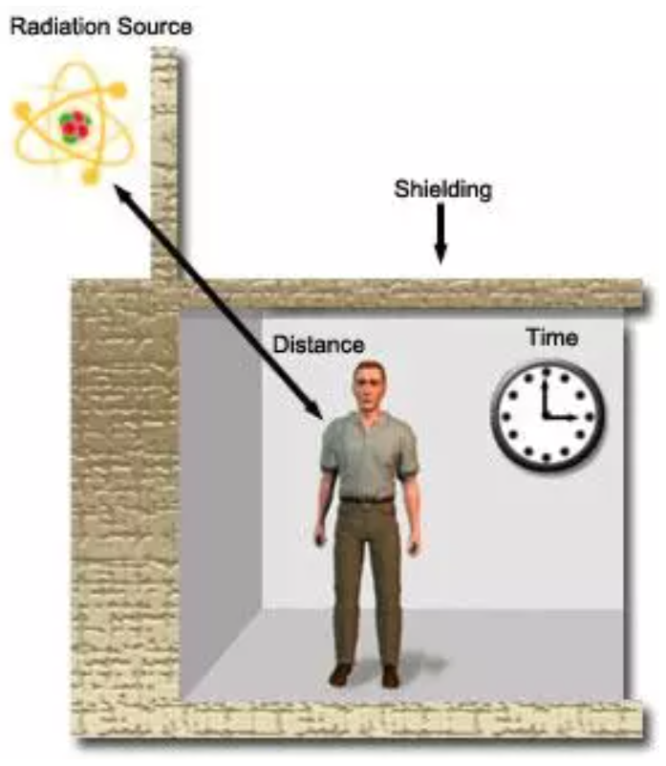
Review the applicability of currently used location factors to calculate external doses and recommend revisions where necessary in the context of nuclear detonation events
Regional & national analysis of geospatial data:
Document current DSS approach & its applicability to ND scenarios.
Explore other means of utilising large scale geospatial data to effectively categorize (urban) buildings & generate location factor mapping:
  Remote sensing / satellite imagery data
  GIS datasets
Local analysis of air exchange & indoor deposition rates of housing stock:
  Review (& develop) building ingress modelling.
  Assess air exchange rates & indoor deposition rates.
  Derive location factors e.g. using MCNP.
  Review location factors for bomb shelters (tilfluktsrom) & comparable protection.
https://www.radiation-therapy-review.com/Radiation_Protection.html

Slide 11
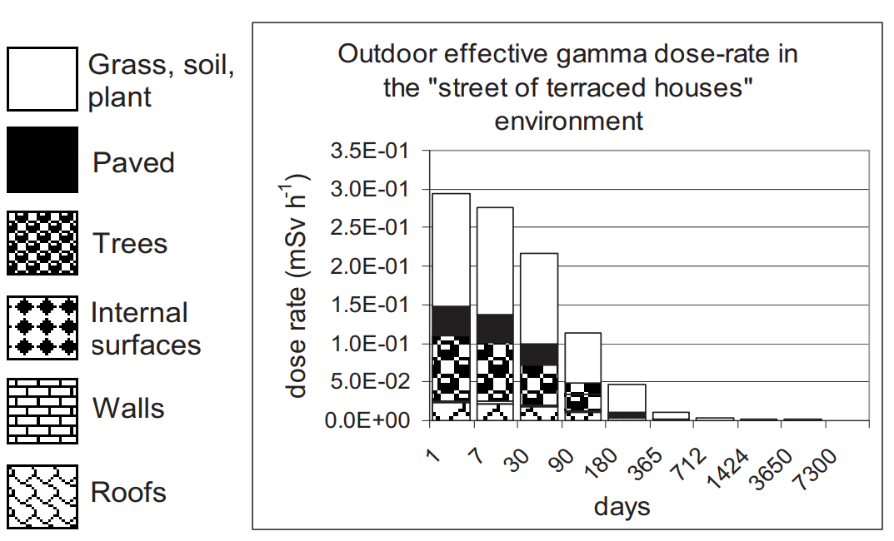
Advances in recovery options following the contamination of an urban environment with radioactive material
  Updates to ERMIN (European Model for Inhabited Areas)
  Identify “new” radionuclides to add to ERMIN (progeny, dose per unit intake values, DCF)
  Determine unit doses for one or more of the environments defined in ERMIN (focus: brick house without basement)
  Create new deposition scenarios in ERMIN (based on chemical & physical form: particle type, size & susceptibility to weathering)
    assign model parameters eg deposition ratios, retention parameters and countermeasure parameters
  Aspiration to feed into the versions of ERMIN applied in ARGOS and RODOS (for one environment).

Slide 12
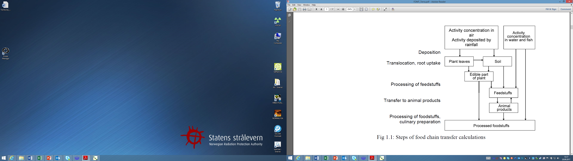
Task 2.3 Application of food-chain transfer models following a nuclear detonation
(DSA Lead, BfS, DEMA, DTU, EPA, NMBU, SSM, UKHSA)
Test applicability of commonly used foodchain models (e.g. FDMT, FARMLAND) to fallout from nuclear detonations by:
    Investigating whether (particle) size distributions & solubility influence food-chain transfer
    Considering whether uptake of short-lived radionuclide can be important
    Revisiting assumptions concerning interception & retention of radionuclides
    Addressing the issue of ‘non-standard’ radionuclides where transfer data may be lacking
The goal will be to determine:
    The extent to which existing models can be adapted & applied
    Whether ingestion doses are significant (for selected scenarios)
    Where model improvements are needed for decision support systems

Slide 13
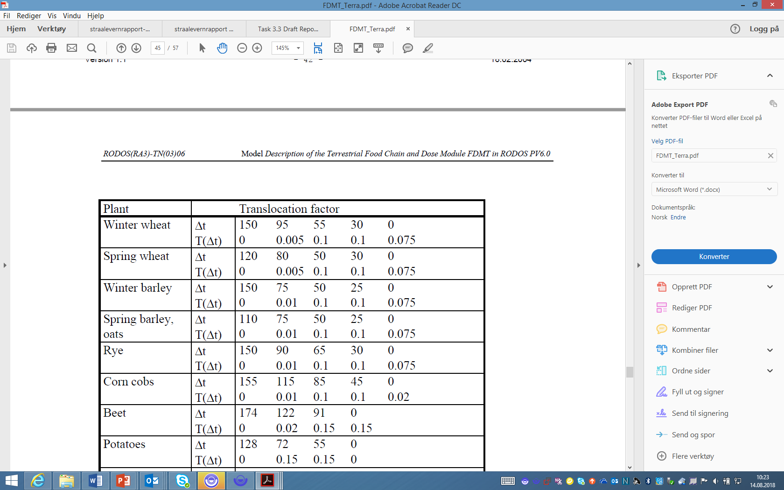
Which factors/processes may be important for radionuclide food-chain transfer following a detonation & how might these differ from a “standard” application?
Dry deposition
  It is well established that particle size & density affects deposition velocity. Explore how particle size distributions associated with detonations affect this parameter.
Translocation (for plants which are only partly used)
  FDMT uses a mobile-immobile element categorization for translocation factors. Map “new” radionuclides onto the most relevant category.
Root uptake (soil to plant transfer)
  Modelled using concentration ratios based on empirical datasets & (usually) a location distant from detonation sites. Transfer will be affected by the presence of particles; but essentially driven by ‘soil processes’.
Soil processes
  May recommend a model with a slow release from an (initially) inert pool so that activities in a ‘bioavailable’ compartment increase over time.
Transfer to animals
  A general (non-quantitative) consideration/review of particle size on transfer to animals is needed. The derivation of (particle-specific) quantitative values for transfer coefficients & biological half-lives may be challenging.

Slide 14
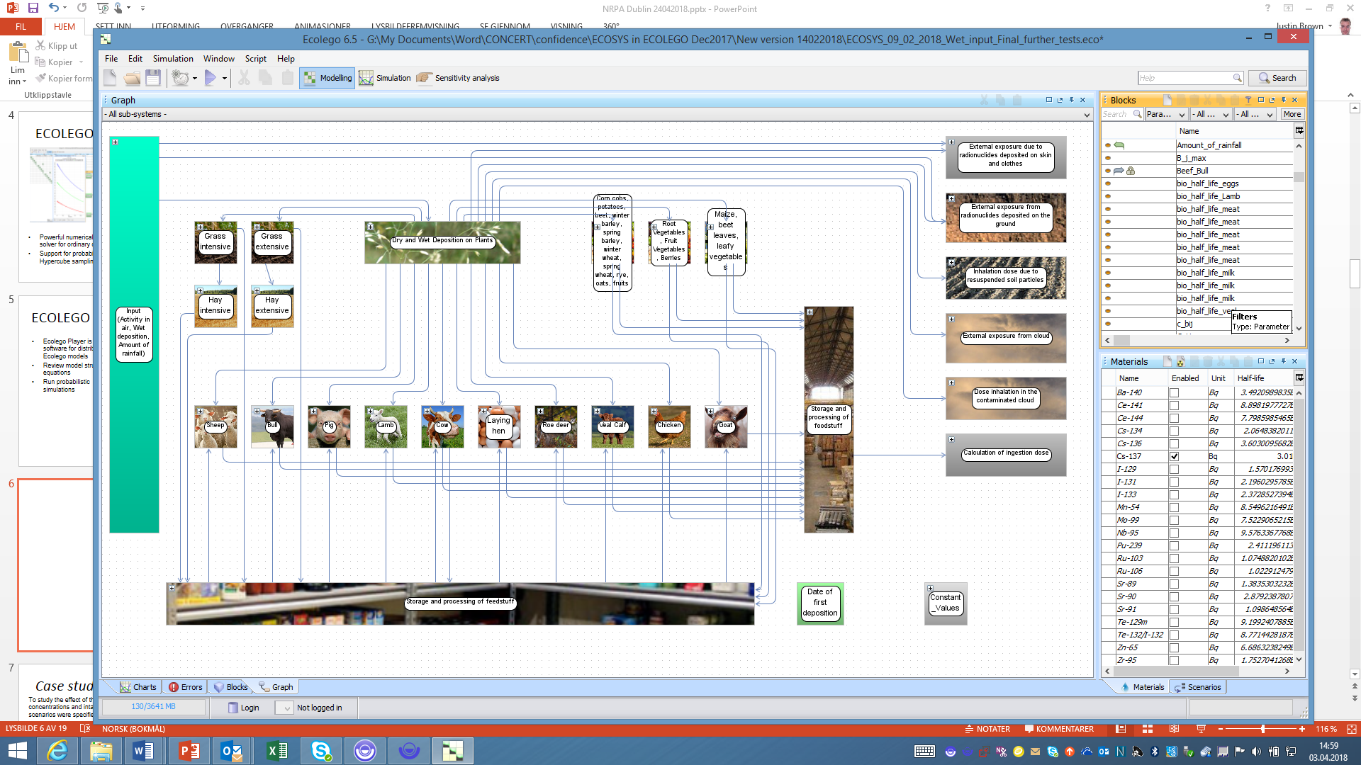
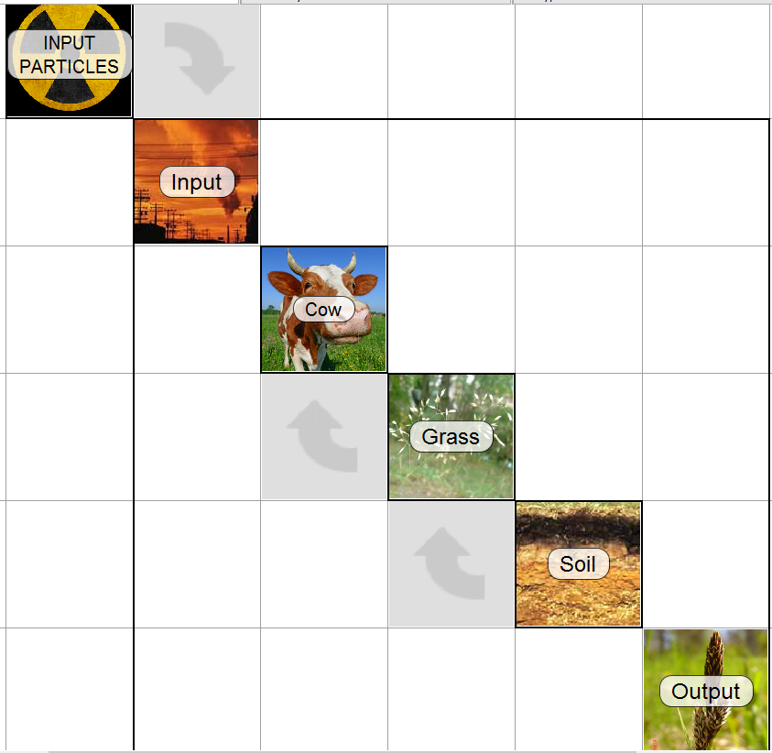
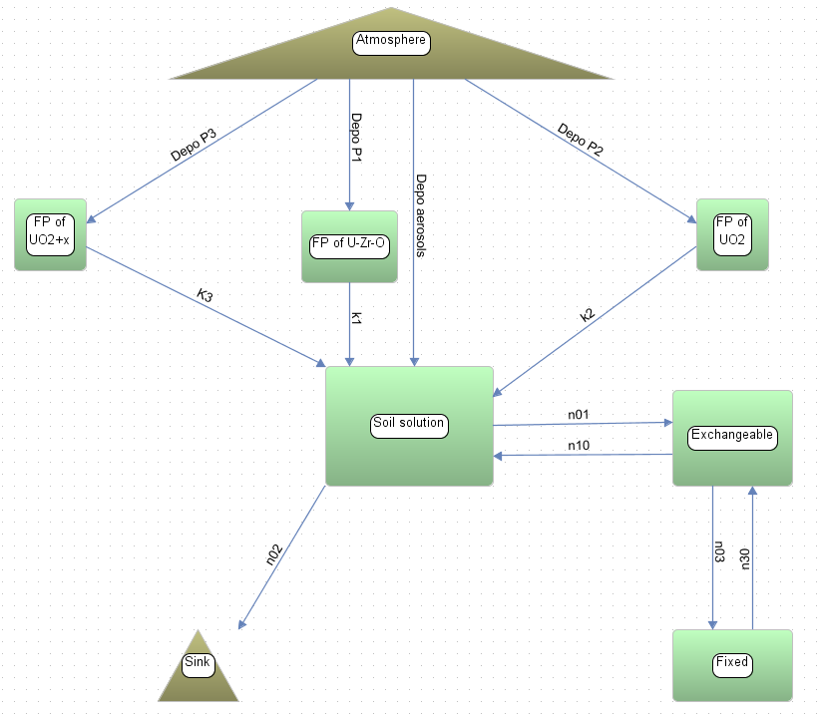
Potential adaptation (further development) of existing models to cover nuclear detonation scenarios
The original/default FDMT 2 compartment ‘soil process’ adsorption-desorption model can be replaced by a bespoke particle weathering model.
FP model

Slide 15
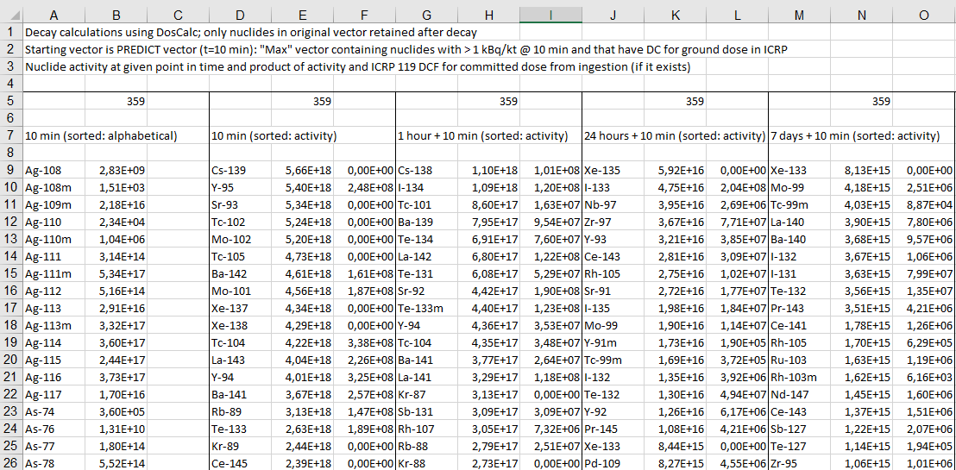
New radionuclides and scenarios
Addition of new radionuclides
  Methodology/rationale for selection of radionuclides
    List based on fission yields
    Rank according to:
      ingestion dose coefficients &
      radioecological parameters
Simple scenarios & model-model comparisons
  Scenario set up (source-radionuclides, time & (generic) location)
  Model runs (including original defaults)
  Comparisons – qualitative or statistical? Develop approach

Slide 16

Deliverable
One deliverable in the form of a report will be produced.
Aim for a first full draft late 2025 / early 2026.
WP2 report to be delivered by 30th June 2026.

