Slide 1


PREDICT WP1.2
On stabilized cloud dimensions and aerodynamic features of fallout particles from a nuclear blast
(DTU, DSA, NMBU, BfS, RIVM, UKHSA)
Rome, November 11th, 2024

Slide 2
Objectives of WP1.2
  The parameters influencing the environmental mobility of contaminants dispersed in air after a nuclear detonation are very different from those that can currently be modelled in for example the RODOS/ARGOS DSS.
  On background of literature and relevant physics/chemistry expertise we investigate the influence of detonation height and device yield on, e.g., plume contaminant particle size distributions, morphology/elemental constituents and density in the initial stabilized cloud.
  We also investigate the influences of the particular scenario features on the initial plume shape and dimensions including height.
  We have seen in the Chernobyl case that particle solubility in the environment may vary greatly, determining environmental transfer, and studies are being made to shed light on this in the context of nuclear bomb detonations.
Rome, November 11th, 2024

Slide 3
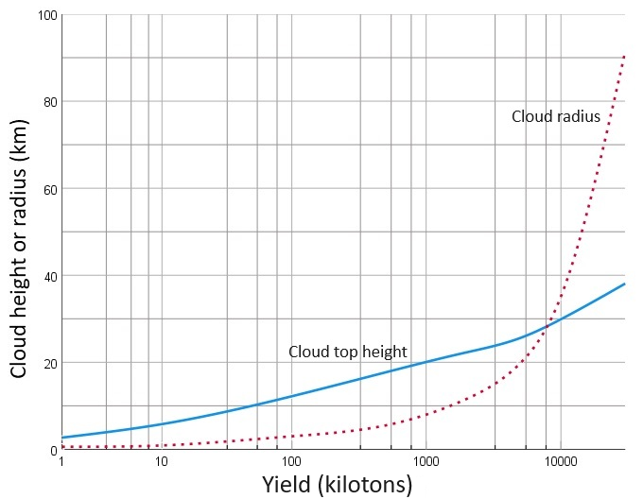
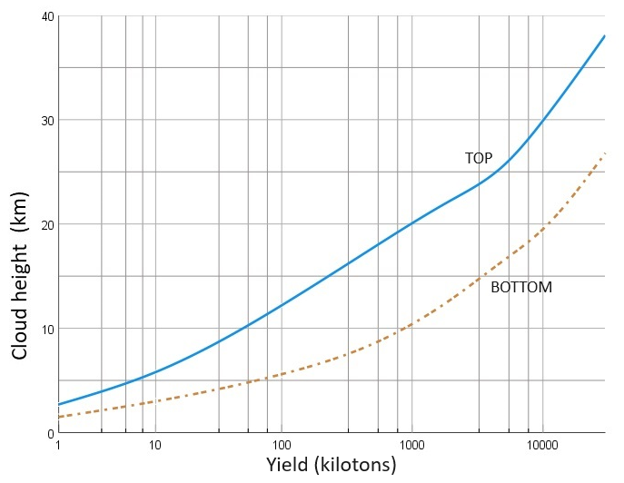
Cloud dimensions
    On the background of reports of the US nuclear explosion testing in the 1960’s parameterization has been derived for modelling purposes
Approximate values of stabilized cloud height (continuous blue line)
and radius (red dashed line) as a function of explosion yield for land
surface or low air bursts
Altitudes of the stabilized cloud top and cloud bottom as a function
of the explosion yield for surface or low air bursts
Rome, November 11th, 2024

Slide 4
Particle activity vs size – ground blasts
Particles originating from ground (land or subsurface) bursts are reported to have a size range from less than one micron to several millimeters in diameter.
It is generally assumed that only the very smallest of these will remain suspended in the atmosphere for longer periods of time.
However, following Former Soviet Union and Chinese tests, spherical radioactive particles with diameters up to some 20 µm were identified >4000 km away.
Note that plumes formed after 1-100 kT explosions, which is the range of main concern in the PREDICT project, do not reach the tropopause.
    Particle activity distributions recommended by various authors
Rome, November 11th, 2024

Slide 5
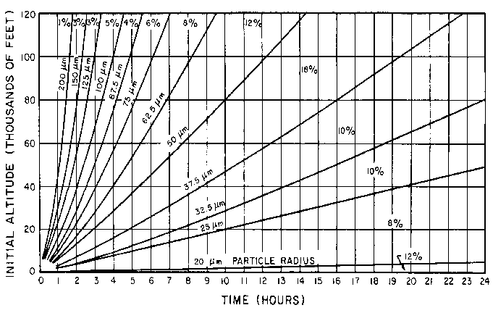
Particle activity vs size – ground blasts
The most trustworthy of the above particle size distribution data can for particles >20µm be reasonably well fitted to a log normal distribution.
An optimized fit was suggested by Harvey et al. (1992) for the particles between 5 and 500 µm: 23% by a lognormal distribution
with activity median 2.67µm (sigma of
1.4) and 77% by lognormal with activity
median of 5.02µm (sigma of
0.99).
Very similar cap particle size frequency
curves have been recorded for a range
of yields between 0.5 kT and 14.8 MT.
Example of ground blast aerosol size distribution as measured based on times-of-fall data.
Rome, November 11th, 2024

Slide 6
Particle activity vs size – ground and air blasts
For small particles up to at least a few µm, two types of particles were clearly distinguished in ground blasts (Baker, 1987): (1) spherical particles with high specific activity (~r³), and (2) irregular particles with lower specific activity (~r²).
The lognormal particle size distributions found for these (with median respectively 0.1 and 0.2µm) could be used to describe the small particle ‘tail’ for ground blasts.
The distribution for the spherical particles fits exactly with that recorded for high air blasts (Nathans et al., 1970).
Typical particle densities for respectively high air and surface bursts are 3.0-4.3 and 1.0-3.0 g cm⁻³
Autoradiograph of ca. 1 mm ground blast particle from Bikini (Crocker et al., 1966)
Round vs. irregular small particle distributions
from surface bursts (from Baker, 1987).
Rome, November 11th, 2024

Slide 7
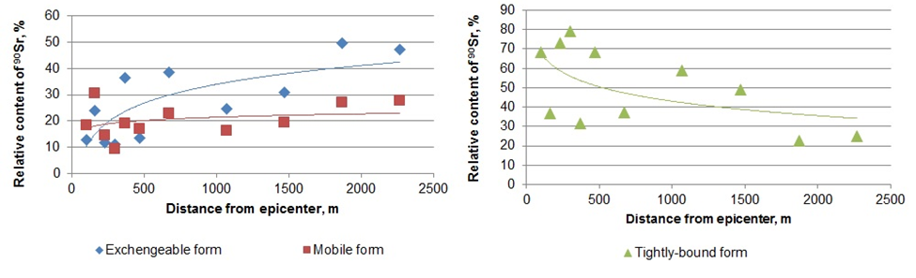
Other investigations
    Post-deposition particle mobility in the environment and particle solubility as a function of time and distance from the explosion.
Relative concentration of ⁹⁰Sr species in soils, as a function of distance from the Atomic Lake crater, along the axis of the fallout plume.
Rome, November 11th, 2024

Slide 8
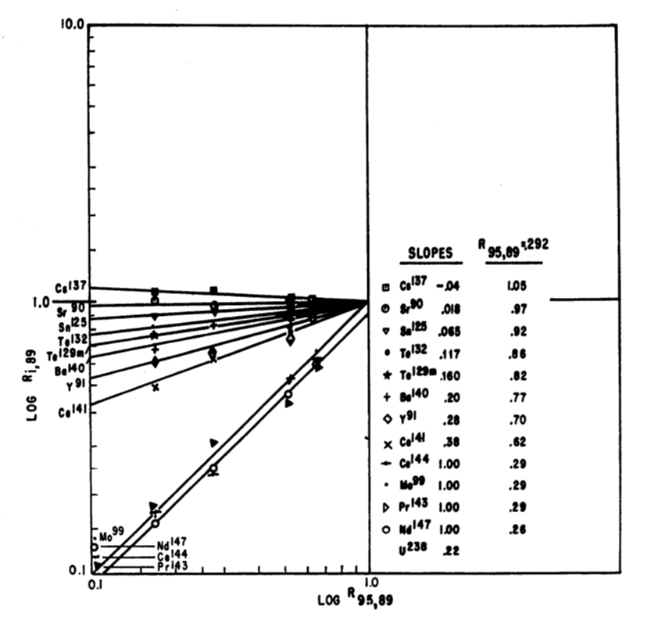
Other investigations
    Fractionation (depletion of volatile elements in connection with particle formation processes). Some particles in ground bursts are only contaminated on surface. Very complicated processes control this in reality. We have some relevant data for ground blasts, but need to further discuss the applicability in practice of the options.
Fractionation plots (volatility-indicating ‘R factors’ relative to that for Sr-89) for cloud aerosol samples observed in various surface blasts (from Russell, 1965).
Rome, November 11th, 2024

Slide 9

WP1.3 Model scenario recommendations
    On basis of WP1.1 and WP1.2, WP1.3 will establish a limited number of representative scenarios (in the kT yield range) following different relevant nuclear blast types.
    WP1.3 will feed directly into WP2 (modelling improvement) and WP3 (model comparison). Work on WP1.3 will be finalized by May 2025.
Rome, November 11th, 2024

