Slide 1
PREDICT Project - Overview
ImPRovements in atmospheric dispErsion moDellIng and proteCTive action strategies in case of nuclear detonations

Slide 2











Introduction
PREDICT aims to enable the major internationally used decision support systems JRODOS and ARGOS and other nationally used atmospheric dispersion and transport codes and follow-on foodchain models to simulate and predict consequences due to the fallout of a nuclear detonation in Europe or worldwide.
Duration: 01 February 2024 – 31 January 2027
12 partners from seven European countries

Slide 3
Project structure
WP6
WP1
Source term & Scenarios
WP5
E&T
Diss.
WP2
Modelling improvement
WP3
Phase 1
Phase 2
Model comparison
WP4
Protective actions strategies

Slide 4
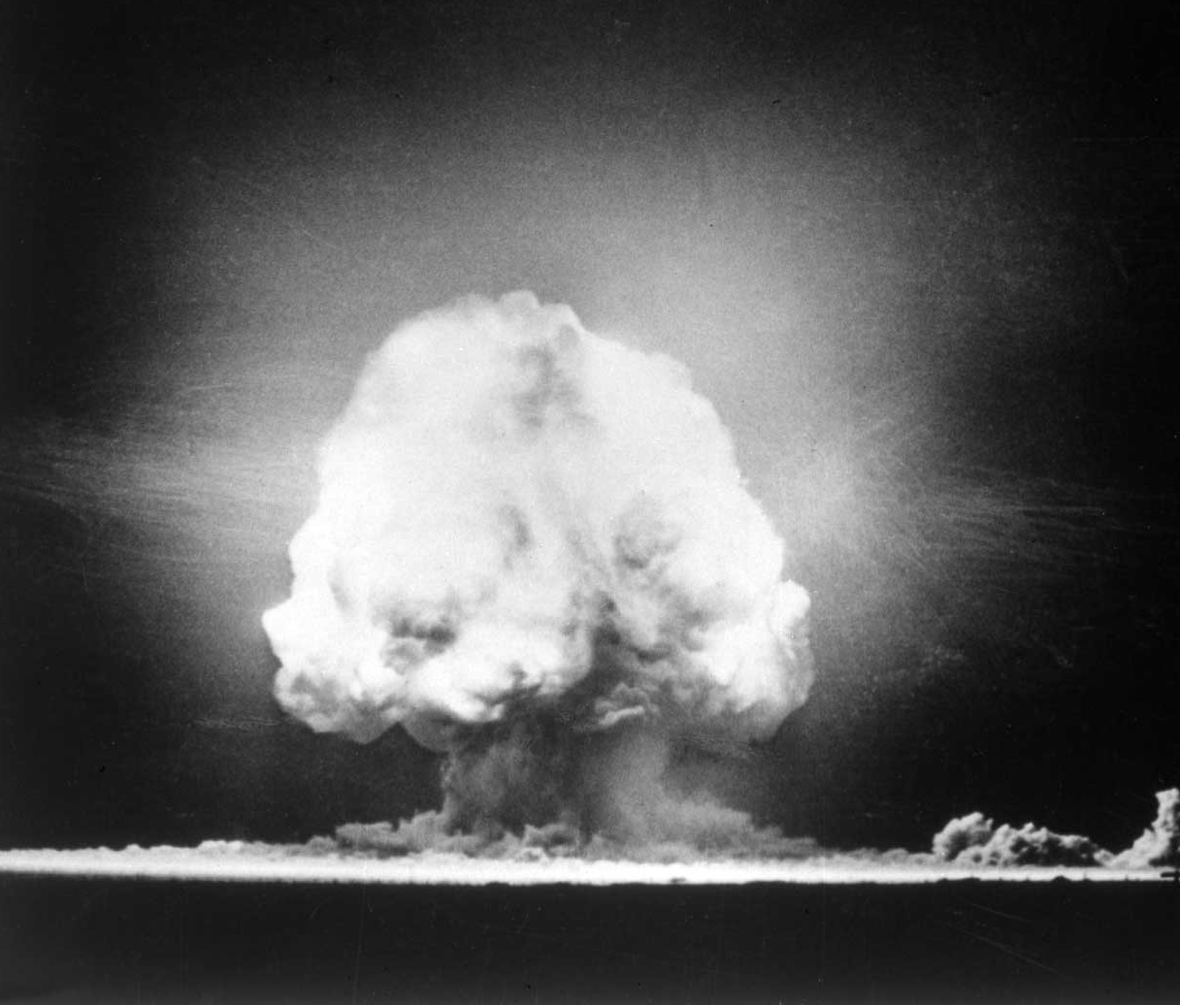
Project structure
WP 1 – Characterization of airborne radiocontaminants (source term description) (DTU):
Research into datasets, relevant for atmospheric dispersion modelling for airburst and ground detonation
What are the main dose-delivering radionuclides, activity-height and particle size distributions?
Reduce computing time and develop relevant scenarios to be used in other WPs
WP2 – Modelling Improvement (UKHSA):
Develop scientifically based recommendations for future improvements of atmospheric dispersion and radiological dose assessment models applied to nuclear detonation scenarios
Image: Glasstone and Dolan, 1977

Slide 5
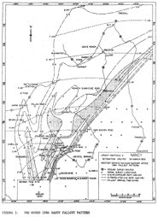
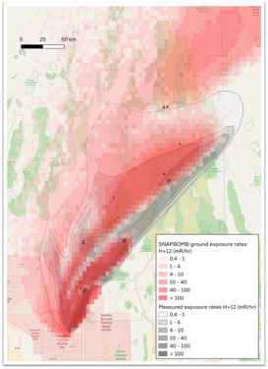
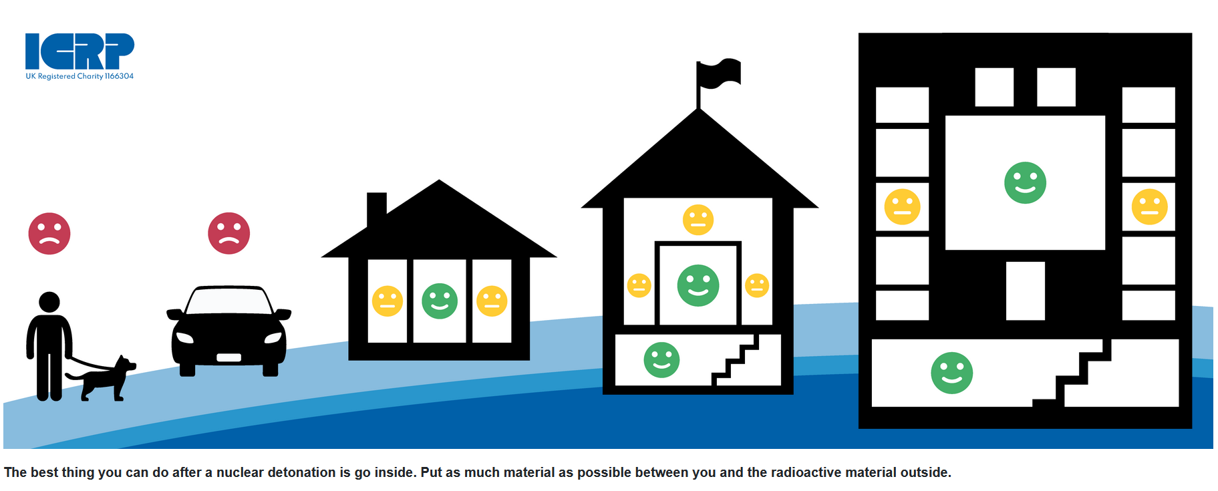
Project structure
WP3 – Model Comparison (KIT):
Model validation with historical contamination data from 1950s weapon tests (accuracy of the prediction)
Assess model uncertainty for same input data set but different codes:
  yearly averaged meteorological conditions
  specific, most relevant meteorological conditions (precision of the prediction)
WP4 – Protective actions strategies (BfS):
Develop harmonized protective action strategies, based on the unified source terms of WP1 and specific endpoints of the uncertainty analysis in WP3
Develop effective ways of communicating protective measures to the public, taking into account psychological, social and ethical consideration and utilizing results of a workshop with key players in emergency response
Advice for the Public on Protection in Case of a Nuclear Detonation

Slide 6
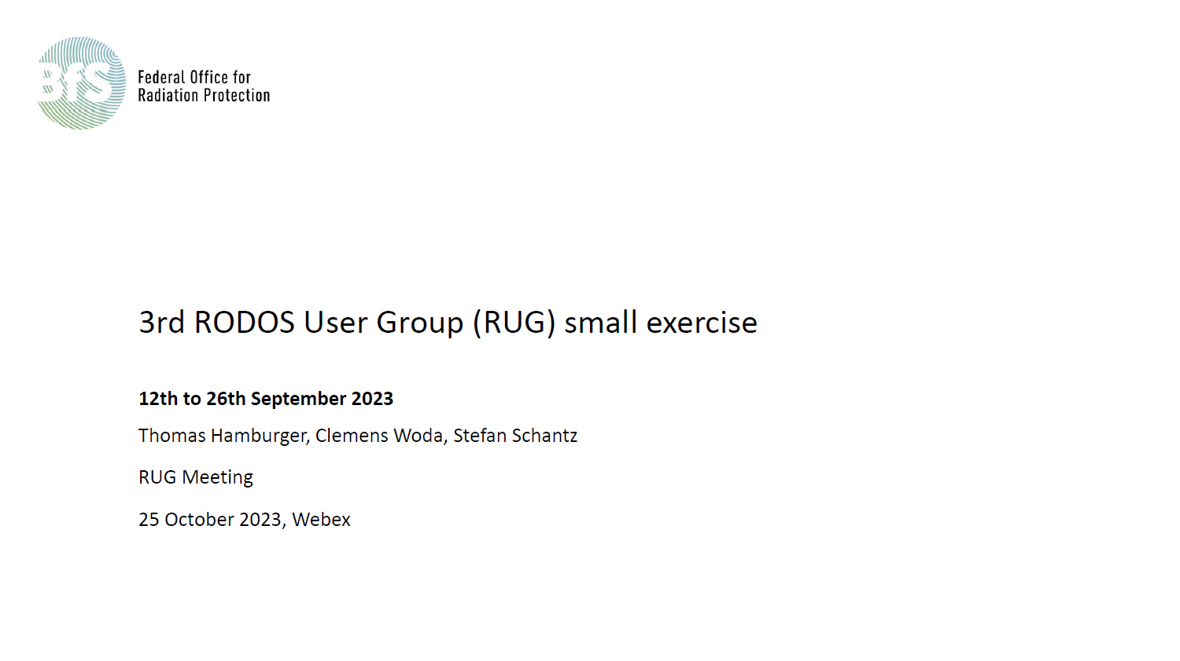
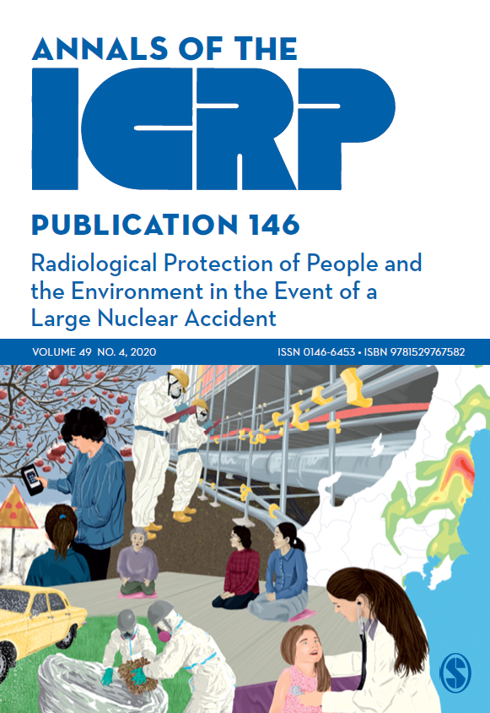
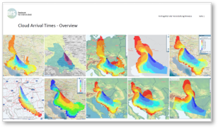
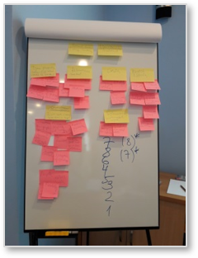
Project structure
WP 5 – Education, training and dissemination (NMBU) :
Disseminate project results to the European operational emergency preparedness and response community and worldwide using:
European Radiation Protection Platforms organised in MEENAS
International bodies such as IAEA, OECD NEA, HERCA-WENRA
Regular international exercises of the RODOS and ARGOS user groups
International conferences
Training courses targeted at the next generation of radiation protection specialists, PhD students and early career scientists
WP 6 – Project management

Slide 7
Timing of the different WPs
Today

Slide 8
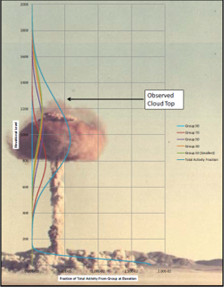
Project Results & Impact
Updated simulation models, which will be state-of-the-art at the end of the project
Recommendations for protective actions & strategies to disseminate them to the population, based on the updated models
Implementation in national and supra-national DSS (e.g. ARGOS, JRODOS, JAM-IntND (UK), SNAP (Norway))
Harmonized models potentially lead to a harmonized cross-border transnational emergency response
Recommendations for future research for further improvement in modelling and dose assessment
Image: O'Day, Buckley E. III , 2009
https://scholar.afit.edu/etd/2454

