Slide 1


Individualized radiation mass-dosimetry during emergencies
Maria Karampiperi, Christian Bernhardsson
Medical Radiation Physics, Malmö, ITM, Lund University

Slide 2
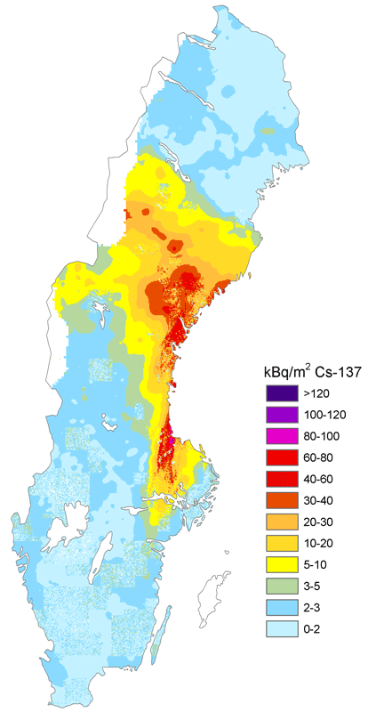
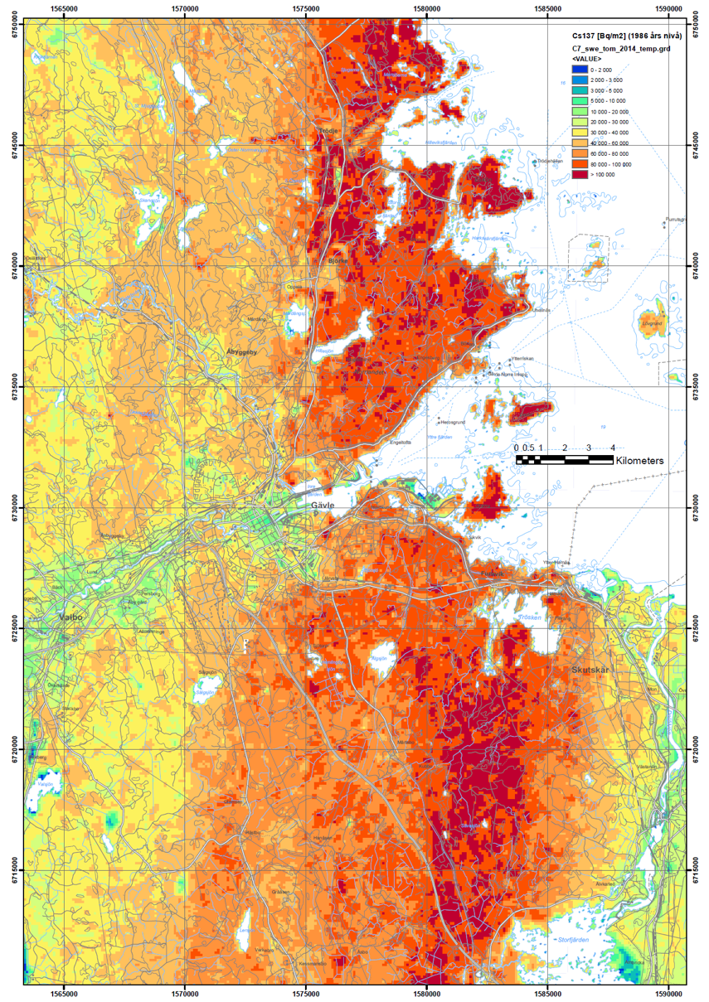
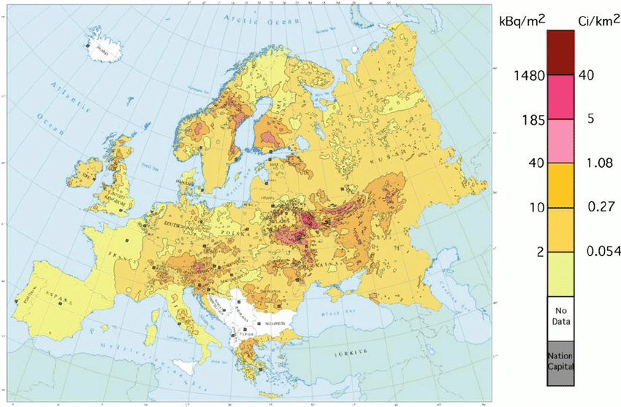
Complex dose estimation: inhomogeneity in radionuclides deposited, residence times, decay
Cs-137 from Chornobyl deposited over Europe, Sweden, and Gävle area in Sweden
De Cort et al. 1998
SGU
→Justification for individualised (external) dosimetry
Notes:
This is just to show how large the variability was in the deposition of Cs-137 after Chornobyl, in Europe, over Sweden and within a small Swedish county (Gävle). This shows that precise doses require individual dose measurements and cannot easily be calculated based on a few in situ measurements.
(If someone comments on the reader capacity – this is a secondary problem that can be solved with networks, constructing cheaper readers etc. that is to be organised and thought of in the meantime.

Slide 3
Retrospective dosimetry methods
Biological
  chromosomal aberrations, lymphocytes, radionuclides in the body, etc.
Physical
  TL*- and OSL** materials, EPR***, radionuclides in the body.
Mathematical
  Monte Carlo calculations (based on in situ measurements).
*Thermoluminescence; **Optically Stimulated Luminescence; ***Electron paramagnetic resonance

Slide 4
Optically stimulated luminescence dosimetry
Retrospective- and prospective dose determinations on an individual level
Energy is stored in crystalline defects (quartz, feldspar, salt, and others) when exposed to ionising radiation
Energy is released, as luminescence, when the material is stimulated by heat (TL) or light (OSL)
“Accident”-signal
Accumulated signal
Bkg. signal
Time

Slide 5
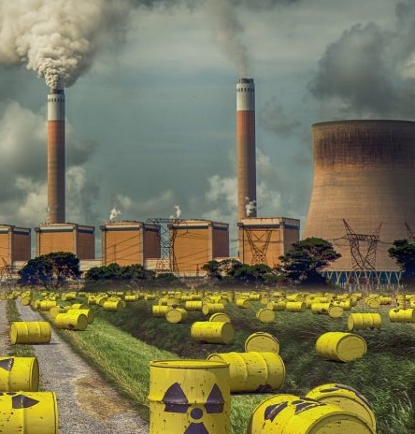
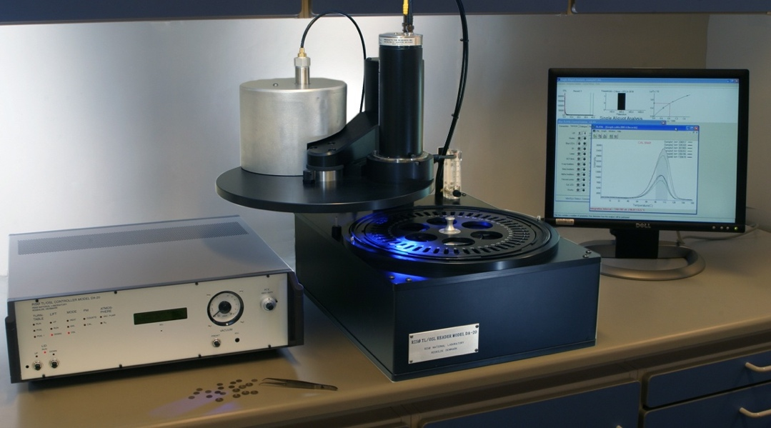
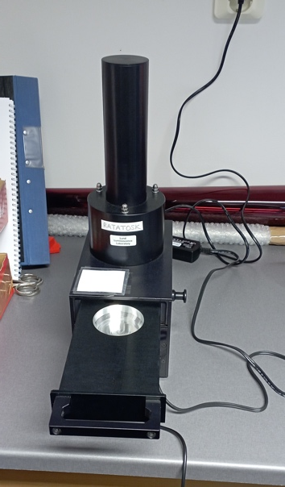
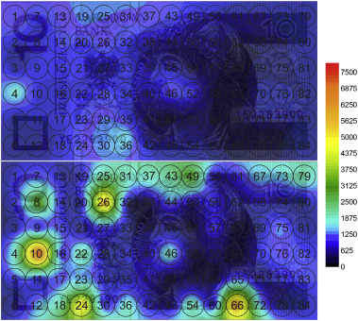
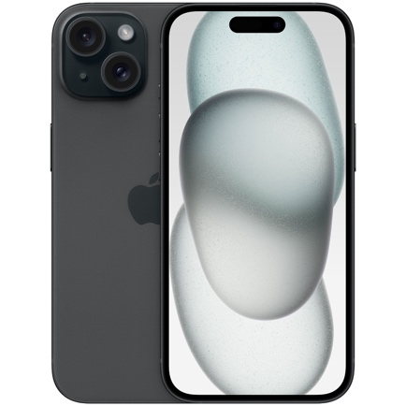
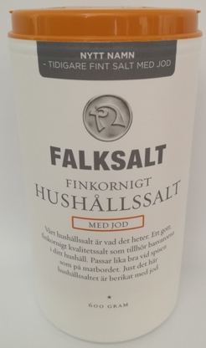
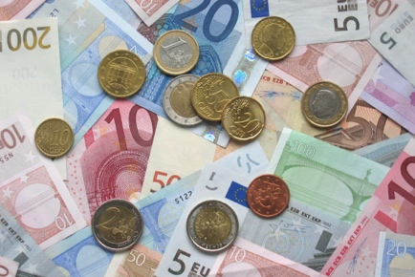
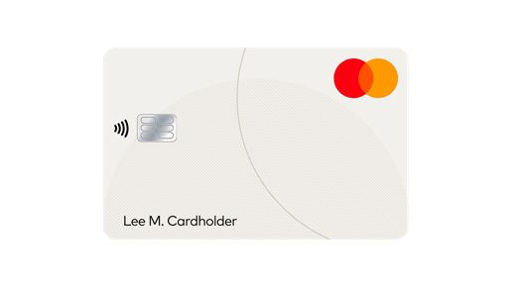
OSL dosimetry with fortuitous materials
Unintentional exposure (OR NOT) to ionising radiation
In situ or ex situ read-out (+calibration/pre-determined curve)
Reporting of estimated doses (if in situ – potential for triage support)
RRADEW
Analysis of OSL signal vs absorbed (whole-body) dose – estimation of effective dose
10 PLN sedel
Collection of personal materials
https://doi.org/10.1016/j.radmeas.2017.04.012
Notes:
Concept of using OSL for retrospective dosimetry.
The second step is the retrospective line. Between step 1 and step 2 we should try to squeeze in the ours and the RRADEW approach to also include “broadcasting information to the public on how to pack their own dosemeters of household salt and/or swift distribution of NaCl pellets”.

Slide 6
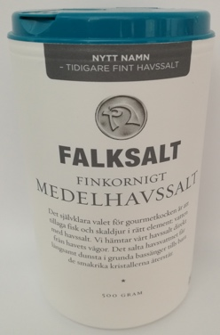
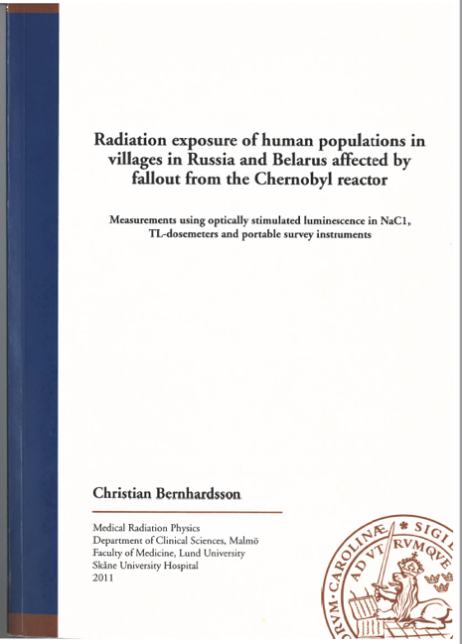
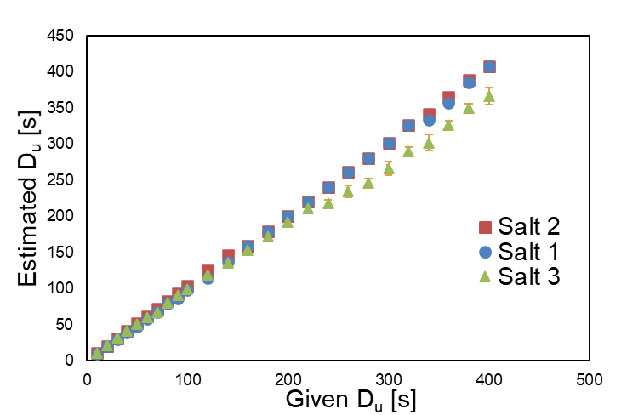
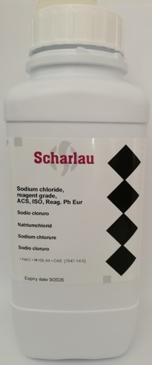
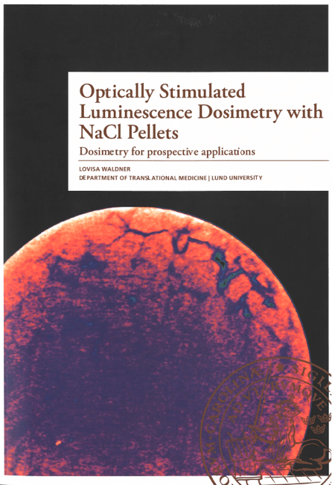
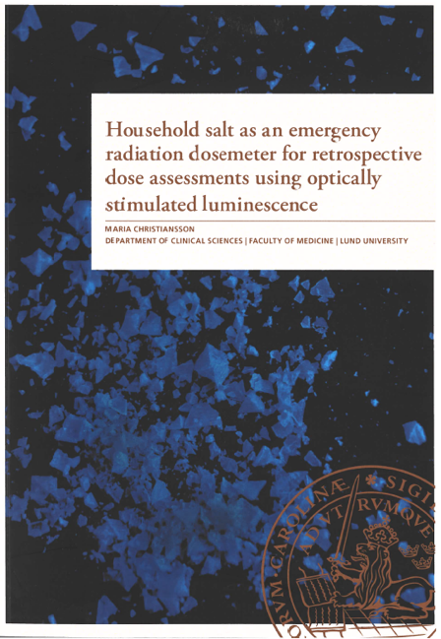
Salt (NaCl) for OSL dosimetry
Dosimetric properties of (NaCl pellets)
  Minimum detectable dose ~10 µGy (normal bkg. radiation ca. 3 µGy per 24 h)
  Reproducibility: ca. 2%
  Dose-reconstruction:
Pros./cons.: must be kept shielded from light
Notes:
Use this slide to highlight why household salt is of interest to OSL dosimetry (and quickly mention that other stimulation modes can be considered in parallel).
It has been researched for OSL dosimetry since the 1990s (that we can look up) – mainly at very high doses
In our group we have focused on household salt for dosimetry for two decades – mainly for low-dose applications and not only laboratory studies – three PhD theses published and Yours is the next (but not last)
Rather early we transitioned from retrospective dosimetry applications to prospective applications – for example the in situ point measurements in Chornobyl contaminated areas in Belarus and in Russia.
In that transition we proposed to press the salt to pellets for improving the handling of the dosemeter kits and during readout + but also for improving the reproducibility
Some of the main dosimetric properties for NaCl pellets are listed. I did not add fading, but that you can take from one of the summarise in my Kaunas paper of the one we did with Vadim. The main thing is that there is an initial fast fading, then its stable for the time periods that are relevant for applications in emergency dosimetry.

Slide 7
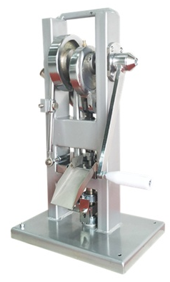
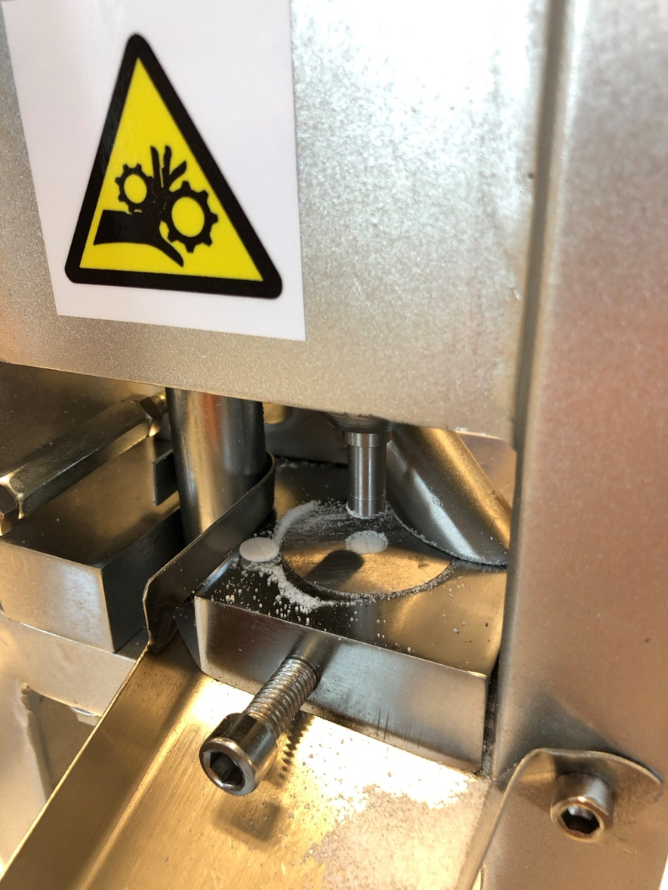
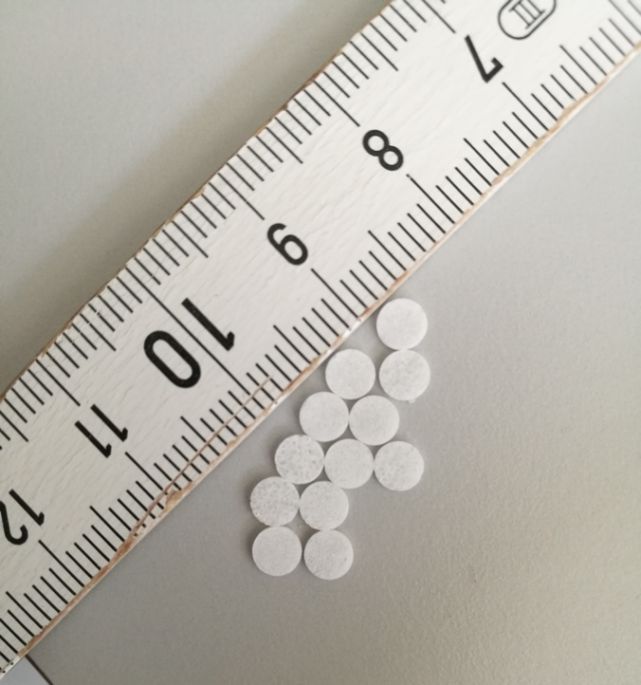
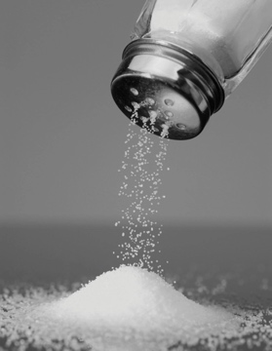
Salt as a prospective OSL dosemeter
A cost-effective and available alternative to conventional detectors and methods for radiation dose determinations
+
=
€1
€1000
Notes:
The slide should send three messages. I think this should be re-done a little. Divide the page in three parts (with emphasise on the third one):
The upper part shows (in pictures) the retrospective approach – when someone collect salt from a home in a contaminated area with the intention to estimate the effective dose to the people living there (complicated for too many reasons – nothing we recommend to do on a large scale).
The middle part (also in pictures) shows a ”semi-prospective” approach of using household salt for individualised dosimetry. With proper instructions anyone can pack their salt in their own home when recommended to do so, and if they are interested in an individualized dose measurement (these instructions will be developed within RRADEW).
The third and lower part is what is on the slide now – prospective dosimetry with pre-pressed pellets that can be distributed to an unlimited amount of people. (If extremely many pellets are need to be read in a short time it will be possible to pool them, measure ~20 pellets each time. If signals above a certain pre-defined threshold are observed – then more pellets from these 20 dosemeters are analysed more carefully to identify who or whom had high doses).

Slide 8
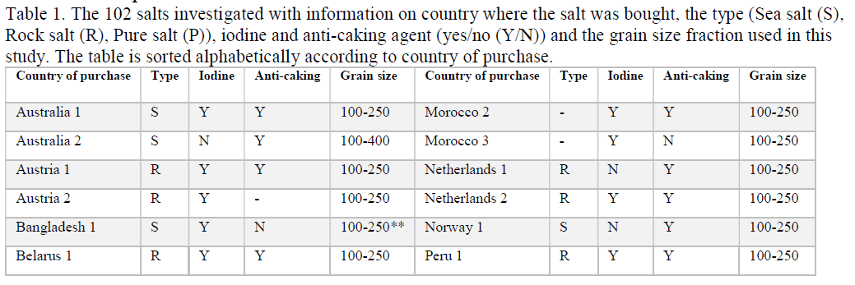
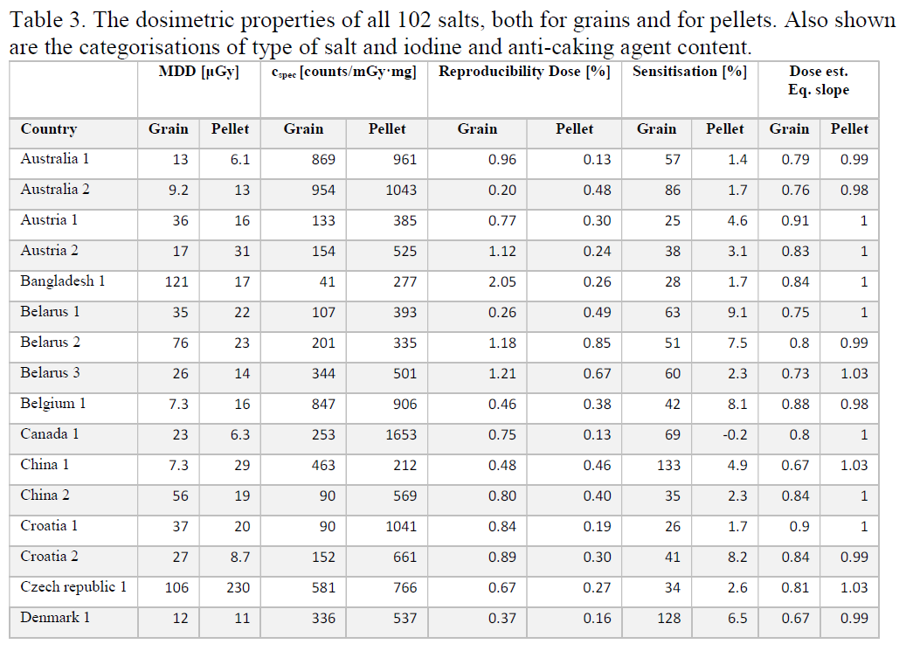
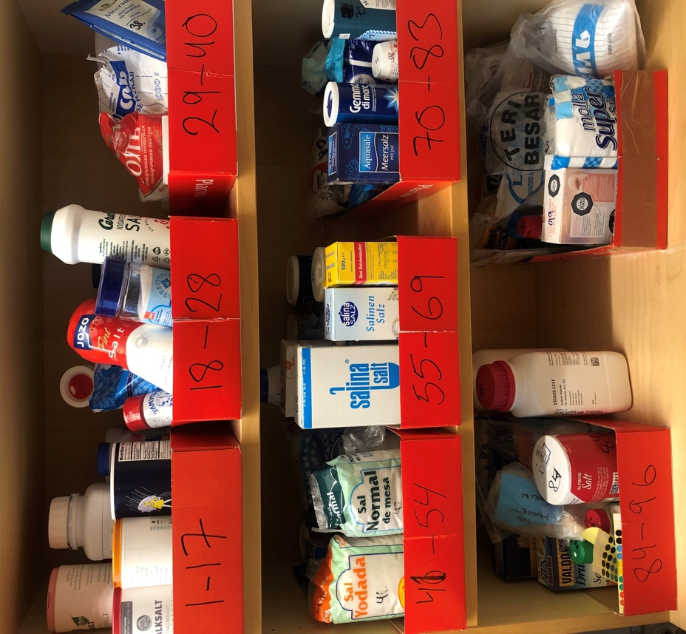
Salt as an OSL dosemeter
102 different salts from 47 countries and 6 continents
See Waldner L. thesis (2020) for the full list of salts investigated: https://portal.research.lu.se/en/publications/optically-stimulated-luminescence-dosimetry-with-nacl-pellets-dos
Notes:
Important to show somewhere that we have analysed very many salts world-wide to determine if its only Swedish salts that are useful for OSL dosimetry – and the answer is NO, but Himalayan salt should be avoided for the use in OSL dosimetry and its unproportionally high price to taste ratio.

Slide 9
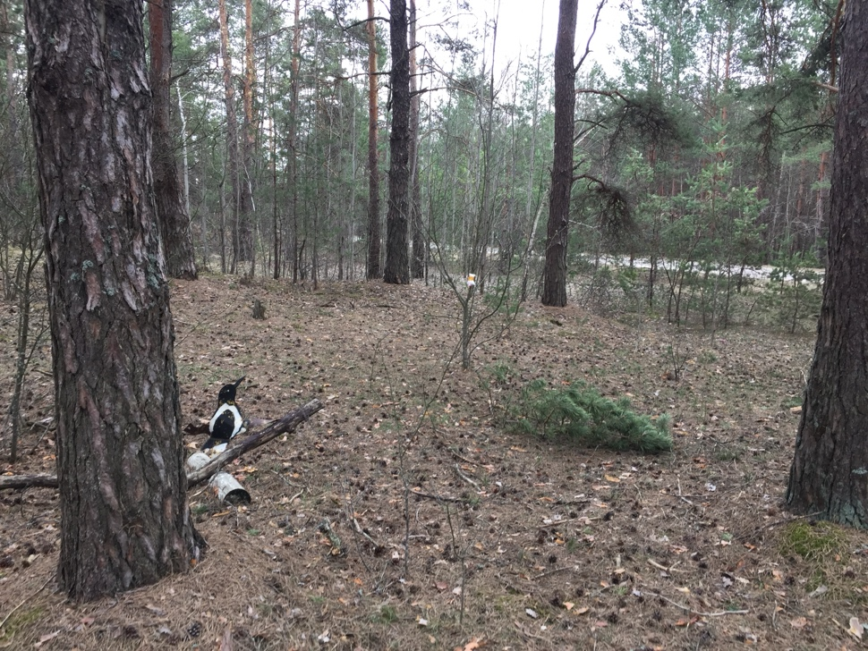
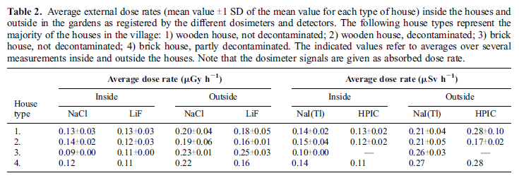
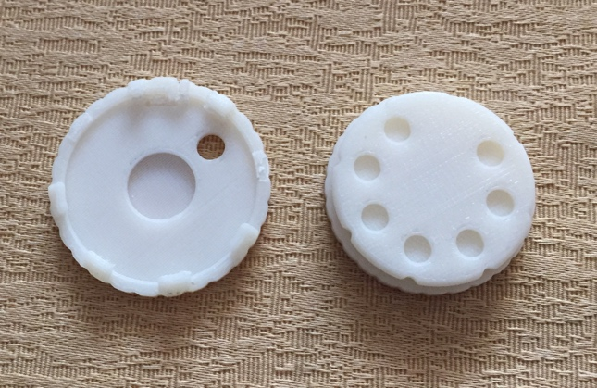
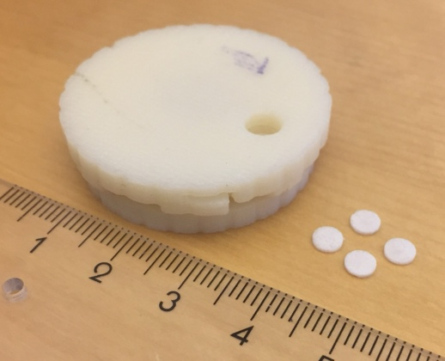
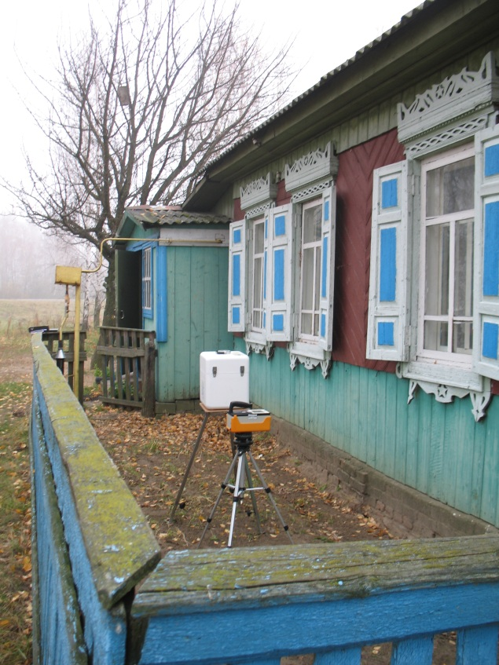
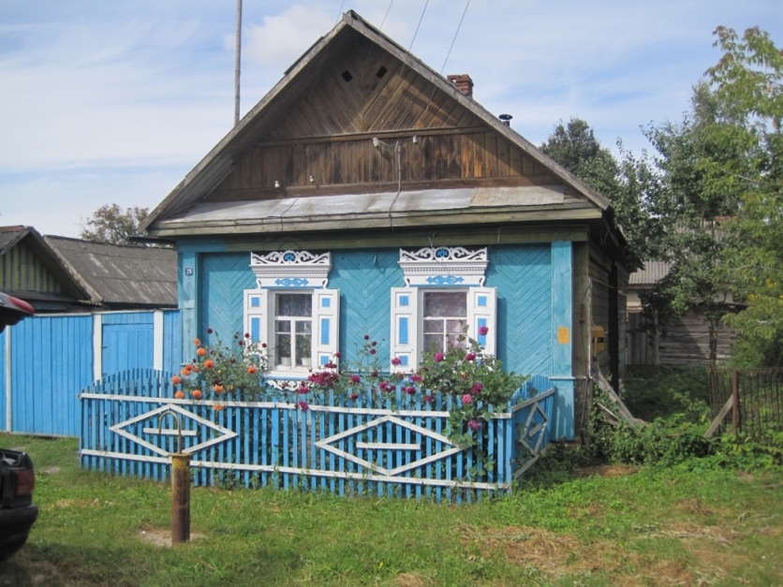
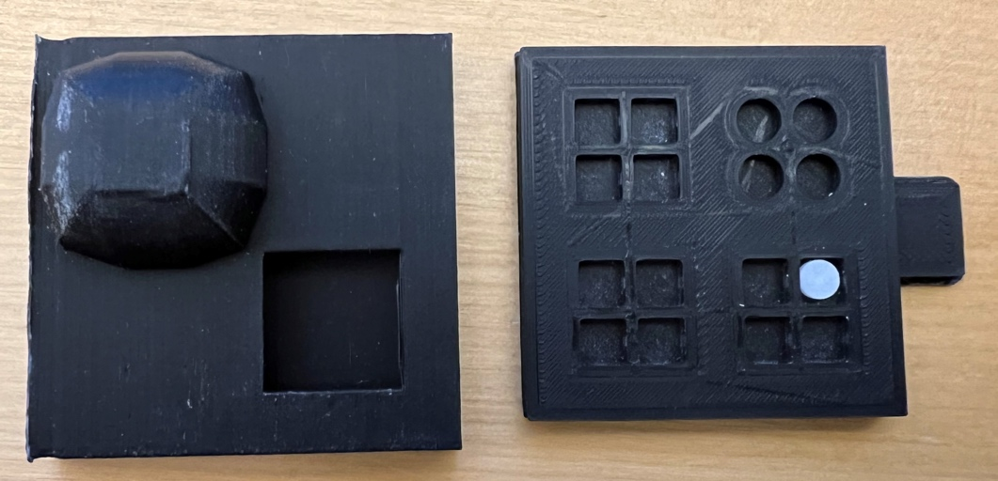
NaCl pellets – applications within environmental radiology
Health Phys. 103(6):740Y749; 2012
Notes:
OSL(NaCl) dosimetry really works – in controlled situations in the lab/hospital clinics and in the environment.
The results on this slide are from 2008, 2009, 2010 that showed that the salt (as grains in light sealed dosemeter packages) could be used in situ in Belarus for periods of 2-3 months, with the same results as ordinary TLDs and measurements with NaI(Tl) and HPIC (High pressure ionisation chamber) at the same stationary positions when put up and when collected.

Slide 10
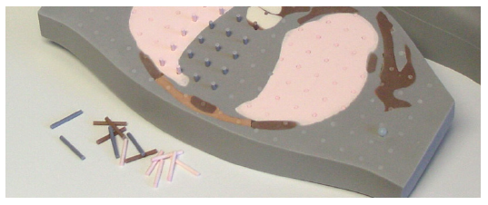
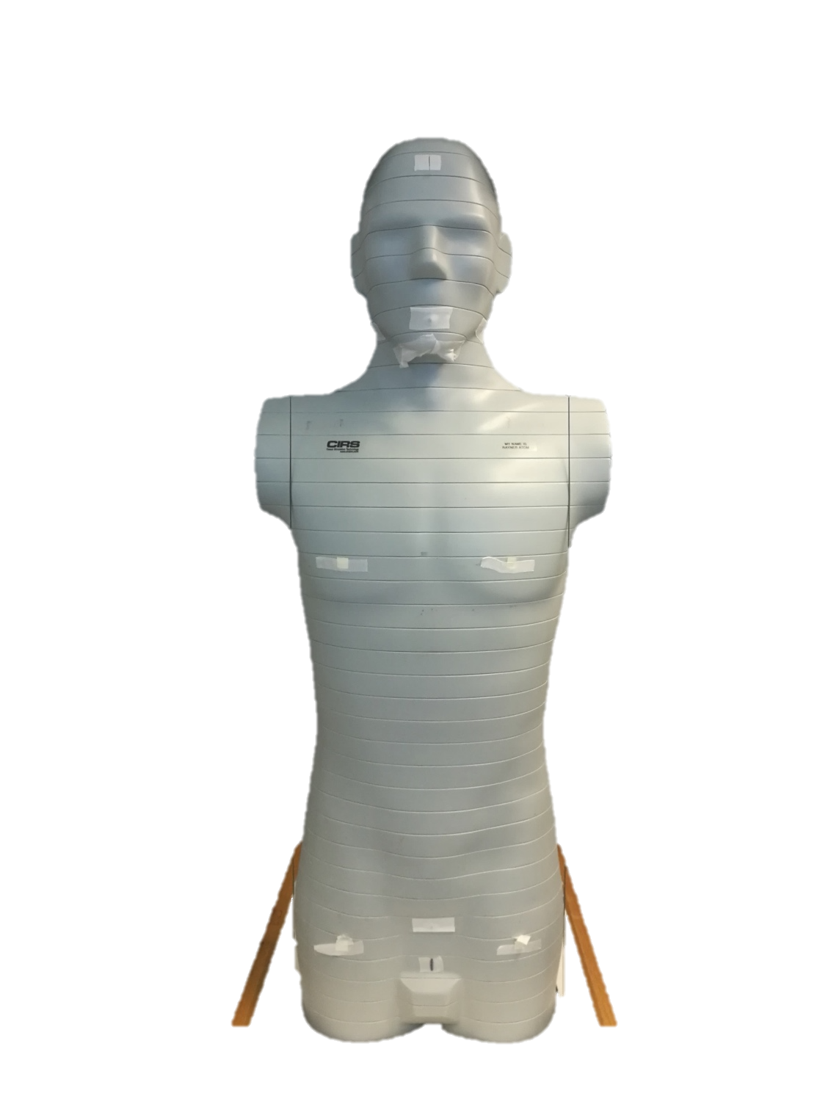
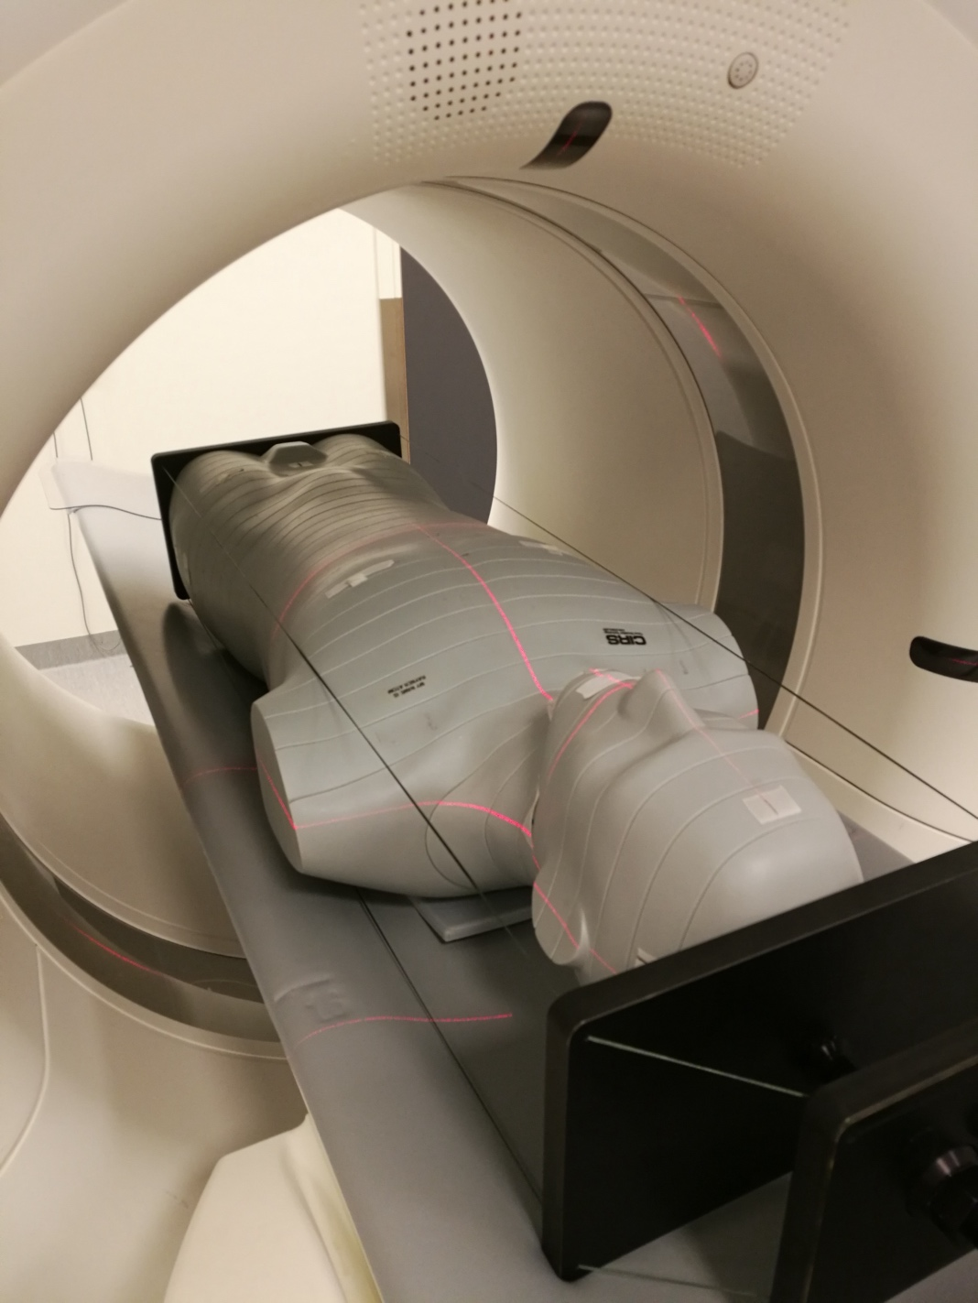
NaCl pellets – applications for CT
Effective dose: 5.6 mSv
Estimated effective: 3.7-4.9 mSv
Notes:
Almost 300 NaCl pellets were used in this CIRS phantom during a pelvic CT scan for determining organ absorbed doses and the effective dose. The good results were achieved without using proper calibration for the energy spectrum of the CT scan.
DLP according to CT: 326.2 mGy*cm
k-factor for abdomen/pelvic: 0.0171

Slide 11
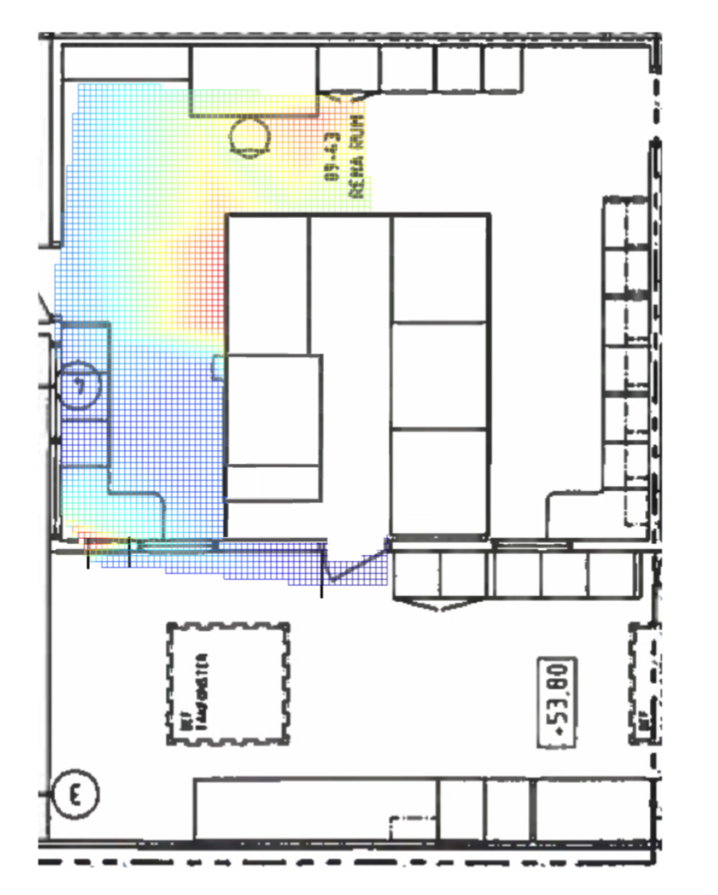
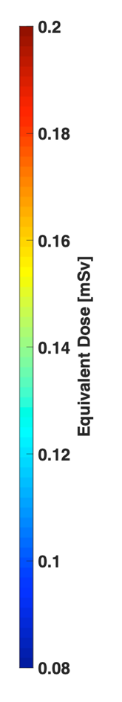
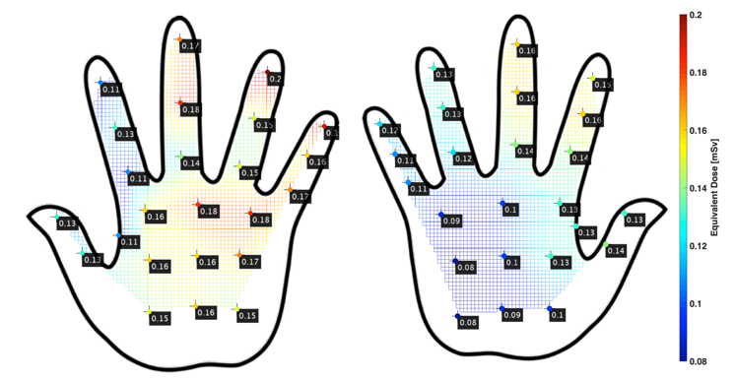
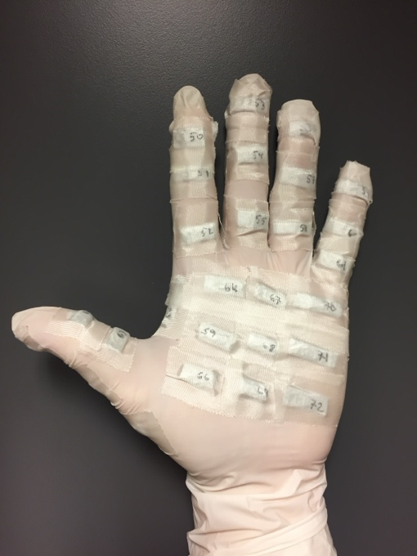
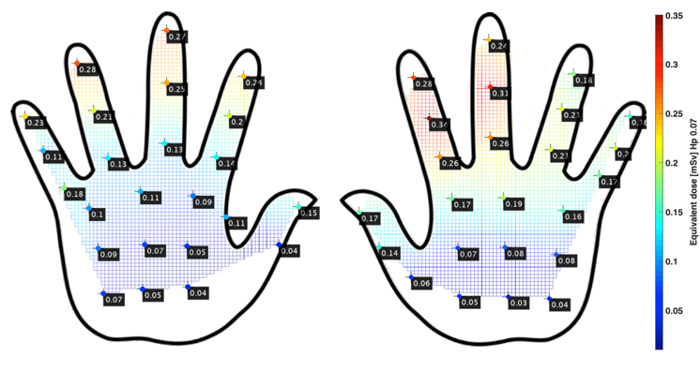
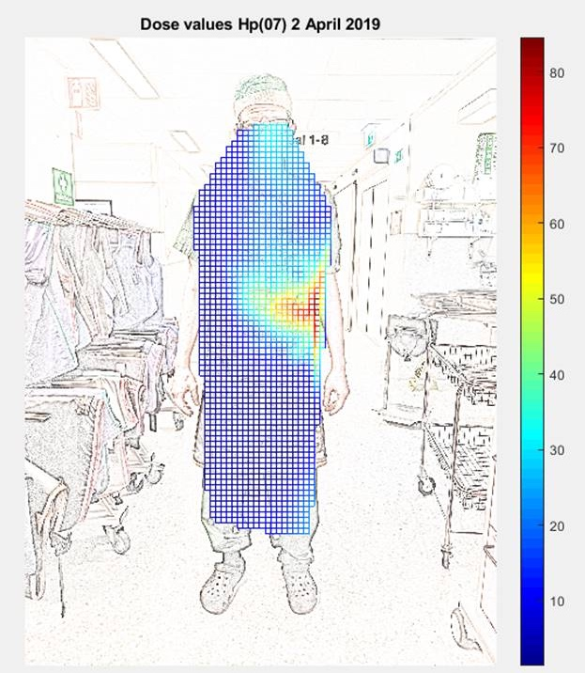
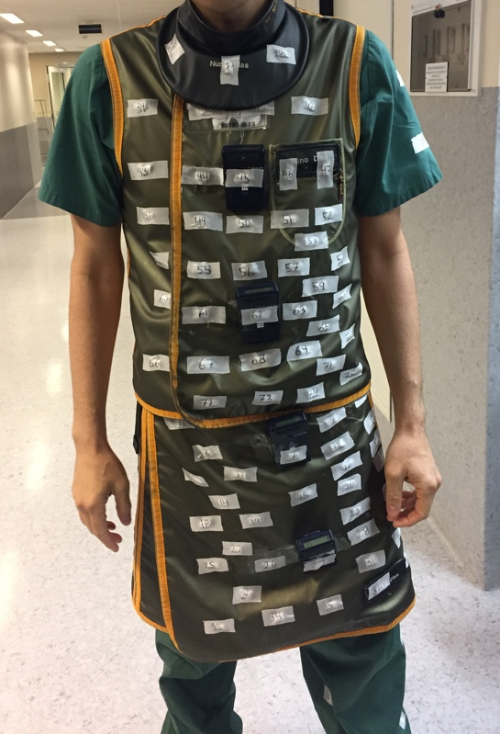
NaCl pellets – clinical applications
Notes:
Large amount of point measurements using NaCl on surfaces (hands of nurses preparing radiopharmaceutical kits, and on the lead apron on a physician performing and interventional examination with the x-ray tube on the left hand side, and to the right is the mapping of a nuclear medicine room “hot-lab”).

Slide 12
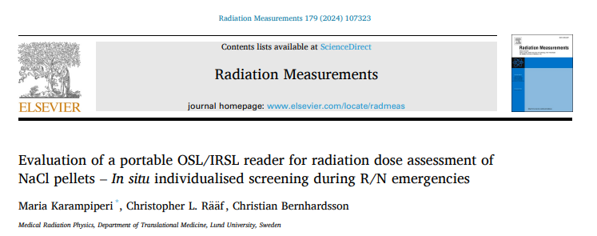
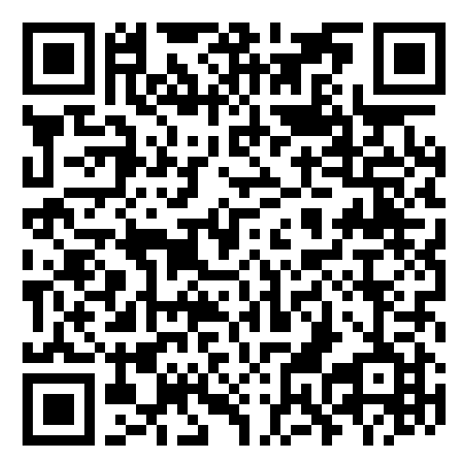
13th of November
SESSION 7B

Slide 13
Why NaCl pellets? Why OSL?
NaCl:
Cheap
Common
Good luminescence properties
No need for pre-treatment
NaCl pellets:
Uniform
Higher reproducibility
OSL
→ No need of N₂
Readers
Cheaper
Portable
Network
In situ +
No need of external power
Rapid results
Notes:
So, at the end, I will ask “But can a portable reader perform equally well?”

Slide 14
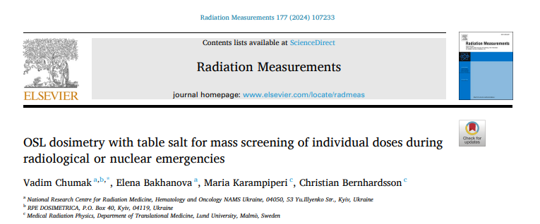
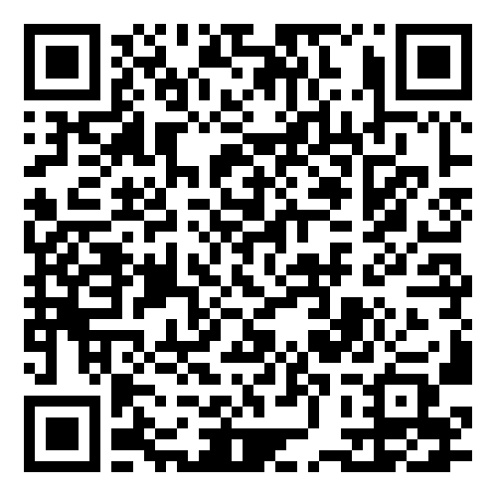
NaCl properties vs. other dosemeters

Slide 15
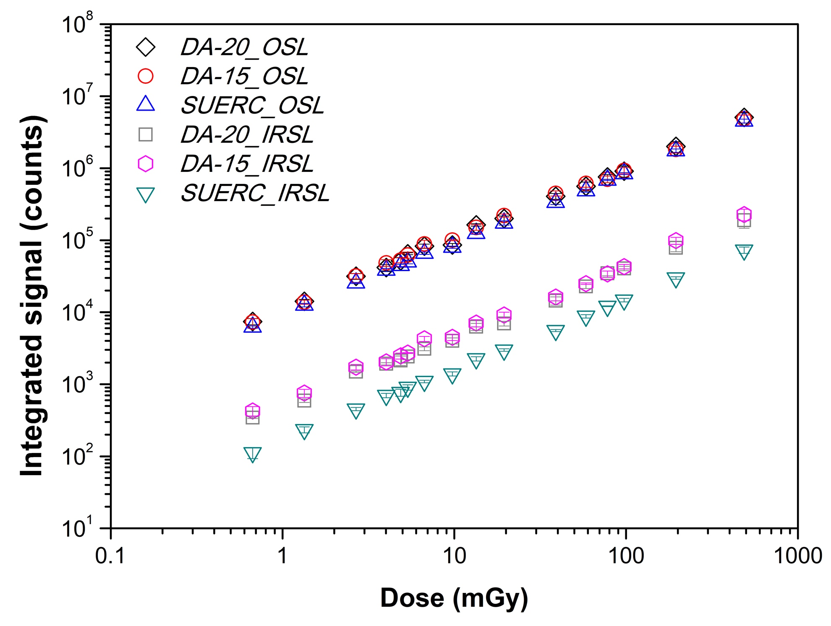
Performance
Tested for β & γ
SUERC → 5 pellets together
Detection limits:
OSL → 3 µGy
IRSL → 50-80 µGy
OSL and IRSL dose response for irradiations with ⁹⁰Sr/⁹⁰Y, for all 3 readers.

Slide 16


Potential in war-time
No need for power supply
Low-cost → building a larger network of readers
In situ → overcomes the difficulty of transporting samples through borders
No limitations due to communication disruption during war
Linear response to dose → Ability to retrieve the dose
Low detection limit → can relief even the “worried-well”
Higher residuals → re-reading the same samples
Combination of IRSL and OSL
Helpful for triage → can even read many samples together and do 1-1 analysis only to batches that the dose appears higher than the threshold

Slide 17
RRADEW - Resilience to RADiological Events in Wartime
WP4 (Ukrainian case study)
Develop information material to the public
  Packaging material & method, optimal positioning on the body, labelling, general information
Study optimal ways of broadcasting the information
Establishing workflow for the chain packing-collection-readout-reporting back the results
Testing parts or the whole chain of the proposed guideline for using NaCl as a “folk-dosemeter”

Slide 18

Thank you for your attention!
Maria.Karampiperi@med.lu.se
Christian.Bernhardsson@med.lu.se
https://www.msf-malmo.lu.se/

