Slide 1
The potential usefulness of citizen radioactivity measurement to improve institutional monitoring
J.M. Bertho, P. Croüail
Neris Workshop, Nov. 11, 2024

Slide 2
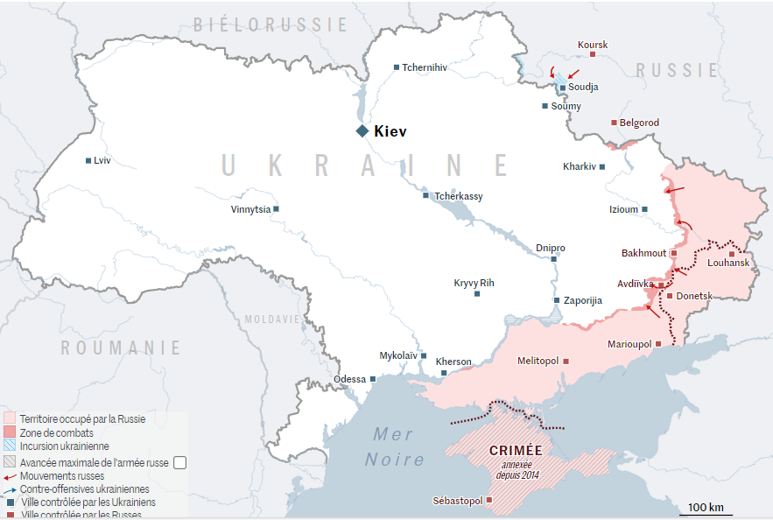
Conflict situations
Recent conflict situations (Ukraine, Israel) highlighted the risks
for nuclear installations:
  Infrastructures and energy network become a strategic target
  Nuclear power plants may become targets
But also other risks:
  Resuspension of deposited radionuclides due to military activities in contaminated area of Ukraine and Belarus (especially in the Chornobyl exclusion zone)
  Threats of nuclear weapons use
In such a context, environmental monitoring becomes a major concern
  Availability of environmental monitoring network, especially around nuclear power plants
  Need for an increased number of measurements in case of nuclear or radiological emergency
Moreover, two main characteristics of such a conflict situation:
  A situation with a potential rapid kinetics of dispersion
  An unknown source term

Slide 3
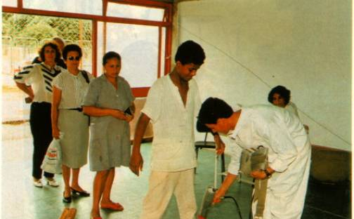
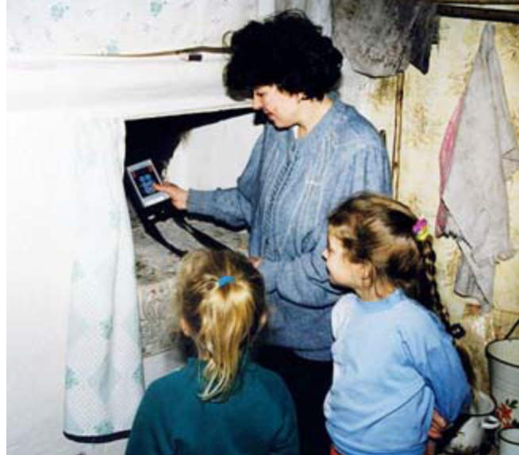
How managing environmental monitoring in such degraded situations?
No such previous accidental situations where environmental monitoring was unavailable, excepted some ancient accidents
Goiania, 1987: absence of environmental monitoring induced a delay of 19 days in the recognition of the radiological nature of the accident.
Need to explore lessons learn from previous major accidents: Chornobyl, Fukushima
  During these accidents, the expert environmental monitoring was available and strongly and rapidly implemented.
  However, in both situations, measurements of environmental radioactivity by citizens rise progressively, during the post-accident phase: ETHOS and CORE programs in Belarus, NGO ETHOS in Fukushima in Japan.
  These measurement activities are continuing even more than 35 years after the accident.
  Radioactivity measurement have been demonstrated as a good tool to empower inhabitants living on contaminated territories and effective in reducing mental health troubles
© IAEA, 1988
© CEPN, 2005

Slide 4
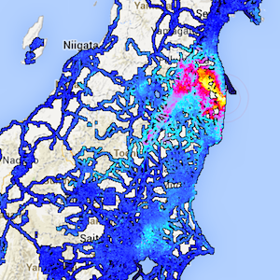
Citizen measurements could be a solution …
Several citizen science measurements were developed in the aftermath of the Fukushima accident (Safecast)
Advantages in situations where the environmental monitoring network is not anymore available:
  A network of contributors dispersed and potentially abundant
  A network of contributors independent from energy network
  A network of contributors able to move
But some disadvantages:
  A dependence on the availability of a cell phone network
  Time needed to develop a network of contributors
  Training needed, although short.
  Ethical issues (see later on)
© Safecast 2012

Slide 5
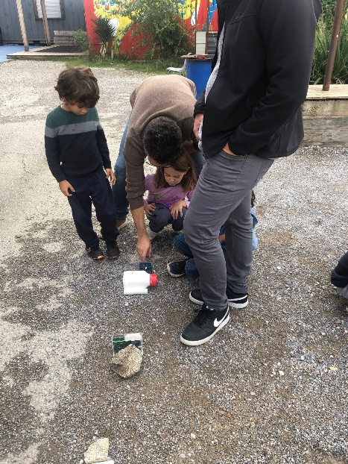
… but need to be developed before any event
Numerous projects were developed in the aftermath of the Fukushima accident and disappeared in the following years: Atomtag, Pocket geiger
Several projects of citizen measurement of radioactivity are currently working: Safecast, Openradiation, Citistra
How to maintain such projects of environmental monitoring during peaceful time, i.e., in absence of any radiological issue?
  Absolute need for reliable measurement results
  Environmental dose rates vary mainly with some environmental parameters: altitude, soil composition, presence of radon
  Variations of dose rates are usually in a narrow range: 0.04 – 0, 250 µSv.h⁻¹
© IRSN, 2024

Slide 6
Potential uses of citizen measurement systems
Main possible actions in the absence of radiological issue:
  Education to science and technology
  Education to radiation protection
  Awareness-raising actions about nuclear and radiological risks (e.g. training of potential first and second responders: rescuers, firefighters, army, deminers and clearers)
  Support to citizen network of environmental monitoring
  Tool for research activities in various domains: physics, biology, environmental sciences, social sciences and humanities, …
Are such activities sufficient to support citizen measurements tools in a sustainable way?
Some absolute requirements:
  Reliability of measurement tools
  Diffusion of measurement protocols
  Objective: providing reliable measurements results both to citizen and to public decision

Slide 7
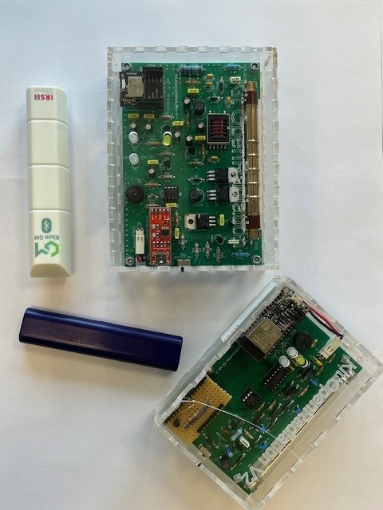

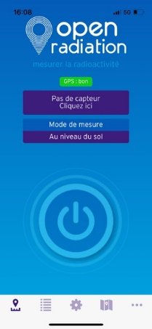
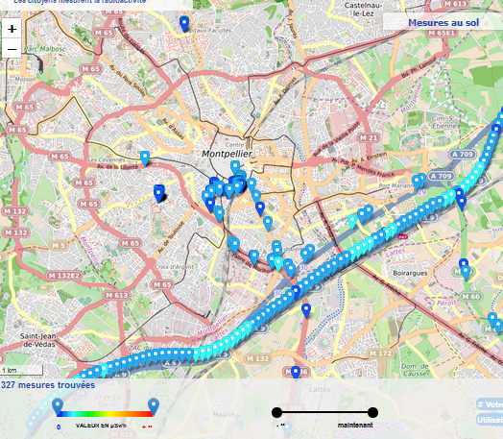
What is OpenRadiation?
is dedicated to the radioactivity measurements by and for citizens
It is made of three components:
A detector with an integrated calibration function connectable through bluetooth
A smartphone application to drive the detector, to collect data (GPS location, date and time, etc) and to send the informations to the web site
A web site with the interactive map to present the results and to communicate
Everything is in open source (creative common licence) and open data

Slide 8
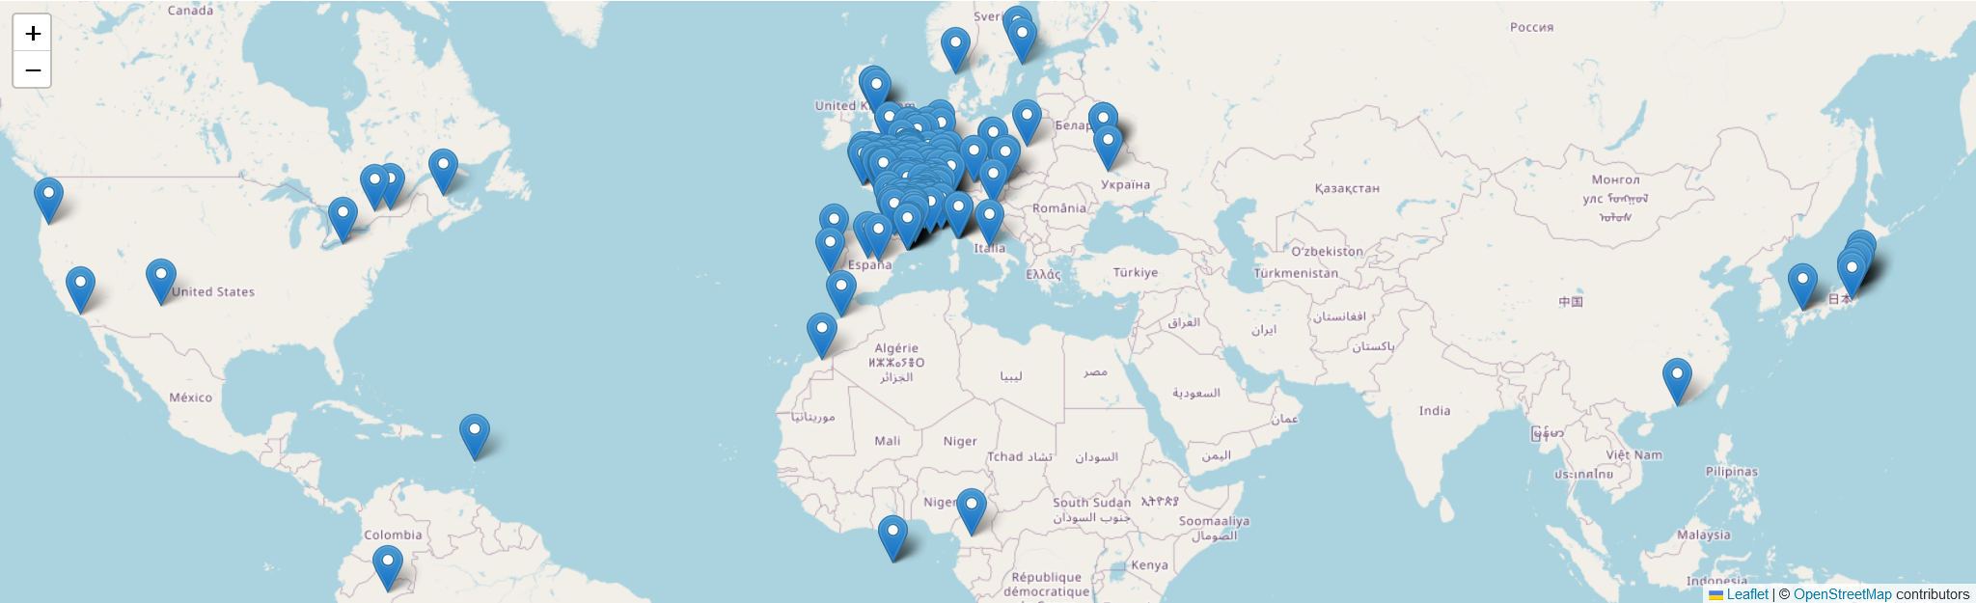
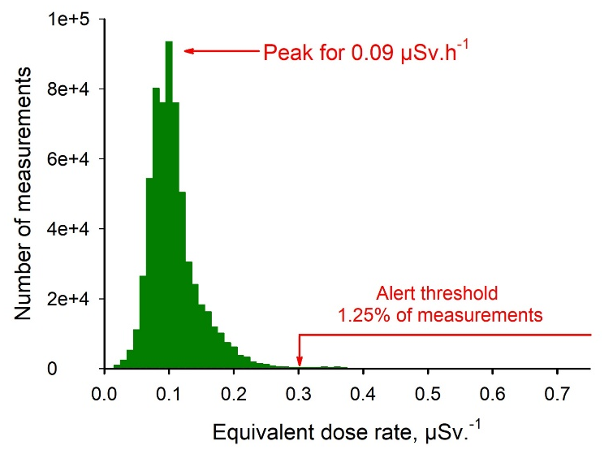
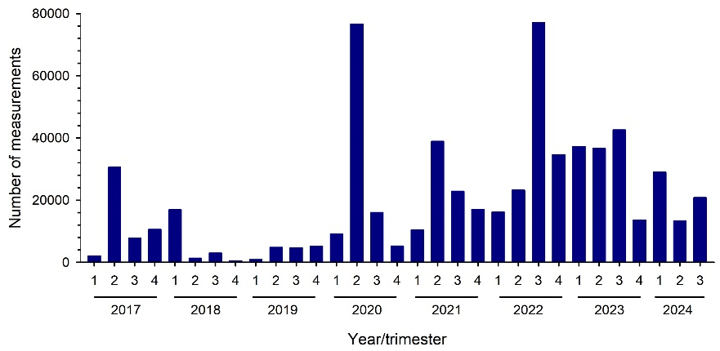
Some data about OpenRadiation
300 contributors, worldwide
An action threshold at 0,3 µSv.h⁻¹
< 800,000 measurements since 2017

Slide 9
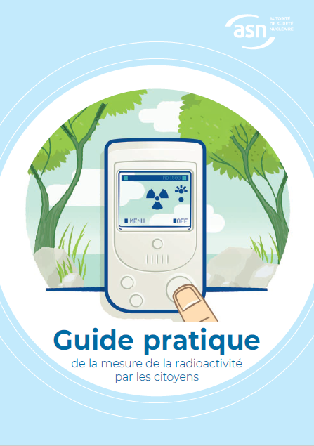
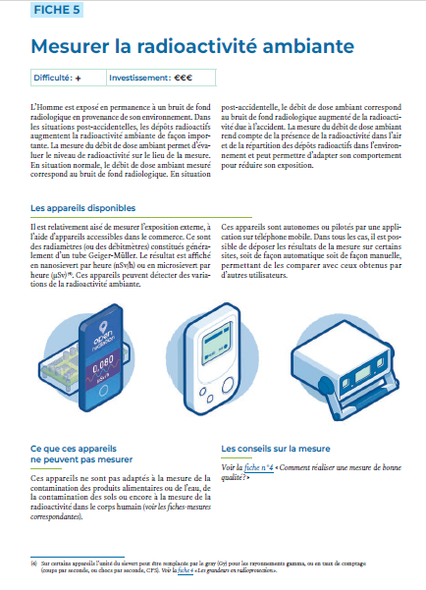
A Guide for citizen measurement
The French steering committee for the management of post-accidental situation identified a need for a guide to provide some guidance about radiation activity measurement.
The guide was created with a group including both experts of radiation activity measurements and citizen interested in such measurements
Requirements:
  Simple, concise: 11 factsheets for eleven matrix
  Presenting what is feasible by a citizen and what is not.
  With 8 annexes explaining some complex concepts and detailing useful information.
In French only, unfortunately.

Slide 10
Is Openradiation adapted to a degraded situation?
A secured web site
The anonymity of contributors is guaranteed
Possibility to post individual measurement results in an anonymous way
Possibility to define a specific project to be associated to the measurements
Some detectors are available for loaning
The current limitation is to find volunteers at the places of interest
OpenRadiation might be useful in such situations and could be deployed rapidly if there are some active contributors in the area

Slide 11
Ethical issues
For the Openradiation project:
  Make free access codes and data but protect personal data of contributors (EU Data protection regulation)
  All the data are public, none retrieved. Data over the alert threshold are commented.
During normal situation, some basic recommendations:
  Do not place yourself in danger, especially dangers others that radiation exposure.
  Respect private properties and places forbidden to the public.
During degraded situations, which recommendations?
  Do not place yourself in danger of receiving excessive exposure (be aware that there may be high activity sources lost)
  What is an ‘excessive’ exposure? In France some limits exist for public and responder exposures either during emergency or during existing exposure situations.
  During conflict situations, avoid battle areas, be discrete while making measurements
  Consider risks of GIS uses, and identification of users that may become highly sensitive data. Should these results be publicly available ? If not, who and how to inform?

Slide 12
Thanks a lot for your attention!
For further discussions jean-marc.bertho@irsn.fr pascal.crouail@cepn.asso.fr

