Slide 1


Development of national stockpiles for
radiation emergencies
Dr. Zhanat Kenbayeva
Radiation and Health Unit
Dept. of Environment, Climate Change and Health
11.11.2024 – Rome, Italy

Slide 2


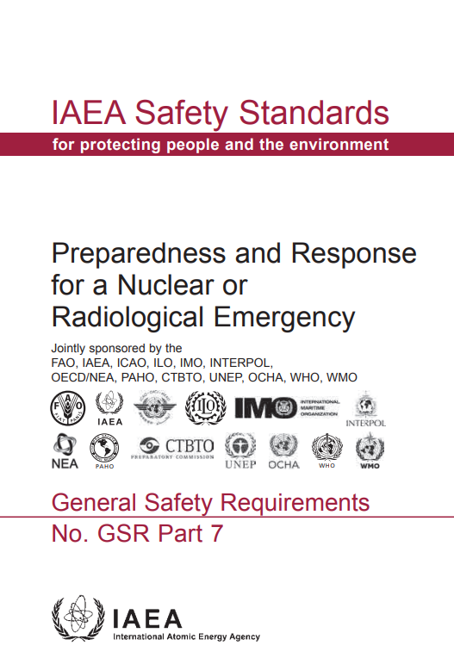
Why the Stockpile Policy Advice?
GSR Part 7, Requirement N 12 on Managing the medical response in a nuclear or radiological emergency states:
The government shall ensure that arrangements are in place for the provision of appropriate medical screening and triage, medical treatment and longer term medical actions for those people who could be affected in a nuclear or radiological emergency

Slide 3
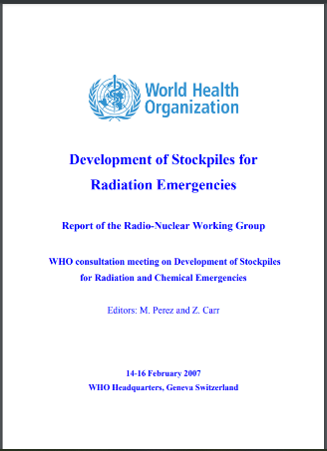
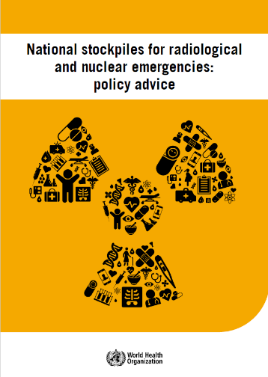
Stockpile Policy Advice development
The first report on national stockpiles for radiation emergencies was a summary of a WHO Consultation held in 2007.
Since then, new drugs came to market and were approved in several countries, new experiences emerged from managing and use of stockpiles health emergencies and new guidelines were developed.
In 2021, a REMPAN Working Group (WG) was set up to revise the 2007 report and held five on-line meetings to develop the draft.
Peer-review conducted in the 1st half of 2022.
Feedback processed and document was finalized, edited and processed through WHO’s publishing protocol by end 2022
Published in Jan 2023
2007
Revision
Update
3

Slide 4
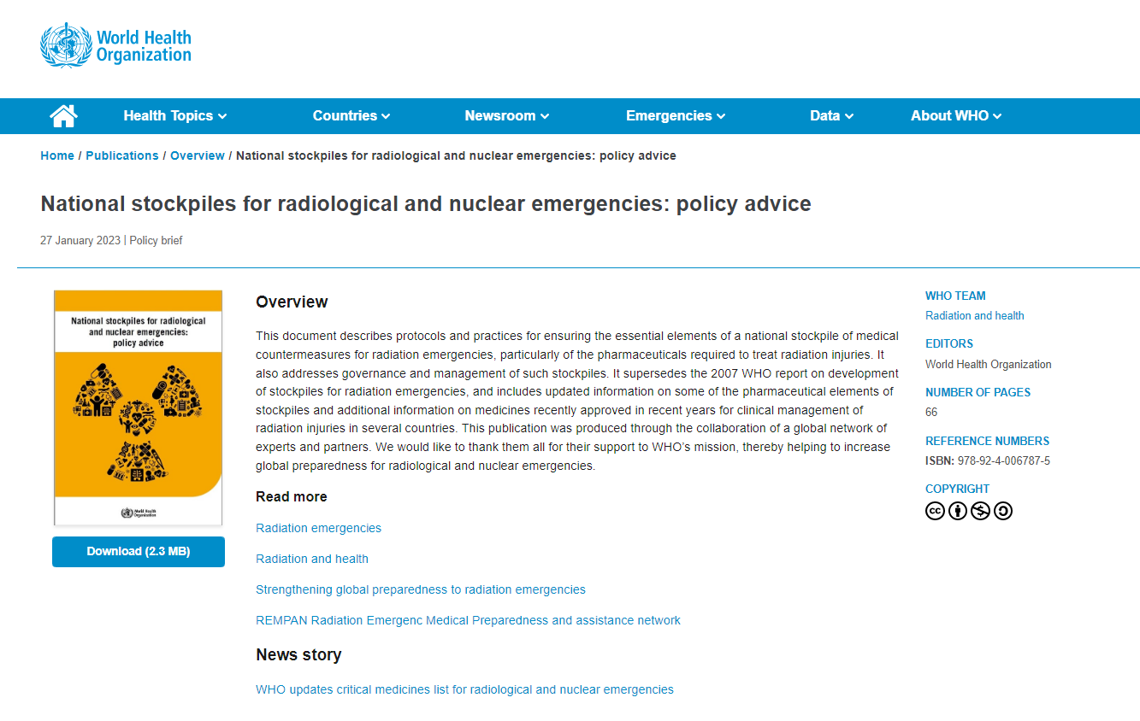
URL: https://www.who.int/publications/i/item/9789240067875

Slide 5
Contributors
Co-Chairs:
Prof. Nick Dainiak – Yale School of Medicine, USA
Dr. Chunsheng Li – Health Canada
Working Group members
Prof./Col. Matthias Port – Institute of Radiobiology, Germany
Dr. Andrea DiCarlo – Institute for Immunology and Allergic Diseases, NIH, USA
Dr. Marc Benderitter – Institute of Radioprotection and Nuclear Safety, France
Dr Maj. Cornelius Hermann - Institute of Radiobiology, Germany
Prof. Makoto Akashi – Tokyo University of Nursing (formerly with NIRS/Chiba), Japan
Dr. Atsushi Kumagai – National Institute for Radiological Sciences (QST), Japan
Dr. Andrey Bushmanov – Federal Medical-Biological Center (Russian Federation)
Critical contributors:
Prof. Urs Schanz – Zurich University Hospital, Switzerland
Dr. Ioana Ghiga - High Impact Events Preparedness Unit, WHO
Dr. Benedikt Huttner – Essential Medicines List Unit, WHO
With financial support of the
Swiss Federal Office
of Public Health

Slide 6
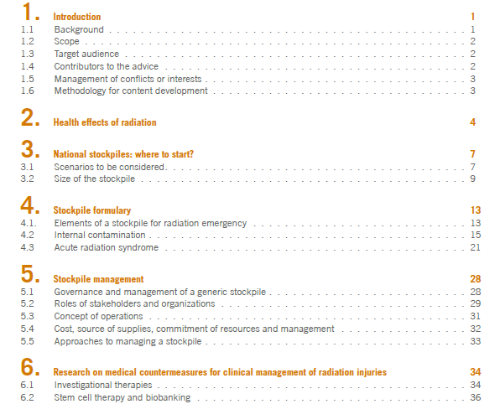

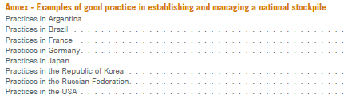
The structure of the document
6

Slide 7
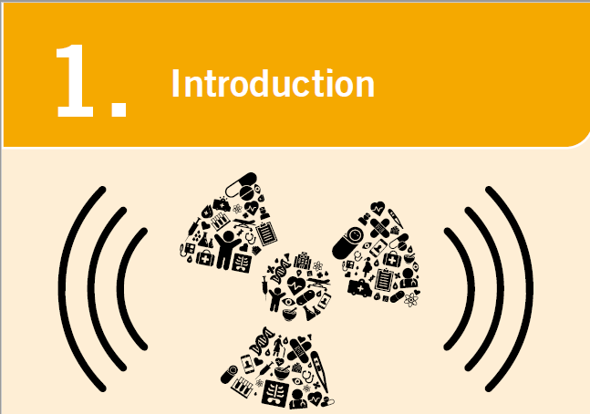
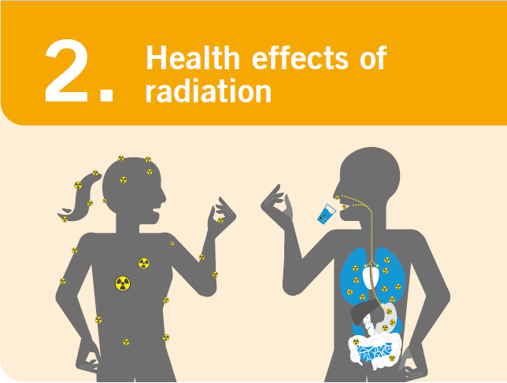
Target audience:
Public health administrators, policy makers, healthcare providers, and any other health professionals responsible for radiation emergencies preparedness and response.

Slide 8

Strategic National Stockpile (SNS) should be able to:
  Rapidly made resources available in response to an emergency
  improve standard of care in a mass casualty incident and reduce morbidity and mortality (combined injuries)
  move from ‘crisis’ to ‘contingency’ and to ‘conventional’ care
  permit efficient distribution of resources

Slide 9
Where to start?
Assumptions and Scenarios
Decision to create a SNS requires
understanding potential scenarios and types of radioactive sources that may be involved
  Medical therapy (diagnostic imaging, brachytherapy and RT for cancer, etc.): ⁹⁹Tc, ⁸²Rb, ²⁰¹Tl, ⁸²Sr, ⁹⁹Mo, ⁶⁰Co, ¹³⁷Cs, ¹⁹²Ir, x-rays
  Research : ³²P, ³H, ¹⁴C, ⁶⁸Ge, ⁹⁰Y, ⁸⁶Y, ¹⁹⁴Ir, ¹²⁵I, ¹²³I, ⁵¹Cr, ⁶⁷Cu, ¹⁹⁸Au
  Energy production (nuclear power plants [NPPs]): ²³⁵U, ¹³¹I, ¹³⁷Cs,
  secondary radionuclides
  Industry (industrial radiography – gas/oil pipe fitting, metal welding,
  aircraft; RTGs; sterilized food; ceramics): ¹⁹²Ir, ⁹⁰Sr, ⁶⁰Co, ¹³⁷C, ⁵⁹Co
Understanding threats (terrorists, states)
Estimating the risk of each emergency scenario, as well as vulnerabilities
Identifying the scope and elements of a SNS based on the information above
9

Slide 10
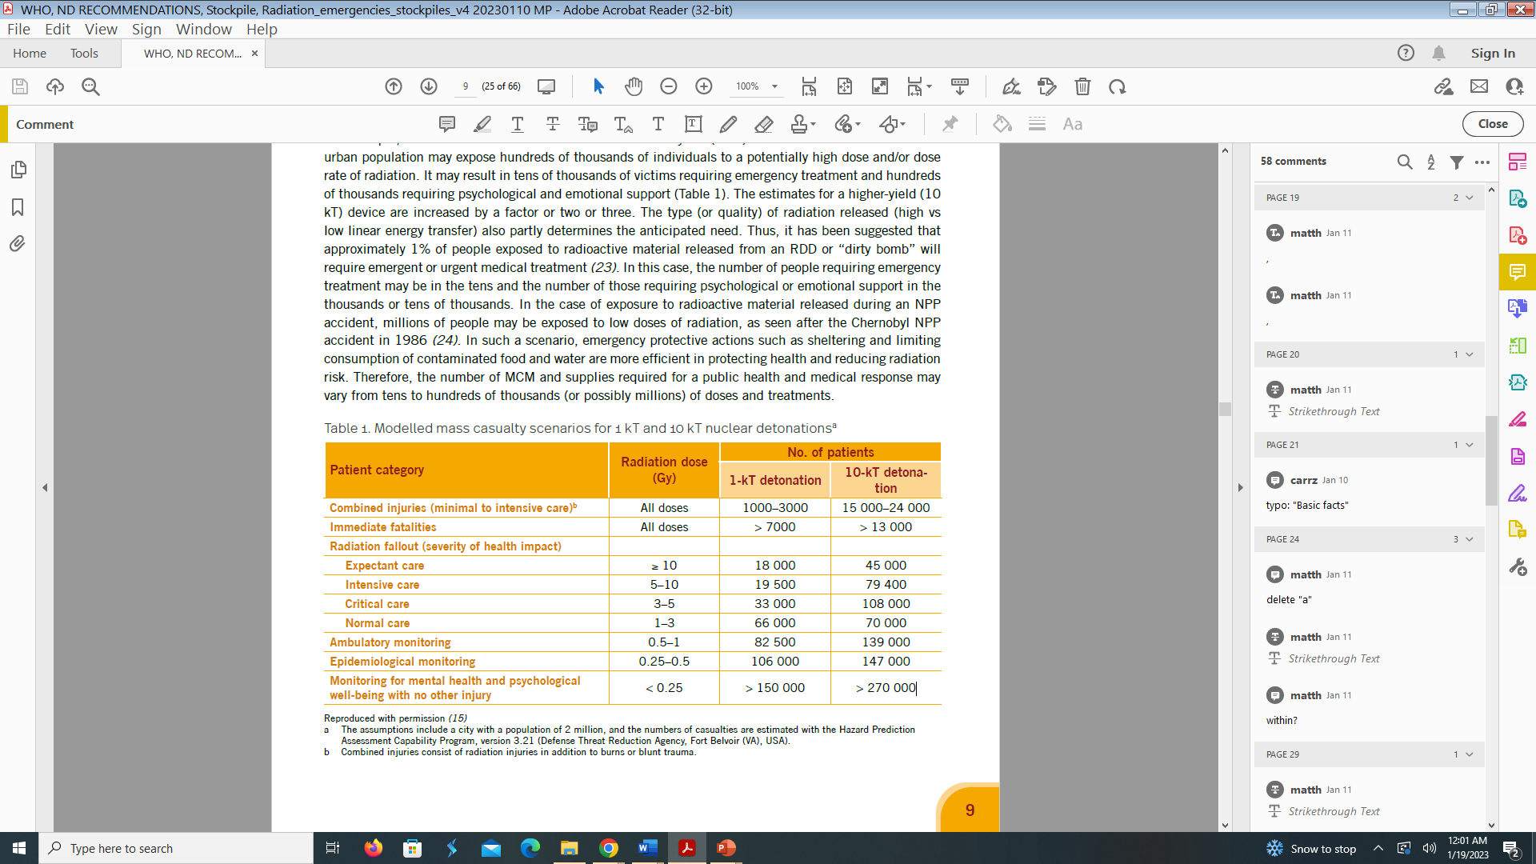
Where to start?
Assumptions and Scenarios
Mass casualties from a nuclear detonation
Waselenko JK, MacVittie TJ, Blakely WF, Pesik N, Wiley ALL, Dickerson WE, Tsu H, Confer DL, Coleman CN, Seed T, Lowry P, Armitage JO, Dainiak N
Ann Intern Med 2004; 140 (12):1037-51.
10

Slide 11
Where to start?
Assumptions and Scenarios
Sizing the SNS is determined by:
  Scenario-based modeling:
    Type of the scenario and specific radionuclides
    Demographics (population size, age structure, niche density, mobility)
    Socio-geographics (urban/rural, spatial variation in relation to terrain, transportation routes)
    Health care delivery systems
    Infrastructure (population transportation systems, communications, internet, public buildings, energy production- nuclear and hydroelectric power, oil and water transport)
  Anticipated number of casualties based on likely scenarios
  Distribution of injuries requiring emergent, urgent and long-term therapy
  Dosing schedule and treatment duration for specific radiation countermeasures
11

Slide 12


Slide 13
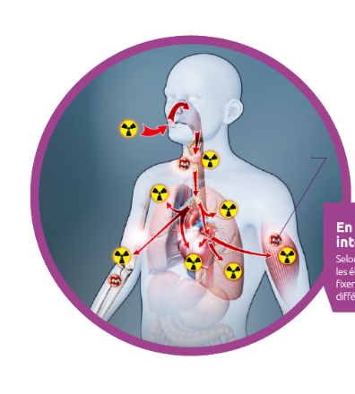
Internal contamination:
Blocking and decorporating agents
Exposure routes
  Inhalation, ingestion, contaminated wounds
Therapy options
Blocking agent (WHO 2017 guidelines on ITB in case of a nuclear emergency)
Decorporating therapy (IAEA 2018 manual on internal contamination with RN):
  Increases body excretion
  Reduced RN distribution and retention in the target tissues/organs
  Decreases chemical/radiological toxicity
Thyroid gland
Iodine (I)
Lung
Am, Pu, Po
Kidneys
Co, Po, U
Bone
Am, Cf, Cu, P, Pu, Ra, Sr, Th, U, Y
Bone marrow
Am, Pu, P, Po

Slide 14
Internal contamination:
Blocking and decorporating agents
Blocking agent
Chemical name | Potassium iodide, KI
EML* 2021 | Included for other indications
Indication | Prevention of accumulation of radioactive iodine isotopes
Route of application | Oral (breakable tablets; gel or liquid for children in some countries)
Dosing | 130 mg KI (100 mg iodide) for people > 12 years and peidatric dosage
Shelf-life | Usually 5 years, with possible extension
* : WHO List of Essential Medicine
Decorporating agent
Chemical name | Ferric ferrocyanide (Prussian Blue), Fe^{III} ₄[Fe^{II}(CN)₆]₃ x HO
EML 2021 | Potassium ferric hexacyanoferrate is included for other indications
Indication | Incorporation of radioactive Cs isotopes, Tl intoxication
Route of application | Oral, 500-mg capsules of tablets
Dosing | Usually 3 x 1 g/day for 30 – 90 days
Shelf-life | Usually 5 years, shelf – life extension technically possible
14

Slide 15
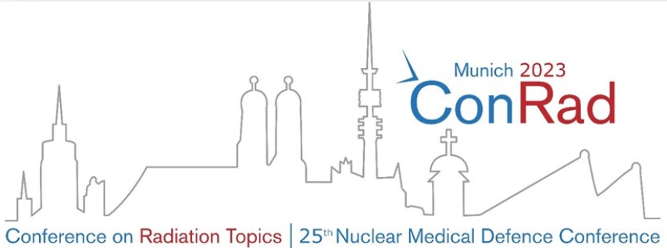
Internal contamination: Blocking and decorporating agents
Chelating agent
Chemical name | Ca- or Zn- Diethylene Triamine Penta Acetate, CaNa₃ DTPA : Ca DTPA, ZnNa₃ DTPA : Zn DTPA
EML 2021 | Not included
Indication | Decorporation of transuranium elements or other polyvalent cationic elements
Route of application | Typically intravenous infusion, inhalation (for decorporation of inhaled radionuclides) and topical application (for wound decontamination). Oral formulations have been studied but were shown to be insufficiently effective.
Dosing | 1 g daily for 5 days, 2-3 injections per week for 6 weeks followed by a break, total duration depending on the response
Shelf-life | 5 years for sterile product when stored at 15 – 30 °C
15

Slide 16
Internal contamination: Blocking and decorporating agents
Chelating agent
Chemical name | Aluminium phosphate, AlPO₄, sodium alginate
EML 2021 | Not included
Indication | Ingestion of radioactive Sr
Route of application | Oral
Dosing | 100 mL aluminium phosphate gel or 10 g sodium alginate
Shelf-life | Suspensions of aluminium phosphate: 3 years; suspension of alginate : 2 years
Chemical name | Sodium hydrogen carbonate, NaHCO₃
EML 2021 | Included for parental use in other indications
Indication | Internalization of radioactive U
Route of application | Intravenous infusion, oral
Dosing | Intravenous : max. 1.5 mmol/kg body weight per h; oral : 2 tablets (1.0 – 1.3 g) every 4h
Shelf-life | Intravenous: 2 years; tablets: 3 years
16

Slide 17
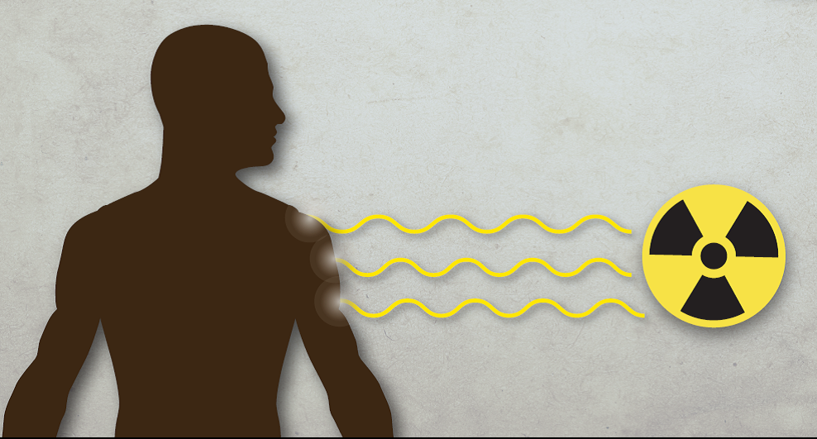
External exposure to ionizing radiation
Image credit: US CDC website

Slide 18
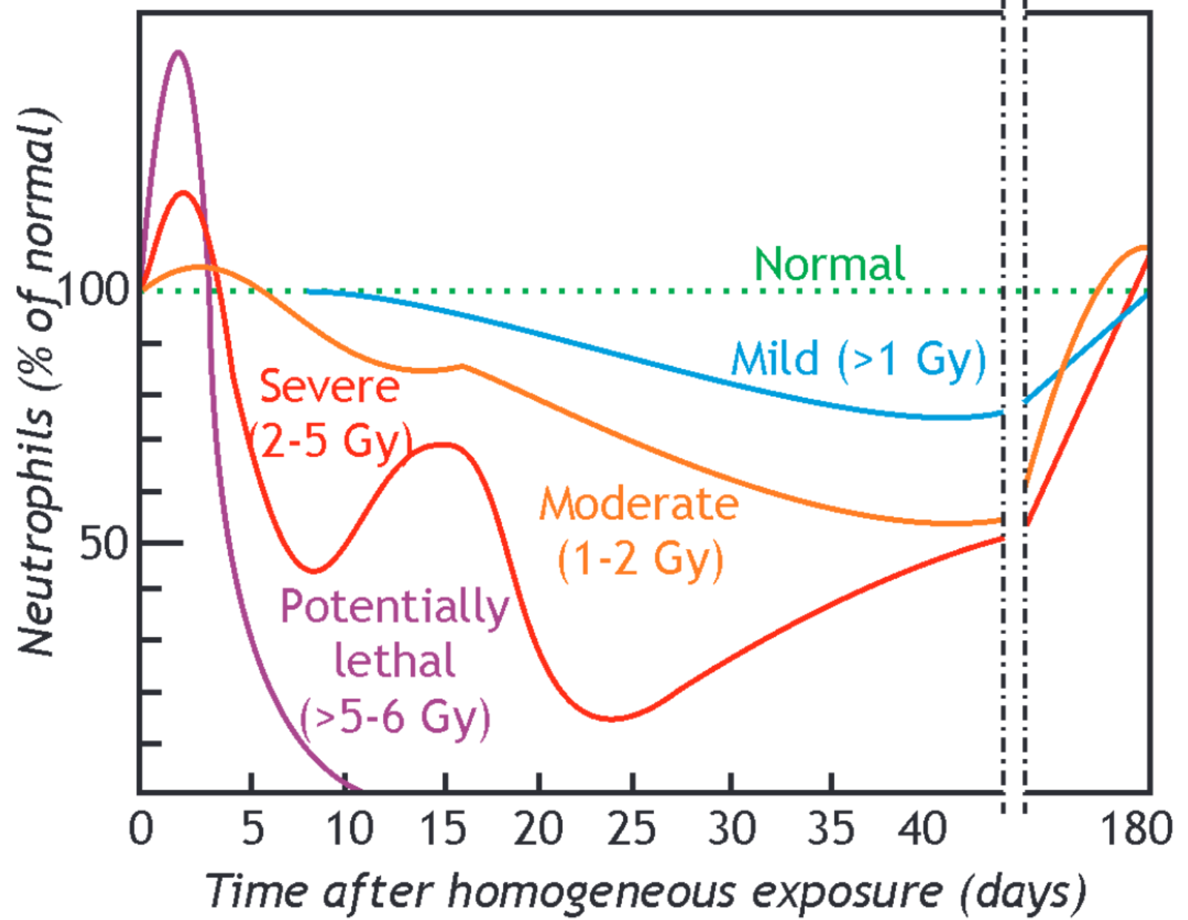
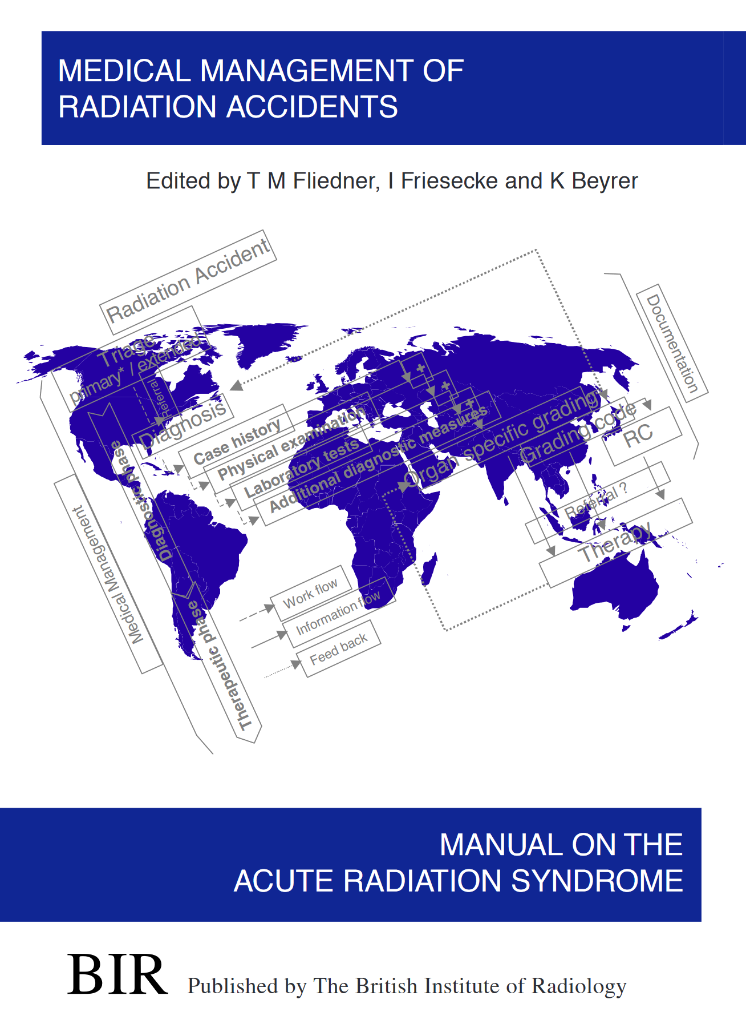
External exposure: management of acute radiation syndrome
Exposure to a high dose of ionizing radiation may result in a life-threatening condition
Acute Radiation Syndrome (ARS)
ARS manifestations (subsyndromes)
- hematopoietic
- gastrointestinal
(excluded cardiovascular and
neurological)
Fliedner TM, Friesecke I, Beyrer K. Medical Management of Radiation Accidents: Manual on the Acute Radiation Syndrome. (METREPOL)
published by Oxford: British Institute of Radiology; 2001)
https://www.ebmt.org/sites/default/files/2018-03/EBMT%20Nuclear
%20Accident%20Committee%20Pocket%20Guide%202017.pdf
18
Notes:
One of the most serious outcomes of the over-exposure to radiation is acute radiation syndrome (ARS),

Slide 19
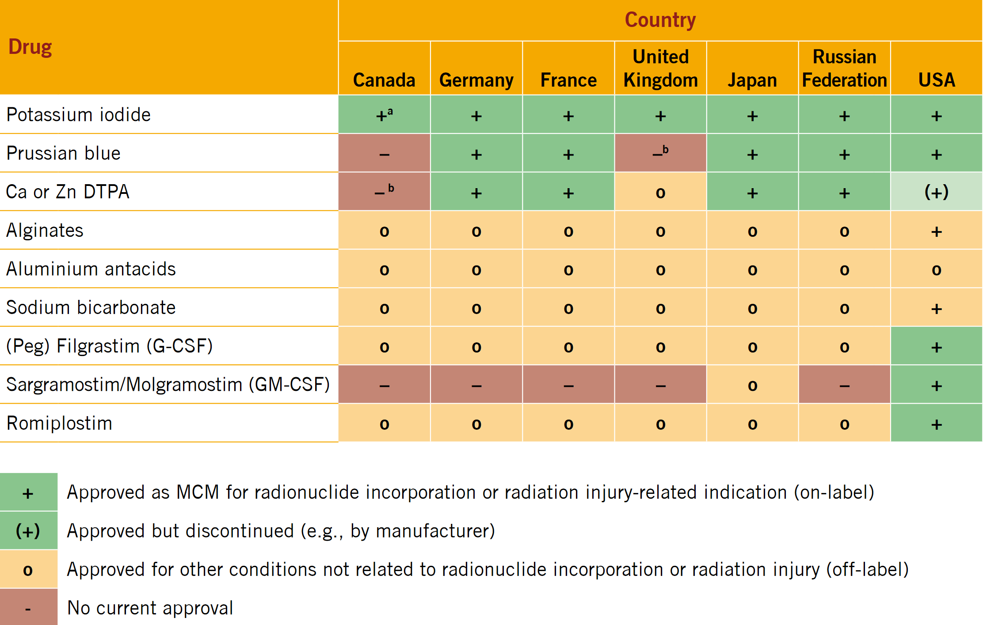
External exposure: management of acute radiation syndrome
Agents for the management of haematopoietic injury
Clinical evidence about the use of cytokines (in ARS) is limited. No clinical trials are available in humans regarding the treatment of ARS for obvious reasons.
Decision on inclusion of a specific agent (especially for cytokines) in the stockpile formulary was based on consensus of the working group experts and the outcome of peer review, including:
Evidence from
large animal studies (leading to approval
in 1 country)
Case reports from individual patients treatments
Data from use of the agent for other that ARS purposes, e.g., hematological patients and healthy volunteers
.
.
.
19
Notes:
Approval based on FDA animal rules in the USA

Slide 20
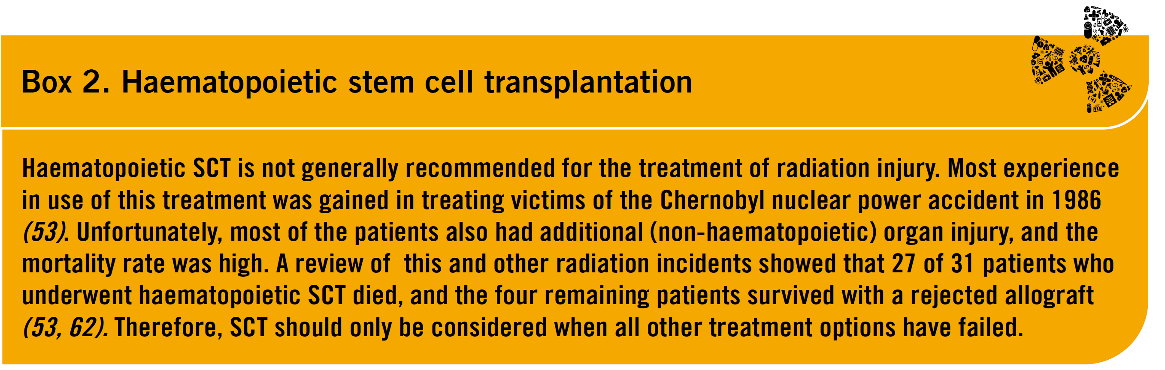
External exposure: management of acute radiation syndrome
Agents considered for the management of haematopoietic injury
growth factors (i.e., cytokines) targeting myeloid cells (granulocytes) (G-CSF) or granulocytes and macrophages (GM-CSF) enhance proliferation of progenitors, facilitate myeloid maturation, protect against apoptosis, and enhance cell function
one growth factor to mitigate thrombocytopenia (romiplostim)
one growth factor available to mitigate radiation-induced anaemia (although it is not approved for ARS)
certain pharmaceutical products used to treat other clinical conditions that are also used in ARS management
20
Notes:
Approval based on FDA animal rules in the USA

Slide 21
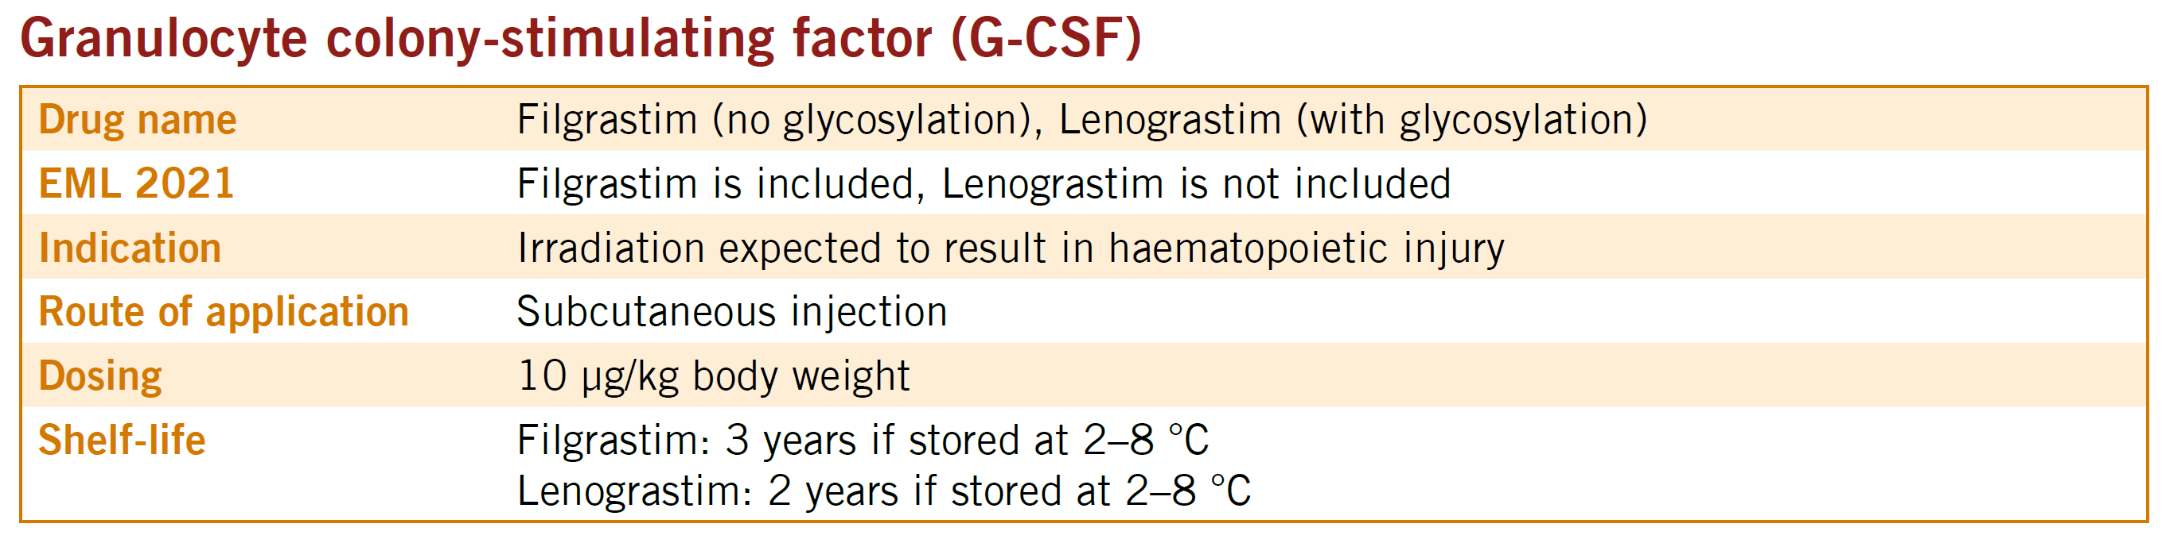
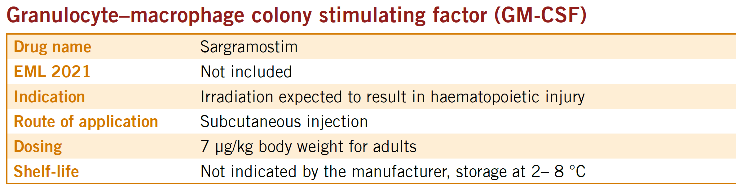
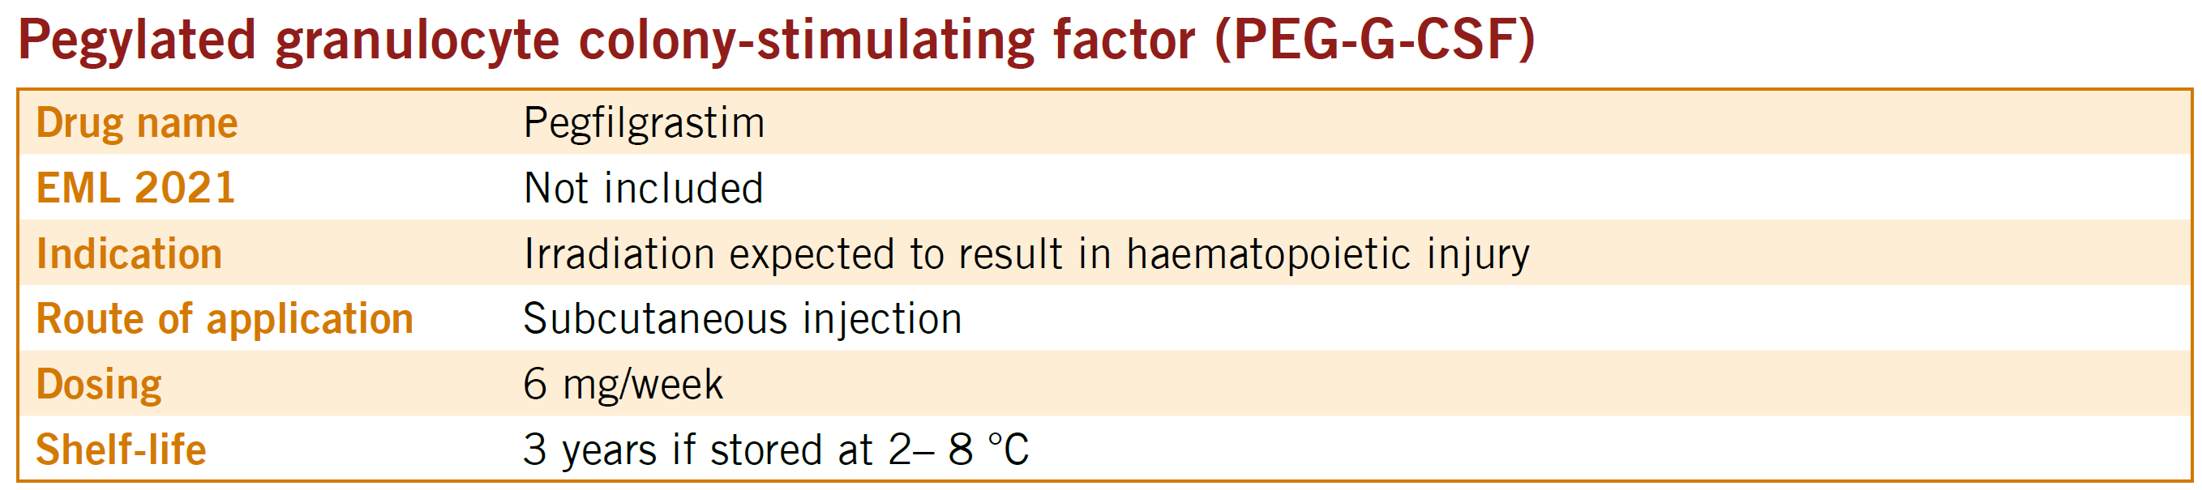
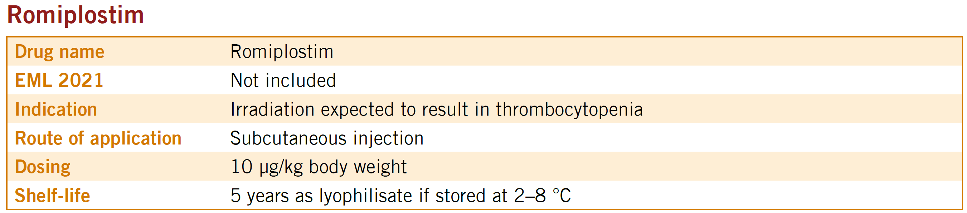
External exposure: management of acute radiation syndrome
Agents for the management of haematopoietic injury
once daily, as soon as possible after a suspected or confirmed radiation dose of > 2 Gy
huge experience in hematological and cancer patients, including healthy BM donors
once daily, as soon as possible after a suspected or confirmed
radiation dose of > 2 Gy
first dose is administered as soon as possible after suspected or confirmed exposure to > 2 Gy
second dose is administered 1 week after the first
huge experience in hematological and cancer patients, including healthy BM donors
single dose as soon as possible after a suspected or confirmed
radiation dose of > 2 Gy
21
Notes:
Approval based on FDA animal rules in the USA

Slide 22
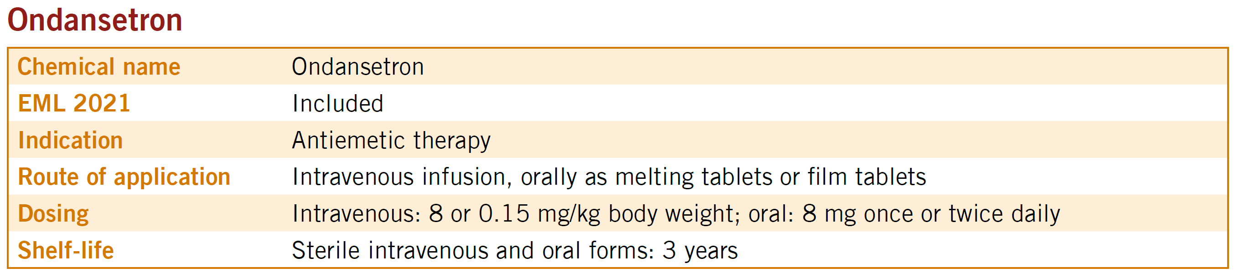
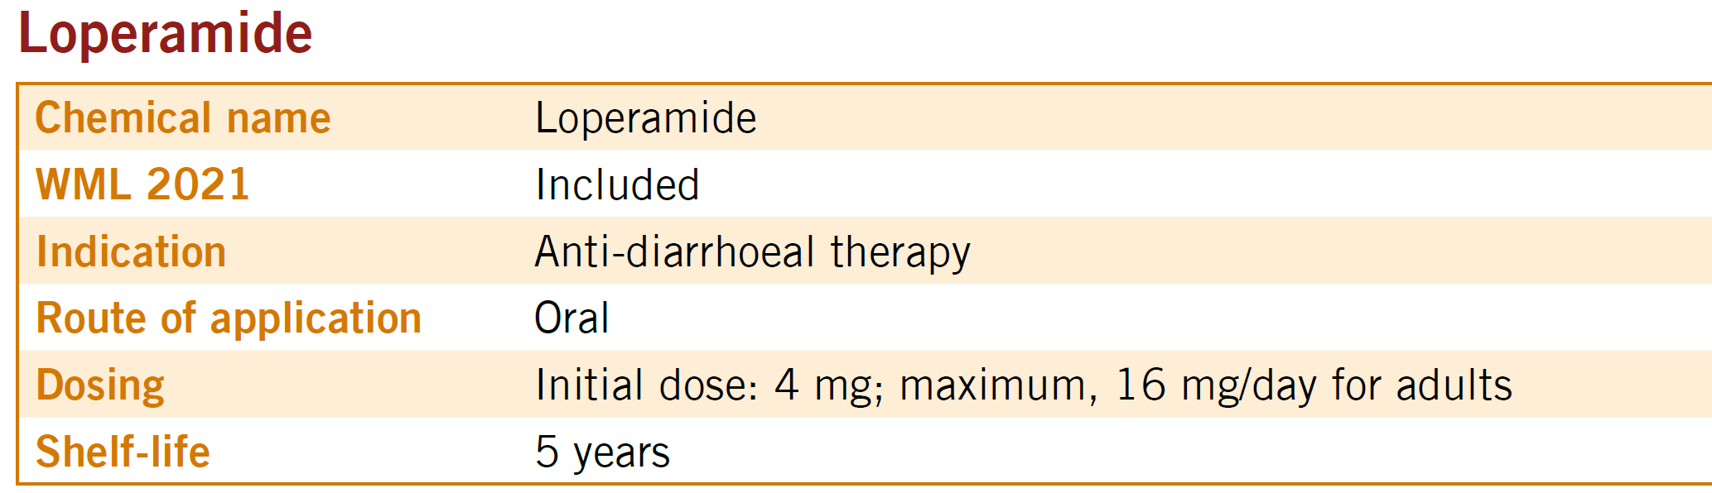
External exposure: management of acute radiation syndrome
Agents considered for management of gastrointestinal Injury
Whole-body exposure to ionizing radiation at doses ≥ 5 Gy induces breakdown of the GI barrier/tract leading to
severe secretory diarrhoea and dehydration
electrolyte imbalance
invasion of enteric bacteria into the blood circulation
Today, there are no specific therapeutics approved by regulatory bodies for treatment of GI radiation injury. Symptomatic treatment is limited to fluids and electrolytes, antiemetic compounds, anti-diarrhoeal drugs and antimicrobial agents
22
Notes:
Approval based on FDA animal rules in the USA

Slide 23
External exposure: management of acute radiation syndrome
Acute Radiation Syndrome is not a sum of isolated subsyndromes
No successful treatment was shown in patients with ARS on treatment with single agents only.
A combined effort including hospitalization at intensive care (with availability of laminar flow rooms) is necessary for a successful implementation of this stockpile.
This includes non-radiation specific drugs need to be stockpiled including
antibiotics
antifungals
Antivirals
… and access to blood products.
23
Notes:
Approval based on FDA animal rules in the USA

Slide 24


Slide 25
Stockpile Governance and Management
National emergency management plan should provide basis for SNS use
- National risk profile, assumptions and modeling results
- National preparedness capabilities and capacity
Legal aspects of SNS management
- Legislation on procurement (approval of medical products/devices)
Decision-making protocols for releasing the SNS elements in emergency
- Criteria for prioritizing allocation and distribution of the medical products
Communication strategy
- Timelines and priorities for access
25

Slide 26
Stockpile Governance and Management
Roles and Responsibilities:
National stakeholders (health authorities, emergency response agencies, healthcare facilities, pharmaceutical suppliers etc)
International organizations (WHO, IAEA, regional partners e.g. European Commission
Neighboring countries through bilateral arrangements
Concept of Operations for a SNS:
Setting up the stockpile (scoping and sizing, procurement, storage)
Managing the stockpile (inventory, protocols for deployment, integration into the overall response plans, refill)
Staffing and training
26

Slide 27

Stockpile Governance and Management
Approaches to Managing a National Stockpile
A physical inventory
- Warehouse-stored inventories
- Vendor-managed inventories
- User-managed inventory (“stock bubble”)
Virtual inventory
Short-term loan
27

Slide 28
Stockpile Governance and Management
Resource Commitment and Management
Substantial initial cost
- Purchase of pharmaceuticals, supplies, equipment
- Other cost
Sustainable finance and human resources
- Replenishment after use and stockpile rotation
- Maintenance of facilities and expertise
Reliable and sustainable sources of supplies
- Purchase agreement, assistance during an emergency, contingency plans
28

Slide 29


Slide 30
R & D for Medical Countermeasures
Investigational Therapies to watch
HOPO - Experimental oral drug that seems promising for an effective and safe decorporating agent for actinides and more potent than DTPAs (decorporates Pu & Am when given 5 days post-exposure)
Lung Surfactant - under consideration for radiation-induced lung injuries (used for treatment of premature infants with respiratory distress syndrome), preserves lung function and improves survival in irradiated animals
Angiotensin Converting Enzyme (ACE) Inhibitors (Lisinopril, Captopril, Enalapril, Fosinopril widely used for hypertension, heart failure, and other clinical conditions) show increased survival in rodents when dosed weeks post-irradiation, clinical trial showed reduced kidney and lung injuries in irradiated patients
Erythropoietin (EPO) Stimulating Agents used for treatment of anemia associated with chronic renal failure and conditions, used off-label in radiation accident patients by promoting recovery of red blood cell production post-irradiation. In rodent studies showed a radiation survival benefit
Mesenchymal Stromal Cells (MSCs) - innovative strategy for radiation skin burns combining classical surgery/skin grafts with local MSCs – used successfully in a limited number of patients
30

Slide 31
Thank you!
CarrZ@who.int

