Slide 1
Radiation Protection in Military Conflicts: Lessons from Ukraine
Katarzyna Siegien PhD, Senior Adviser
NERIS Workshop 2024 Monday 11th November 2024, Rome, Italy Aurelia Congress Center, VEGA Room

Slide 2
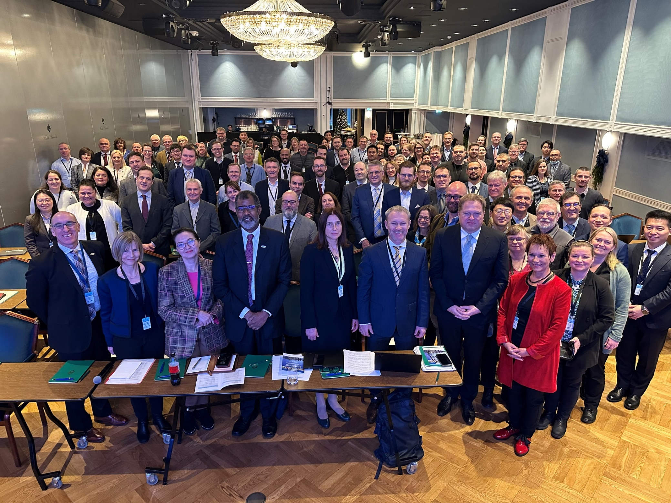
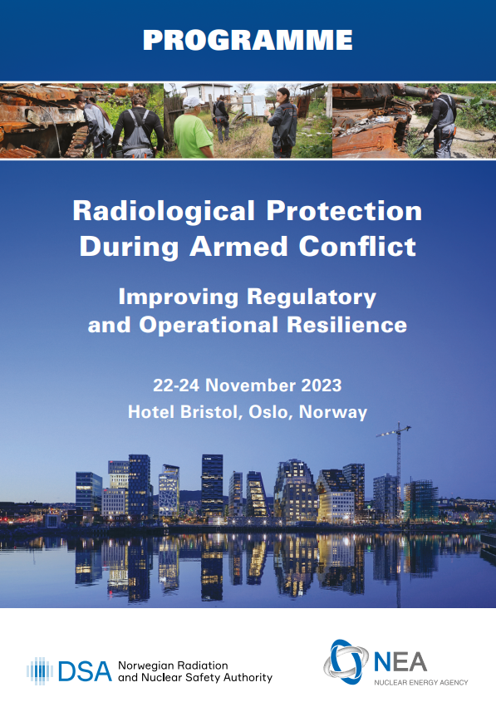
DSA-NEA Workshop on RP during armed conflict, Nov 2023, Oslo, Norway
  A Workshop co-organised by the Norwegian Radiation and Nuclear Safety Authority (DSA) and the Nuclear Energy Agency, in cooperation with the Ukrainian Nuclear Safety Authority (SNRIU).
  130 experts from 28 countries, NGOs and international bodies (NEA, European Union, HERCA, IAEA, ILO, WANO, and WHO) explored how, during armed conflict:
    (1) to maintain and enhance the capability and capacity to monitor, analyse and manage radiological protection and public health;
    (2) to anticipate consequences on the implementation of radiological protection regulation and practices.
    The workshop is comprehensively documented in an NEA/DSA joint publication

Slide 3
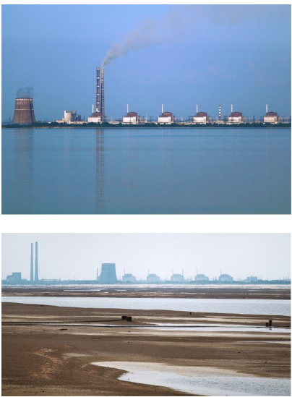
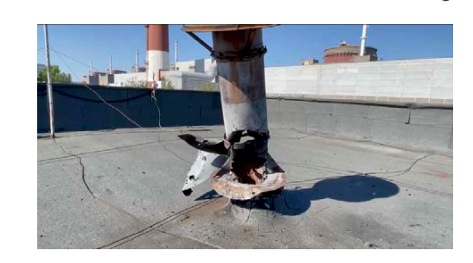
RP during war in Ukraine
Adverse Impact on Nuclear Facilities:
  Occupations, bombings, and theft of radioactive sources
  Disruptive events impacting day-to-day operations, transportation, and waste management
Challenging Circumstances:
  A lack of equipment and human resources
  Workers, families, and the entire population experience significant stress
  Healthcare system undermined
Insights from Ukraine:
  Improved understanding of the reality on the ground during armed conflicts.
  Enhanced resilience within RP and nuclear safety frameworks.
Main challenges for regulatory body:
  Communication Breakdowns
  Direct Attacks, Infrastructure Damage
  Information Delays and Errors
  Restricted Access to Facilities, Physical Barriers, Logistical Challenges
  Targeting of Regulatory Infrastructure
  Cyber Threats
Before and after destruction of Khakovka dam
220 mm Uragan rocket on the ZNPP building
Notes:
The military aggression in Ukraine has directly threatened nuclear facilities, with instances such as the occupation of the Zaporizhzhya Nuclear Power Plant (ZNPP) and Chernobyl Exclusion Zone.
Risks/threats to radiation protection from direct damage to nuclear facilities during military conflict:
Radiation Leaks and Contamination
Loss of Critical Cooling and Containment Systems
Disruption of Safety and Monitoring Systems
Compromised Radiation Shielding
Spread of Radioactive Materials
Sabotage Leading to Intentional Releases
The SNRIU has faced substantial hurdles, with staff unable to perform regular duties such as onsite inspections and routine surveillance, especially in occupied regions. This has necessitated a shift towards regulatory oversight through information analysis rather than physical inspections.
Adapting to these challenges, SNRIU implemented special regulatory measures, such as temporarily suspending certain licenses and transitioning to regulatory supervision through information analysis.
This approach reflects a broader necessity to adapt regulatory frameworks to the realities of armed conflict, where traditional regulatory practices may not be feasible.
The ability of nuclear regulatory bodies to adapt to the disruptions caused by armed conflict is crucial for maintaining nuclear safety and protecting public health and the environment.
By enhancing communication systems, modifying operational protocols, decentralizing functions, forging international partnerships, and adjusting legal frameworks, regulatory agencies can effectively manage the increased risks and challenges posed by such extreme scenarios.

Slide 4
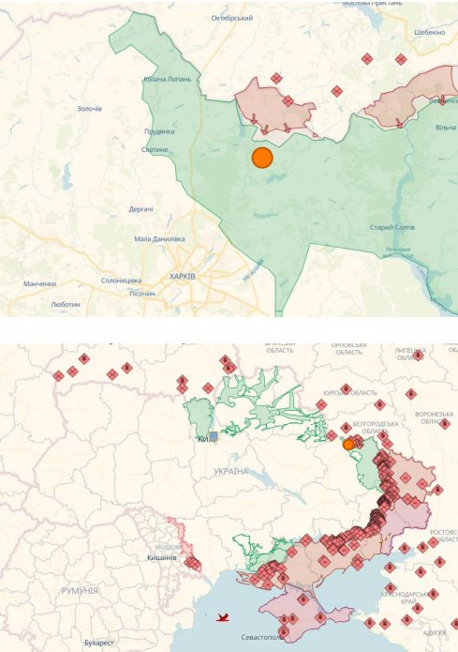
RP during war in neighbouring countries
War weakens nuclear and radiological safety in various ways
How to be better prepared for similar situations and address hostile actions.
No country has fully developed specific regulatory and operational provisions for nuclear safety and RP for their civilian nuclear facilities in case of war.
  Some countries have started implementing frameworks to address challenges.
  Routine operations at nuclear facilities and emergency plans may need to be adapted considering the potential of armed conflict.

Slide 5
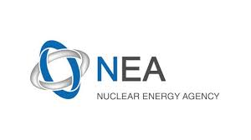

Key take-aways
Importance of the system's adaptability:
  To make regulatory frameworks more flexible and capable of rapidly implementing new operational RP plans and procedures during armed conflict
  Useful to update national regulatory assessments for emerging threats
Essential to foster international collaboration and knowledge sharing, including learning from each other’s experiences and best practices and integrating them into national frameworks.
The conflict underscores the critical role of international assistance and collaboration in maintaining nuclear safety.
This international aid is not only crucial for immediate safety needs but also for rebuilding and strengthening the regulatory infrastructure post-conflict.
Notes:
Forms of international assistance:
Provision of Equipment and Technology
Advanced Monitoring Systems
Radiation Protection Gear
Expertise and Technical Support
Training and Capacity Building
Consultative Support
Regulatory Development and Legal Assistance
Framework Enhancement
Legal Expertise
Challenges for international collaboration and assistance:
Coordination Efficiency
Ensuring effective coordination among various international bodies to avoid duplication of efforts and to streamline the delivery of assistance.
Establishing clear communication channels and protocols to ensure that all parties are consistently informed and aligned in their efforts.
Cultural and Operational Alignment
Addressing potential cultural and operational differences that might affect the implementation of international advice and equipment. Tailoring support to fit the local context is crucial for its effectiveness.
Sustainability and Long-Term Integration
Focusing on building local capacity rather than just providing temporary solutions. This involves training local personnel, transferring knowledge, and integrating international best practices into local operations permanently.

Slide 6



Actionable recommendations
Area 1- Strengthen international cooperation and reinforce international conventions
Strengthen international/bilateral cooperation to address radiation and nuclear challenges within Ukraine.
Establish such cooperation to enhance preparedness and response in friendly neighbouring countries.
Consider an international/multilateral framework to coordinate activities on the provision of assistance (expertise, human and financial resources), on procurement of specialised equipment and other matters (including post-conflict recovery).
Establish a small task force or team of representatives from key organisations (development of effective networks).
This task force would reflect on the learning and actions which could then be considered for implementation at an international level.
Review and enhance conventions (and/or guidance on their application) to explicitly exclude nuclear installations from being targeted in attacks (e.g. by granting nuclear facilities special status beyond normal infrastructure during armed conflict, establishing exclusion zones around facilities) – although ruled out by aggressors, it could provide a basis for holding them accountable post-conflict. Cooperation protocols could then be scaled toward developing global decisions on how to act together to address nuclear facility risks into the future, essential in achieving a collective commitment for global security.

Slide 7


Actionable recommendations
Area 2- Build and maintain resilience nationally and beyond through flexible regulatory frameworks
Build on information sharing mechanisms:
  to strengthen networks among regulators for different sectors and develop national resilience when facing radiation threats combined with other threats;
  to establish protocols for mutual cooperation among all organisations that are able to support swift mobilisation of (human and logistics) resources during armed conflict;
  to support an holistic dialogue: between different regulatory bodies in various areas of responsibility and safety issues, but also health and welfare services; and with the military on how risks near major facilities can best be managed.
Build more flexibility into regulatory frameworks to allow for adaptive decision-making and prioritisation rather than trying to change regulations in urgent situations
A vigorous safety culture within and among the operators, TSOs, regulators and other organisations well in advance of armed conflict is key to support safe operations during times of limited and/or intermittent regulatory inspections and oversight, information accessibility challenges, human capacity deficiencies, etc.
Integrate radiological protection within the overall resilience system. Relevant international organisations, including the NEA, are encouraged to prepare guidance for regulators.

Slide 8




Actionable recommendations
Area 3- Develop practical guidance for RP while the RP principles and policy framework apply
Better understand what application of RP principles means in practice and how to improve the practicability of RP to ensure an appropriate level of protection.
Revisit the justification process to recognise additional threats during armed conflict (e.g. missiles, mines) that could require prioritisation to be made on a case-specific basis.
Adapt regulatory frameworks to make decisions considering other risks, while adhering to the principles in place (justification and optimisation) which guide the application of the international RP system when deciding protective actions.
Consider war scenarios within the ICRP system, as a country at war has not yet been considered. A war scenario could have important implications for the application of the concept of justification and selection of reference levels.
Address the challenge of a cascade of crises occurring simultaneously during armed conflict, making optimisation very difficult and complex.

Slide 9




Actionable recommendations
Area 4- Adopt an All-hazards approach, broaden dialogue between civil and military authorities for EPR
Engage in dialogue with authorities responsible for safety in other fields, including military authorities, in addition to RP and nuclear safety communities.
Establish communication networks for the decision process to gain insights on how to operate within the objectives of military actions. Sharing the experience of different countries could be an important first step.
Adopt a holistic view so that the focus is not solely on RP, but also security and other threats, i.e. all-hazards approach. This includes threats associated with the availability of reliable information, how to make decisions in the absence of data, establishing reliable and direct contact points for trustworthy exchange of information, ensuring security of communication channels.
Enhance EPR analysis with release scenarios including war scenarios for nuclear installations but also for high-risk radiation installations (e.g. waste storage facilities, industrial irradiators, hospitals).
Consider building defense and mitigation capacities and capabilities. A first step for countries could be sharing of scenarios already available within national EPR programmes.
Adjust protective actions during armed conflict and disruptive scenarios.
Strive for balance between different hazards and risks (e.g. advice to shelter from shelling may conflict with advice to evacuate due to radiation emergency).

Slide 10



Actionable recommendations
Area 5- Stakeholder engagement, critical aspects of information, communication and trust
Practice communication of information to those who need it, especially during emergency situations when electricity supplies and communication channels may be disrupted.
Conduct exercises to improve coordination and develop most effective communication channels
Leverage social scientists to address issues related to reliability, misinformation, and fake news during conflict situations. Their expertise can facilitate effective communication in emergencies.
Engage civil society actively to build trust. Proactively implement trust-building initiatives well before conflict situations arise between operators, regulators, other stakeholders and the public in general

Slide 11
List of potential activities- CRPPH/WPNEP
Organise exchanges/forum where situational awareness is shared between countries and inside countries (including populations):
  close and continuing dialogue with all stakeholders concerned (possibly including interactions between civilian and military) at local, national, international levels; strengthen cooperation/collaboration for better coordination
  Promote citizen participation and stakeholder involvement in armed conflict situation including involvement of NGOs, civil societies in assessment and management of the radiological situation; Public and media interactions with national authorities including the regulators
Develop methodologies and strategies for regular review of regulatory assessment
  The review may address roles, functions, responsibilities defined in regulation. It could be informed by gaps analysis and impact/risk assessment of a wider spectrum of threats to enhance preparedness, response capabilities and organisational/operational resilience (ie mitigate risks/impacts from those threats) (this topic could be investigated with other NEA Standing committees notably CNRA and CSNI)
Investigate how to introduce flexibility in the operational application of the current regulation to better cope with the specific situation of armed conflict (this topic could be investigated with other NEA Standing committees notably CNRA and CSNI).
  Among the topics to address are: e.g. the selection of appropriate radiological Reference Levels, the management of inspection and licensing process; environmental data sharing and secured channel for information access, and secure communication procedures

Slide 12
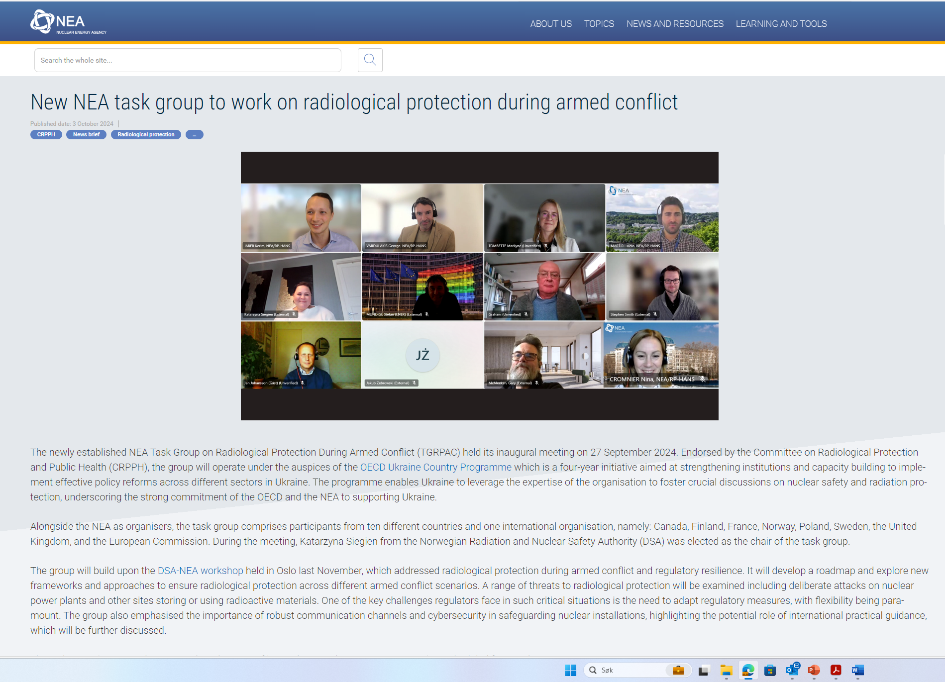
NEA Task Group on Radiological Protection During Armed Conflict
Key (draft) Objectives for the Comprehensive Risk Assessment
Development of Recommendations for Adaptable Regulatory Frameworks
Integration of Physical and Cybersecurity into Radiological Protection
Enhancement of Radiological Monitoring and Public Health Protocols
Strengthening International Collaboration and Legal Compliance
Protection of Information and Cybersecurity.
Public communication

Slide 13
Future Directions
Based on the experiences in Ukraine, several key recommendations emerge for the international community:
Strengthening International Laws: There is a need to enhance international laws and conventions to protect nuclear facilities during conflicts explicitly.
Building Resilience: Developing more resilient regulatory frameworks that can adapt to the disruptions caused by armed conflict is crucial.
Fostering International Cooperation: Enhanced international cooperation is necessary to ensure that countries can quickly mobilize support and share best practices in nuclear safety and radiological protection.
Incorporating Adaptability in Regulatory Practices: Regulatory practices must be flexible enough to respond to the dynamic challenges posed by military conflicts, including the potential for rapid escalation and widespread impact.
Notes:
Key Recommendations and Future Directions
The complex challenges faced by Ukraine in safeguarding its nuclear facilities during an armed conflict offer vital lessons for the global community. These experiences underline the necessity for robust, adaptable, and cooperative approaches to ensure nuclear safety in conflict zones. Here are expanded recommendations based on these insights:
1. Robust International Frameworks
The experience in Ukraine illustrates the need for stronger international legal frameworks to protect nuclear facilities during conflicts. Current international laws could be enhanced to include explicit provisions that:
Prohibit the targeting of nuclear facilities, recognizing them as critical infrastructure with potential catastrophic risk.
Establish clear punitive measures for violations to deter aggressive actions against nuclear installations.
Develop protocols for rapid international response and support when nuclear safety is compromised in conflict zones.
2. Resilience in Regulatory Frameworks
Regulatory frameworks must be dynamic, capable of adapting to the extreme and rapidly changing conditions that arise during conflicts. Recommendations for enhancing regulatory resilience include:
Incorporating flexibility in regulatory requirements to allow for emergency measures that can be swiftly implemented without compromising safety.
Developing guidelines for contingency planning specifically tailored for scenarios involving armed conflict, including provisions for maintaining critical safety operations under varied threat levels.
Encouraging regular stress tests of regulatory systems under simulated conflict conditions to identify vulnerabilities and improve response strategies.
3. Global Cooperation Enhancements
The need for international collaboration becomes even more critical in times of conflict, especially when nuclear safety is at risk. Enhancing global cooperation involves:
Establishing a dedicated international task force that can mobilize quickly to provide technical and logistical support to nuclear facilities in conflict zones.
Creating a global registry of expert resources and technical equipment that can be accessed on short notice by countries under threat.
Strengthening ties between international nuclear safety organizations and regional defense alliances to ensure coordinated responses to threats against nuclear installations.
4. Flexible Regulatory Practices
Adaptable regulatory practices are essential for maintaining nuclear safety during unforeseen and rapidly unfolding events. These practices might include:
Simplifying and expediting the process for emergency regulatory approvals when immediate action is needed to safeguard nuclear facilities.
Allowing for temporary modifications to standard operating procedures that prioritize immediate risk reduction.
Implementing provisional licenses that permit critical operations under modified conditions with stringent oversight to ensure continued safety.
5. Comprehensive Crisis Management Planning
Effective crisis management planning that encompasses both civilian and military considerations is vital. This involves:
Integrating nuclear safety considerations into national defense and military planning to avoid unintended escalations in nuclear risk during military operations.
Developing communication protocols that ensure quick and accurate information sharing between nuclear operators and military commanders during crises.
Training for nuclear facility staff on crisis management in a conflict setting, including drills that simulate the conditions of a military conflict impacting nuclear operations.
6. Enhancement of Cybersecurity Measures
Given the increasing threat of cyber-attacks on critical infrastructure, including nuclear facilities, bolstering cybersecurity measures is imperative:
Implementing state-of-the-art cybersecurity technologies to protect control systems of nuclear facilities from unauthorized access and sabotage.
Conducting regular cybersecurity drills to prepare for and effectively respond to cyber threats during conflicts.
Establishing international collaborations to share intelligence about potential cyber threats and coordinate responses to cyber incidents affecting nuclear safety.
Conclusion
The challenges faced in Ukraine provide a clear mandate for the international community to rethink and reinforce strategies for protecting nuclear facilities during conflicts. These expanded recommendations aim to foster a more resilient, cooperative, and prepared international approach to nuclear safety, ensuring that nuclear facilities remain secure even in the face of geopolitical instability.

Slide 14
Conclusions
Importance of Radiation Protection:
  Ensuring effective radiation protection measures to safeguard public health and the environment.
  Proactive steps to address radiation protection, including training and support to local regulatory bodies.
International Collaboration:
  Vital role of international organizations in supporting Ukraine’s nuclear safety.
  Strengthening global nuclear safety frameworks through collaboration.
  No practical international guidance found on managing and regulating radiological protection (RP) and nuclear safety during armed conflict.
  Potential collaboration through organizations like NEA-OECD TGRPAC.
Notes:
Conclusion
The conflict in Ukraine serves as a stark reminder of the complex interplay between military activities and nuclear safety. The lessons learned here are vital for shaping future strategies not only for Ukraine but also for any nation with significant nuclear infrastructure that could face similar risks. Ensuring the safety of nuclear installations and the effective management of radiological risks in conflict zones remains a paramount concern that requires ongoing attention, innovation, and international collaboration.

Slide 15
Thank you.
Katarzyna.siegien@dsa.no

