Slide 1


Resilience to radiation emergencies in war or armed conflict situations
C. Turcanu, Y. Tomkiv, R. Geysmans, A. Nagy
NERIS workshop 11/11/2024

Slide 2
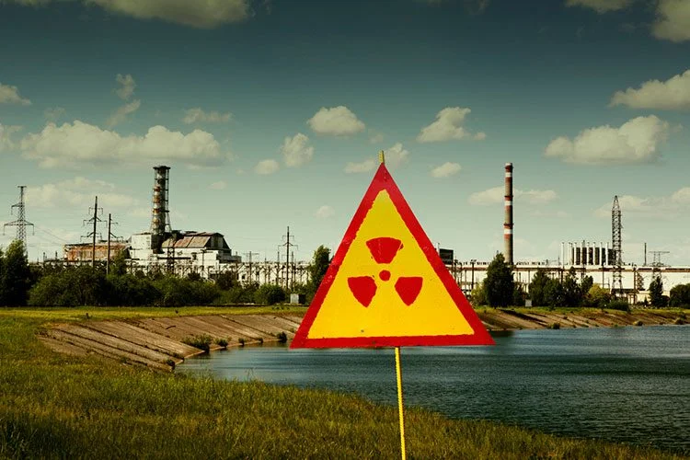
How to
characterise,
assess and
enhance resilience
to radiation emergencies in armed conflicts situations?
Notes:
14 partners 10 countries

Slide 3



How can we characterize resilience to radiation emergencies in armed conflict situations?
Case studies
(first responders, authorities, NGOs, local communities) : Ukraine, Czechia, Balkans, Japan
Training capacities
Framework(s) for resilience in:
- disaster management
- nuclear EPR&R
- war situations
+ ongoing experience from Ukraine
O. Pareniuk and colleagues (INSPP)
Stakeholders’ feedback
Notes:
We want to caracterise relisience through the interaction between biblio on resilie, case study and stakeholder feedback
En particulier l’utilisation de cas d’étude sur lequel nous voudrions insister dans cette communication car cela est plus susceptible d’intéresser le réseau share

Slide 4
What is resilience?
“Transformative process of strengthening the capacity of [individuals], communities, institutions, and countries to resist, absorb, accommodate, adapt to, transform, and recover from the effects of [a radiation emergency] in a timely and efficient manner in the aftermath of shocks, stresses and change.”
UN office for Disaster Risk Reduction
UNDP(2014) https://www.preventionweb.net/publication/disaster-resilience-measurements-stocktaking-ongoing-efforts-developing-systems

Slide 5
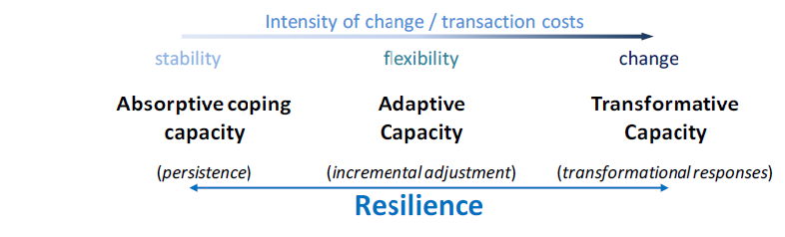
Resilience capacities
UNIT OF ANALYSIS
Individuals
Households
Communities
Systems/states
UNDP(2014)
Notes:
Capacities:
- cope and absorb the effects of known stresses (absorptive capacities);
- make incremental adjustments in anticipation of or in response to change (adaptive capacities);
- change the system to address the structural or root causes of risk (transformative capacities).
Different units of analysis

Slide 6
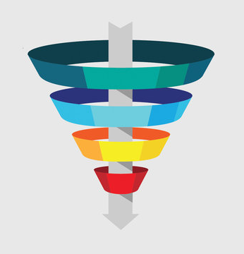
Literature on disaster resilience
  Increased focus in latest years
    7,614 results from Web of Science on “disaster resilience” or “community resilience” (search in March 2024)
      5,700 since 2018 !!
      3,355 with resilience in keywords
        46 highly cited
        232 reviews
        54 refer to “war”
        21 contain “nuclear”
  Grey literature, e.g. (UN, FEMA, ..)
Focus on “community resilience” AND (“war” OR “armed conflict*”)
More comprehensive review for nuclear: “resilience” AND (“emergency” OR “accident”)
Ongoing experience from Ukraine
Scoping review for “resilience” in general

Slide 7
Data extraction
Focus of resilience
Definition
Dimensions, criteria, indicators
Vulnerable groups
Ways to enhance resilience

Slide 8


Which elements of resilience are being assessed?
well-being
vulnerability
resilience capacities
disaster-related shocks, losses and stress
reaction to, and recovery from disasters
Notes:
Wellbeing- development indicators, e.g. related to livelihoods, economic situation, human capital, nutrition ; prior and after the disaster
Vulnerability: how exposed people are to disasters (=exposure) and how likely it is that they get harmed (=susceptibility).
Reaction and recovery: ex-post assessment, e.g. in terms of restoring infrastructure, housing, livelihoods, and social structures

Slide 9
Resilience focus
Individual resilience (e.g. citizens, medical staff)
Community resilience
NPP resilience
EPR&R (system) resilience
National resilience

Slide 10
Individual resilience
Nuclear: focus on psychological resilience (maintain or regain mental health and wellbeing, adaptation)
  Strong agency and responsibility on individuals
  → need to broaden
War literature: broader conceptualisations: e.g. “positive trajectory of adaptation” ; maintain “positive functioning or competence’ (Kimhi et al., 2012), but also global mental health, advocacy, women’s rights (e.g. Veronese et al 2021)
Influencing factors (e.g. Veronese et al 2021; Eshel et al 2017), among others:
  Human Security (feeling safe, psychophysical health); exposure to terror, (memories of) past experiences
  Family Ties (nuclear and extended)
  Psychosocial Resources (friendships, community protection, social support, sense of coherence, social integration, trust in political and public institutions, )
  Individual Resources (sense of purpose, spirituality, education, work, activism and civic engagement, humor)
  Motherhood (protection of children, maternal agency)
  Patriotism
Notes:
despite high-risk status, chronic stress, or following prolonged or severe trauma

Slide 11
Ways to enhance individual resilience (examples)
Educational and culturally-sensitive interventions (also communities where exposure is anticipated)
Interventions focused on promotion of mental health (cf. WHO, 2020; OECD-NEA, 2024)
Community- and school-based programs promoting belongingness and collective efficacy
Mindfulness and narrative interventions
Urban green space for promoting quality of life and resilience
Strengths-based approaches in healthcare screening procedures (screening for assets and resources in addition to risk factors)
Women's’ rights, freedom, and advocacy

Slide 12
Individual and community resilience are connected
Individual resilience is influenced by interactions with the social and political environments (Sousa et al., 2013)
Perceived community resilience as predictor for individual resilience (e.g. Eshel et al 2017)
“Resilience portfolio”: process of positive adaptation which uses individual, family, and community strengths (Kelmendi and Hamby, 2023).

Slide 13
Community Resilience
Nuclear: strongly connected with (post-Fukushima) reconstruction and recovery
  Focus on positive trajectory of adaptation
  Key role of NGOs and NPOs to support a high level of citizens’ participation (e.g. Vlachopoulou & Mizuta, 2018)
  Need to critically reflect on the objectives of resilience: bouncing back, bouncing forward, or transformative resilience?
  Sustainable development should be at the core of resilience building efforts
  Need for reliable and actionable information
  Integrating volunteers in EPR&R efforts (e.g. Raisio et al., 2023)
War context
  Broader context: humanitarian aid, cultural resilience, harnessing resources to sustain well-being
  Highlights the key role of social capital, alongside human, political, …
  Building on and strengthening community assets (e.g. library model) (Antczak & Gruszka 2023)
  Dimensions: place attachment, collective efficacy, preparedness, economic stability, social cohesion
Notes:
Preparedness vs crisis?

Slide 14








Baseline for community resilience
Social
Networks & connections
Social processes
Embededness
Trust
Civic engagement
Civic and social organisations
Political
Community engagement
Leadership, political power
Governance, Social inequalities
Institutional resources (first response bodies, (local) EPR&R plans, participation in disaster reduction plans, response systems)
Access to specific resources facilitating protection, e.g. car, smartphone, iodine tablets, communication,..
Physical
Critical infrastructures
Logistic transport routes
Housing, habitat
Communication systems
Technical (early warning systems)
Cultural
Norms
Perceptions and beliefs
Language
Religious affiliation
Human
Knowledge & skills
Health and wellbeing
Education
Age
Disabilities, long term care
Marital status, single parenting
Healthcare capacities
Health insurance
Access to critical services
Environmental
Environmental protection
Ecological resources
Agricultural land and practices
Land use
Economic
Household income, income inequalities
Diversity of economic activity
Poverty level
Unemployment rate (total and women)
Material insurance
Cutter et al, 2008; FEMA 2022; a.o.
Notes:
All these elements require reflection: how do these play a role for rad emergencies in war situations

Slide 15
Ways to enhance community resilience (selected)
Collective action for problem-solving
Voluntary associations, religious organizations, nonprofit organizations, access to advocacy groups
Collaborative and contextually sensitive approaches
Communication of knowledge relating to resilience practices
Sharing of responsibilities
Incorporating multi-actor perspectives and empower local actors, while providing centralized processes for detecting misalignments
Mobilising resources, e.g. integrate refugees into local services
Stimulating learning for local actors; capture and share local experiences
Enhancing community support systems and connectedness (formal and informal)
Economic diversification
Adaptive management practices
Notes:
Mobilise resources: … thereby, transforming how resources were mobilized and establishing new funding channels
Stimulate learning for local actors to improve skills in information evaluation and dissemination,

Slide 16
4 key elements to consider when promoting resilience frameworks
(after Davoudi et al 2012)
RESPONSIBILITIES
The capacity of communities to adapt and re-organise is not a substitute for responsive and accountable governance
PURPOSE
The purpose of resilience policies and the desired alternative outcome should be the result of critical and inclusive reflection
BOUNDARIES
The scope of resilience is not value-free as it determines what is included and what is excluded from the analysis
POWER DYNAMICS
Any process of resilience building needs to consider power dynamics, justice and fairness
Full reference on the last slide
Notes:
Tensions between different levels of resilience (Yamashita, S., & Takamura, N. 2015)
Man-made disasters have a stronger negative impact on community bonds (Ohto et al 2017)
Responsibilisation of individuals (Coaffee 2023, Wada et al 2022)
“Contemporary community resilience campaigns are different and are aimed at everyone as part of their supposed moral duty as a responsible citizen.”
Promotion of «social acceptability» of certain risks (Kojima 2023)
Pushing people to accept undesirable outcomes?
Acceptance of discomforts in the life after disaster (Kobayashi et al 2022
lies in the scope of resilience: are there also limits to resilience?
Wie decides what
Reinforcement of inequalities: those who already have more resources have capacity to participate in interventions that increase their individual resilience (Raisio et al 2023)
The extent of citizen participation in decisions on resilience interventions (Vlachopoulou, E. I., & Mizuta, D. D. 2018)
How is resilience framed and by whom? (Wada et al 2022, Ribault 2019)
resilience is and when a community is resilient enough?

Slide 17
Resilience policies: cross cutting aspects
Protection, learning and adaptation
Support a trajectory of positive adaptation and sustainable development, facilitating learning opportunities
Informed decision making and community empowerment
Empower communities to adapt and self-reorganize
Use and strengthen community capacities/assets and social processes for resilience building
Justice, fairness and inclusion
Responsible governance
Build capacities, reduce vulnerabilities and address social processes that may amplify the consequences of a radiation emergency
Holistic assessment of impacts of resilience policies
Core RP ethical values
Individual vs Local resilience vs National resilience
Stimulate resilience thinking and learning across all EPR&R structure and actors
Do not shift responsibilities towards affected people or communities
Minimise mental, physical, social and economic negative impacts of a radiation emergency on people and communities
Ensure equitable access to protection resources and critical services
Align resilience policies with community values
Short term vs long term
Notes:
Definition of resilience and whether a community is resilient enough should be an inclusive and equitable process

Slide 18

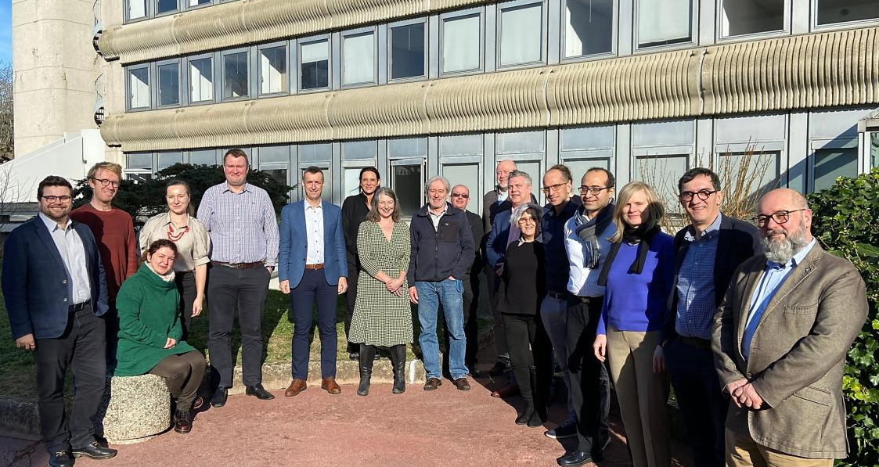
Thank you for your attention
RRADEW

Slide 19
References
UNDP(2014) UNDP 2014. Disaster Resilience Measurements - Stocktaking of Ongoing Efforts In Developing Systems For Measuring Resilience
Cutter, S. L., Barnes, L., Berry, M., Burton, C., Evans, E., Tate, E., & Webb, J. (2008). A place-based model for understanding community resilience to natural disasters. Global environmental change, 18(4), 598-606.
United Nations Office for Disaster Risk Reduction (2015). Sendai framework for disaster risk reduction 2015–2030. United Nations Office for Disaster Risk Reduction: Geneva: Switzerland.
FEMA (2022). Community Resilience Indicator Analysis: Commonly Used Indicators from Peer-Reviewed Research: Updated for Research Published 2003-2021. UD Dept. Homeland Security
Vlachopoulou, E. I., & Mizuta, D. D. (2018). Shellfish aquaculture and resilience: Leadership experiences from Kesennuma Bay, Japan. Marine Policy, 92, 111-119.
Raisio, H. et al. (2023). Could virtual volunteerism enhance information resilience in a nuclear emergency? The potential role of disaster knowledge workers and virtual emergent groups. Radioprotection, 58(1), 11-18. Retrieved from https://doi.org/10.1051/radiopro/2023003
Antczak, M., & Gruszka, Z. (2023). Library model of community resilience during the war. Activities of selected Polish academic libraries addressed to Ukrainians. The Journal of Academic Librarianship, 49(5), 102752.
Westerdahl, K. (2013). Societal consequences of radioactive releases in March 2011 in Japan and implications for the resilience concept. Journal of Risk Research, 17, 1147-1160. doi:10.1080/13669877.2013.841732

Slide 20
References
Kimhi, S., Hantman, S., Goroshit, M., Eshel, Y., & Zysberg, L. (2012). Elderly people coping with the aftermath of war: Resilience versus vulnerability. The American Journal of Geriatric Psychiatry, 20(5), 391-401.
Sousa, C. A., Haj-Yahia, M. M., Feldman, G., & Lee, J. (2013). Individual and collective dimensions of resilience within political violence. Trauma, Violence, & Abuse, 14(3), 235-254. doi:10.1177/1524838013493520
Kelmendi, K., & Hamby, S. (2023). Resilience After Trauma in Kosovo and Southeastern Europe: A Scoping Review. Trauma, violence & abuse, 24(4), 2333–2345. https://doi.org/10.1177/15248380221093693
Veronese et al, 2021 , G., Cavazzoni, F., Russo, S., & Sousa, C. (2021). Risk and Protective Factors Among Palestinian Women Living in a Context of Prolonged Armed Conflict and Political Oppression. Journal of Interpersonal Violence, 36(19-20), 9299-9327. https://doi.org/10.1177/0886260519865960
Eshel, Y., Kimhi, S., Lahad, M., & Leykin, D. (2017). Individual attributes as predictors of protective and risk components of resilience under continuing terror attacks: A longitudinal study. Personality and Individual Differences, 114, 160–166.
Community capitals representation: F. Panzarella

