Slide 1

Coverage in mass media and ethical issues communicating on nuclear facilities during the wartime
Olena Pareniuk
Institute for Safety Problems of Nuclear Power Plants, NAS of Ukraine
ERPW 2024, Rome,
NERIS workshop

Slide 2
Mass media plays a crucial role in society’s well-being
Curiosity ONLY arises as a result of threatening news from NPP;
General threat caused by a lack of understanding of the effects and general threat caused by misunderstanding of the effect and spread of radiation;
Anxiety due to the general uncertainty of the situation;
Resentment towards international institutions that do not make any clear moves;
Attempts to oversimplify the nuclear fuel cycle
ERPW 2024, Rome

Slide 3
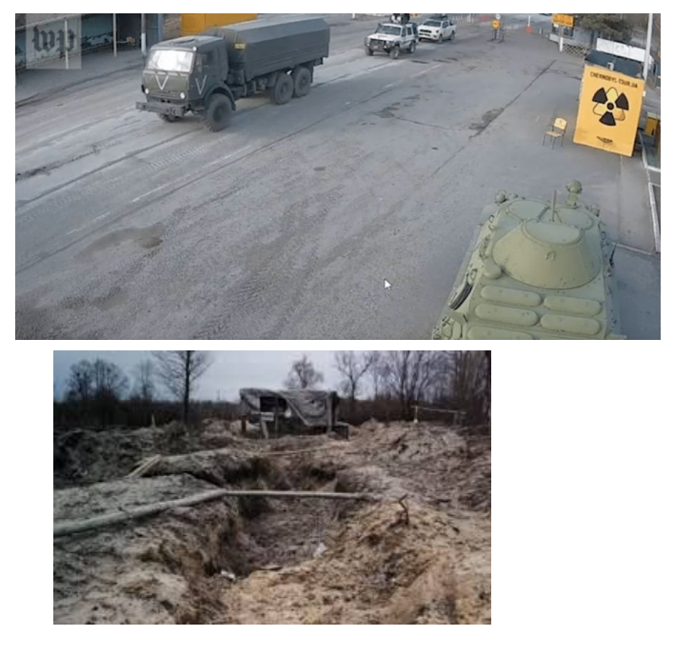
Key narratives in public concern:
ChNPP
Trenches in the red forest;
Can Chornobyl happen again? Is Kyiv is in danger?
Violation of the integrity of the new safe confinement - could a nuclear explosion occur? explosion?
Breach of the integrity of the radioactive waste storage facility radioactive waste storage facility - radiation sickness?
Fires in the Chornobyl Exclusion Zone (Exclusion Zone);
Could military vehicles have removed radionuclides from the Exclusion Zone.
Society WAS NOT ready, so the concern was huge, and trust to nation experts - limited
ERPW 2024, Rome

Slide 4
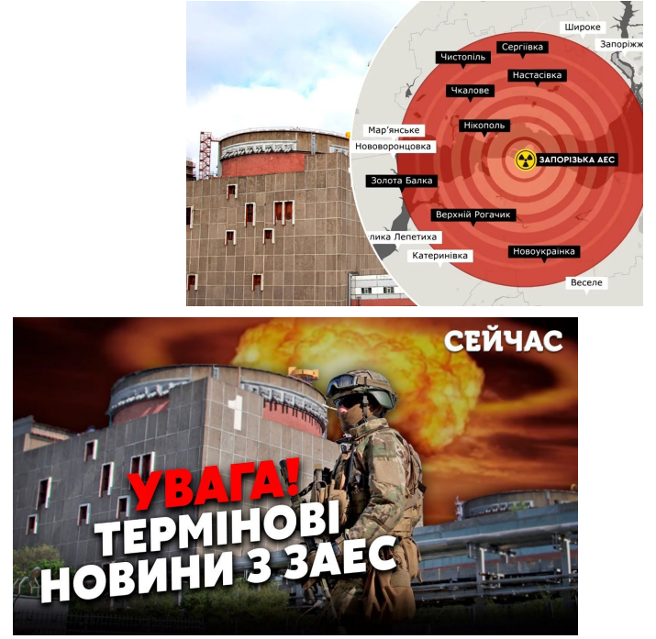
Key narratives in public concern:
ZNPP
Worst-case scenarios for ZNPP;
10 Chornobyls and the whole world under a radioactive cloud;
Can a missile destroy reactors and cause a nuclear explosion and cause a nuclear explosion?
Why are the IAEA silent? Where are the "nuclear troops" of the United States?
Are ZNPP employees in the current situation collaborators, victims or heroes?
Situation became long-lasting, so experts became highly-cited and a hure urge for explanations appeared
ERPW 2024, Rome

Slide 5
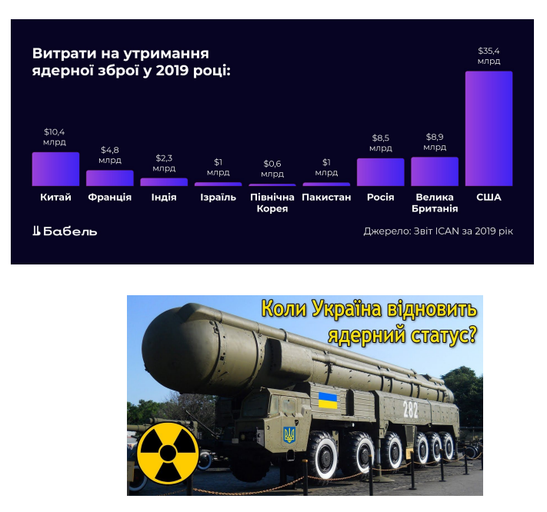
Key narratives in public concern:
Nuclear weapons
Let's make our own nuclear weapons!
Nuclear winter will come after the first strike;
Nuclear backpacks and nuclear suitcases - you need a lot of money and special equipment;
Iodine saves from radiation;
The entire population will get sick with radiation sickness;
The entire territory of the country will be contaminated and impossible to live on.
Real danger for life outburst an interest to understanding the radiobiological mechanisms and international law
ERPW 2024, Rome

Slide 6
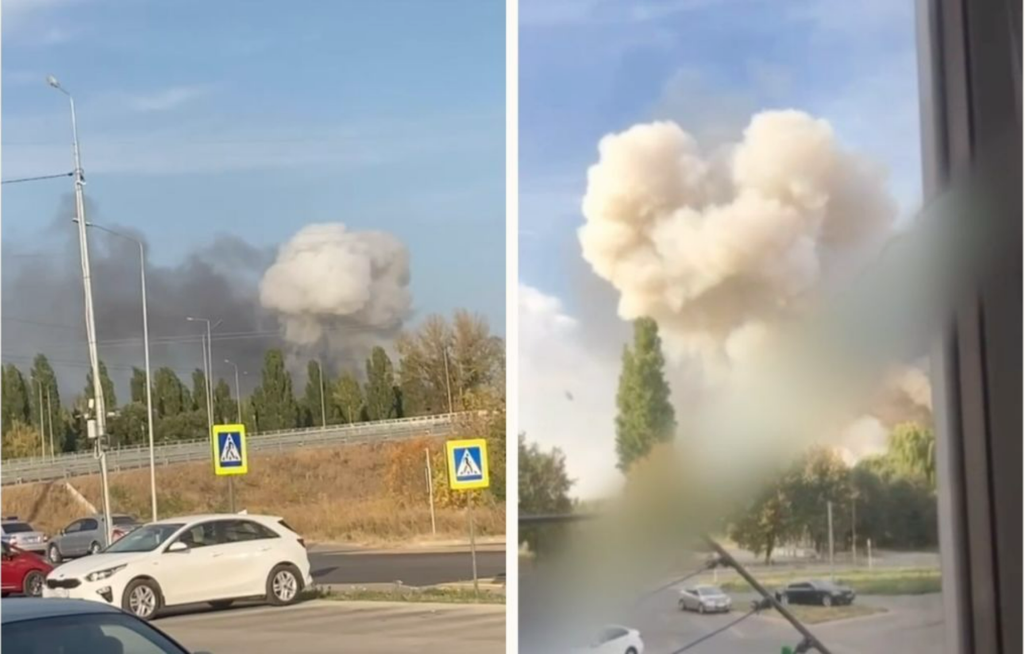
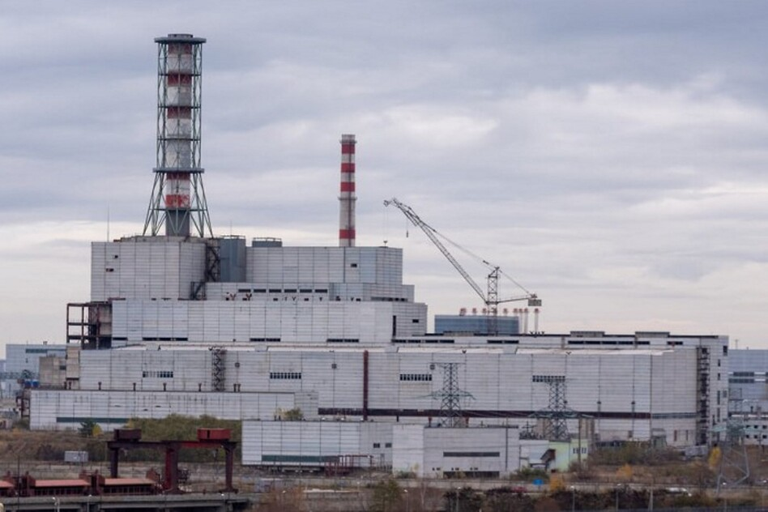
Key narratives in public concern:
Kursk NPP
Attacking KNPP is against international law;
KNPP has old reactors, that are dangerous for Ukrainians
KNPP should stay under fire control of Ukrainian Armed Forces - occupation and violation of its work should be avoided at any cost
3 years of extensive communication with mass media resulted in a very calm and well-balanced response from the society
ERPW 2024, Rome

Slide 7
Ethical challenges:
what should international society focus on
Expectations from the employees in case of NPP occupation;
Create the list on minimal crucial and simple requirements for the radiation safety of employees, soldiers and civilians;
Information hygiene from mass-media representatives - one should not ask for direct interview with employees of NPP under occupation. Thus - we need to create the protocol for employees that will be asked to talk to journalists;
Public speakers of NPPs should be trained to communicate with soldiers and society (like in Chornobyl exclusion zone now).
ERPW 2024, Rome

Slide 8

Thank you for your attention
RRADEW
On behalf of all the RRADEW team
ISEEH, České Budějovice 2024
ERPW 2024, Rome

