Slide 1











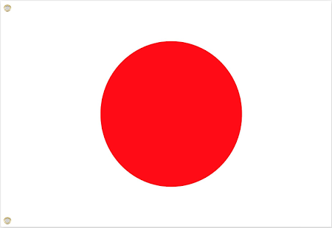
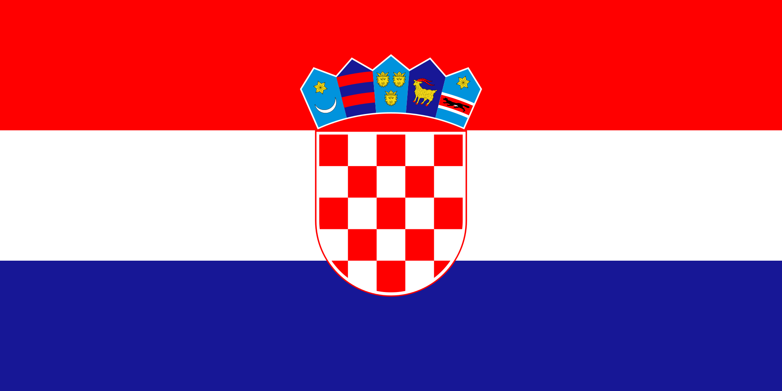

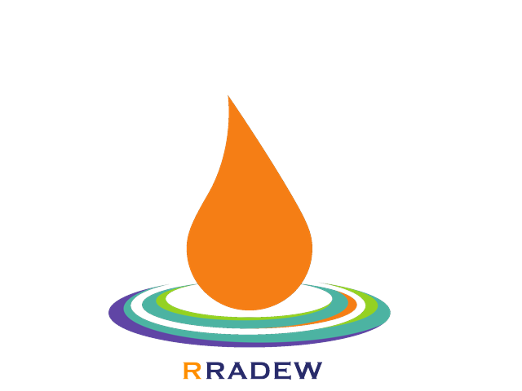
RRADEW
14 PARTNERS – 10 COUNTRIES
Resilience to Radiological Events in Wartime
NMBU
NORWAY – University of Life Sciences
LU
SWEDEN – Lund University
UKHSA
UNITED KINGDOM – Health Security Agency
KIT
GERMANY – Karlsruhe Institute of Technology
SCK-CEN, UA
BELGIUM – Nuclear Research Center +
University of Antwerpen
USB
CZECHIA – University of South Bohemia
ISPNPP, NRCRM
UKRAINE – Institute for Safety problems of NPPs + Research Center of Radiation Medicine
CEPN
IRSN,
ENSOSP
FRANCE – Nuclear Protection Evaluation Center, Institute for Radiation and Nuclear Safety, Firefighter Officer Academy
Rome, NERIS workshop, 11 November 2024
P. Croüail
APA
PORTUGAL – Environment Agency
CIEMAT
SPAIN – Research Center for Energy, Environment and Technology
Notes:
a dew drop resistant to fall ?

Slide 2
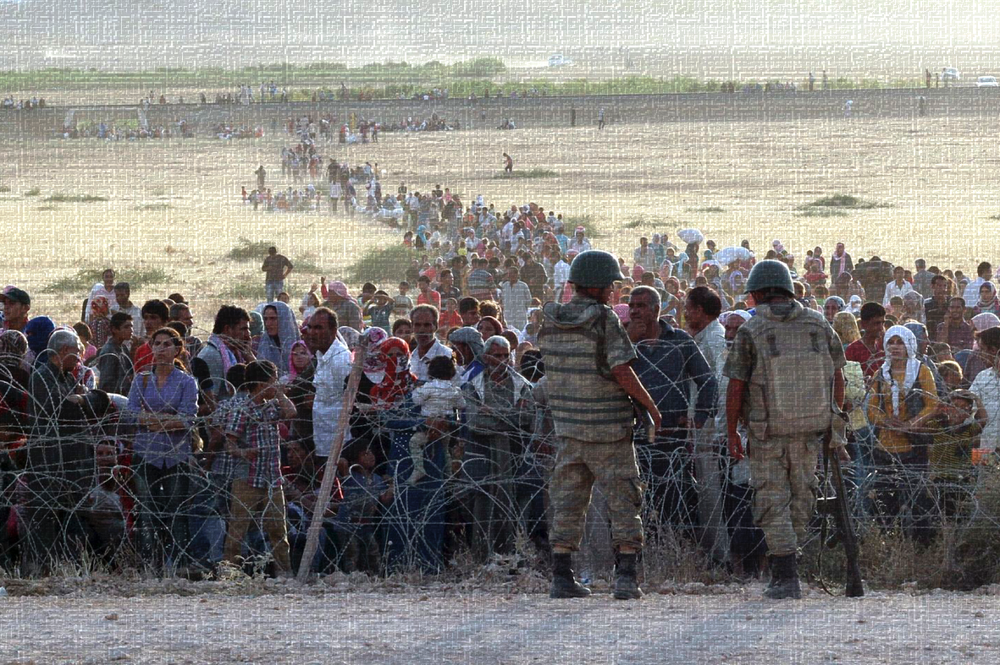
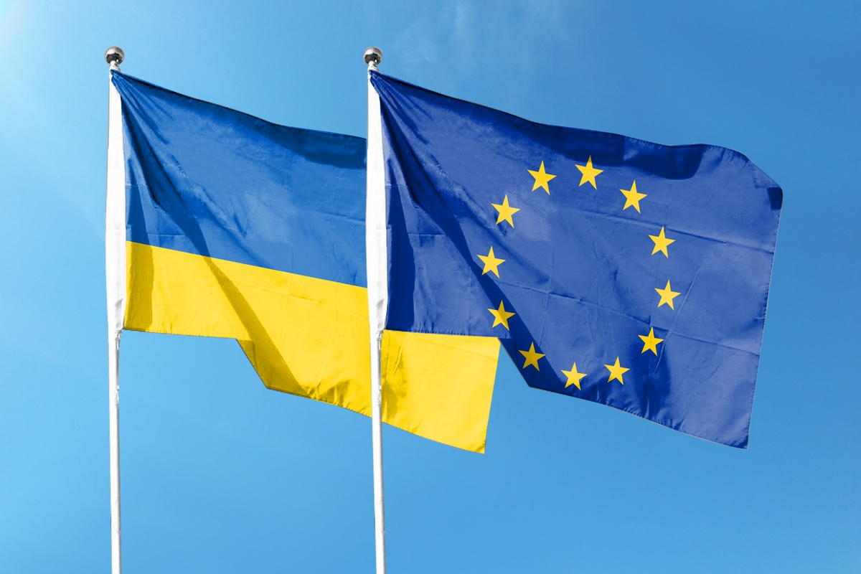
How does a nuclear threat affect radioprotection guidelines?
What are the new challenges to prepare for?
How can resilience be promoted in such situations?
Many radiological events during past wars, armed conflicts, terrorist attacks and rebellions …–2021
Escalation of threats over the last 3 years
2022
- 02 – Invasion by Russian troops of the Chornobyl exclusion zone and capture of nuclear facilities, surveillance garrison held hostage
- 03 & 06 - Kharkiv neutron source facility targeted and damaged by rockets
- 03-10 - Zaporizhzhia NPP and fuel storage hit by missiles, civilian evacuation convoys and residential buildings attacked, NPP occupied by Russian troops, NPP staff held hostage…
2023
- 06 - Destruction of the N. Kakhovka dam and reservoirs used for water supply and cooling of nuclear installations
- IAEA dissuasive [?] presence at Zaporizhzhia, Rivne, Chornobyl, and South Ukraine
2024
- 04 - (All Zaporizhzhia units in cold shutdown status)
- 04 – Iran warns Israel against attacking nuclear sites…
- 07 – UA drone attack of the RU Kapustin-Yar Astrakhan nuclear missile test site
- 08 - Zaporizhzhia cooling water tower fired (act of terror?)
- 08 - RU Kursk NPP is « extremely exposed to attacks » (IAEA)
- 09 - Putin threatens to use nuclear weapons in Ukraine
- 10 - Israel vs. Iran (official: ‘targeting nuclear sites is an option’)
1973 Argentina
Atucha NPP occupied by an armed group
1980 Iraq -“operation Babylon”
Al-Tuwaitha nuclear site attacked by Israel
1981 Iraq – “operation Opera”
Osirak nuclear research facility destroyed by Israel
1982 South Africa Koeberg
NPP occupied by an armed group
1984-1987 Iran Bushehr
NPP bombed several times by Iraq
1991 Israel Dimona
nuclear center attacked by Iraq
2001 (9/11) USA
NRC: “NPPs were targets considered by Al Qaida”
2007 Syria “operation Orchard” Deir-es-Zor
(future) nuclear reactor bombed by Israel
2021 Iran Natanz and Karaj
NPP and enrichment facilities attacked by Israel
Notes:
earthquake, floods, fire or any other grave natural disaster upon proof that such damage could not have been anticipated or avoided.

Slide 3
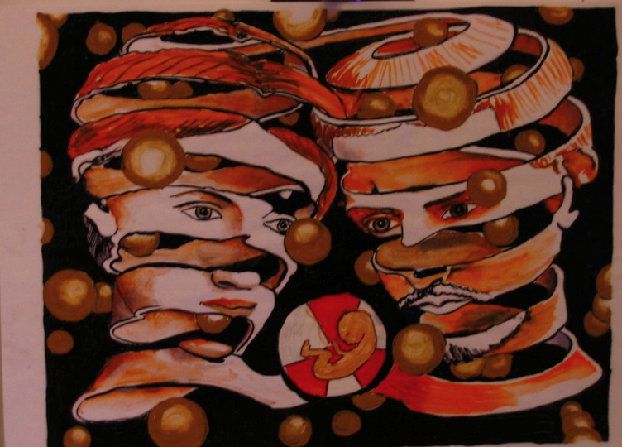
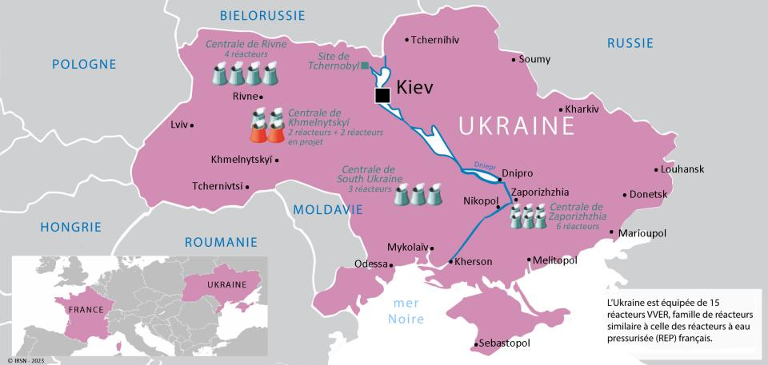

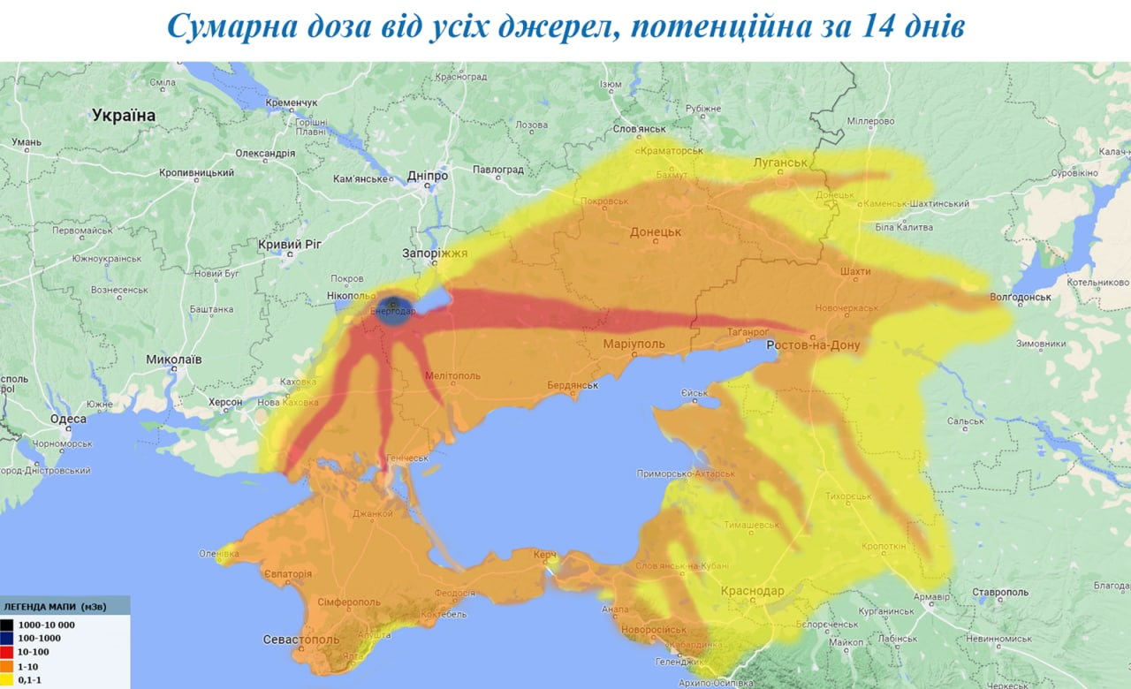
Nuclear accident threat, myths and realities
Nuclear installations and sites have often been designated or were actual targets during past wars or armed conflicts, and they will be even more so in the future (esp. in Ukraine).
Although the radiological consequences could reach areas far from the front line, risks about are often overstated by media incl. social media.
War exacerbates vulnerability of populations
Attack vs a nuclear site is a very effective threat .
Not only by the use of heavy weapons, but also through sabotage (power cuts, cyberattacks, arsons, etc.), staff hostage taking, as well as spreading disinformation and rumours about the potential radiological consequences
When we know that this can (will?) happen, are we really outside the scope of the Civil Nuclear Liability Protocol?
NPPs in Ukraine
Kursk
Possible contamination map after an accident at Zaporizhzhia NPP
Ukrainian Hydrometeorological Institute ©
Notes:
Under the Civil Nuclear Liability Protocol, if the operator of a nuclear installation proves that nuclear damage is directly due to an act of armed conflict, hostilities, civil war or insurrection, he is not liable for that damage
The operator of a nuclear installation is not liable for nuclear damage if such damage is caused by: • a nuclear accident due to an act of aggression, war or armed conflict; or • a nuclear accident directly due to an
The WRF forecast of meteorological conditions was calculated on the basis of GFS (global forecast data) with a spatial resolution of 0.5° and a time resolution of 3 hours. Radioactive emissions are given in the form of two-point sources at heights of 200m and 500m above the earth's surface, with a total stationary power of 1 becquerels/second (0.5 Bq/s for each sources). The following characteristics of the size distribution for radioactive aerosols were used: average diameter 1 μm, standard deviation 2 μm.
According to the results of the calculations, during 15-18 August 2022, the highest concentrations of radioactive aerosols can be observed within the territory of Ukraine, especially in the zone closest to the emission source, with a radius of 50-100 km in almost all directions from the ZNPP.
Significant concentrations of radionuclides could reach the city of Kyiv.
Partially radioactive impurities might also spread to the neighbouring states (the eastern part of Belarus, Poland, the Baltic States).
At the end of the simulated period, the main direction of radionuclide transport was eastward, as a result of which significant concentrations of radioactive aerosols could be observed over the occupied parts of Donetsk and Luhansk regions. »
https://www.pravda.com.ua/eng/news/2022/08/18/7363806/

Slide 4
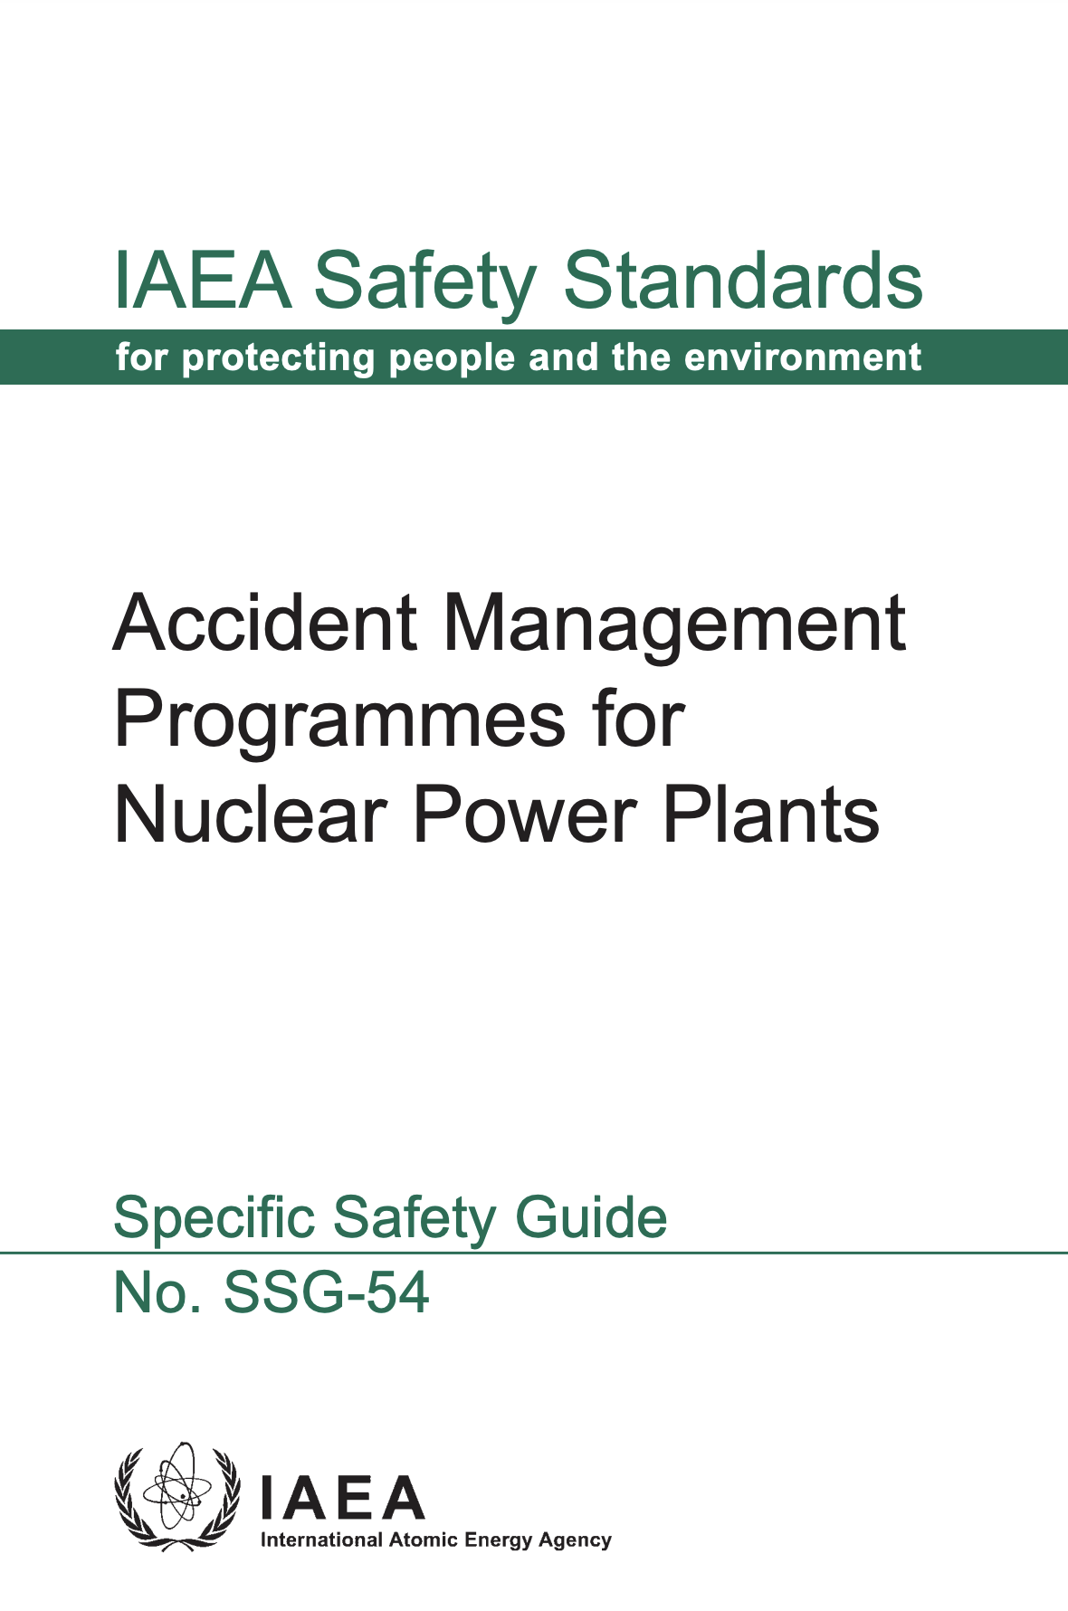
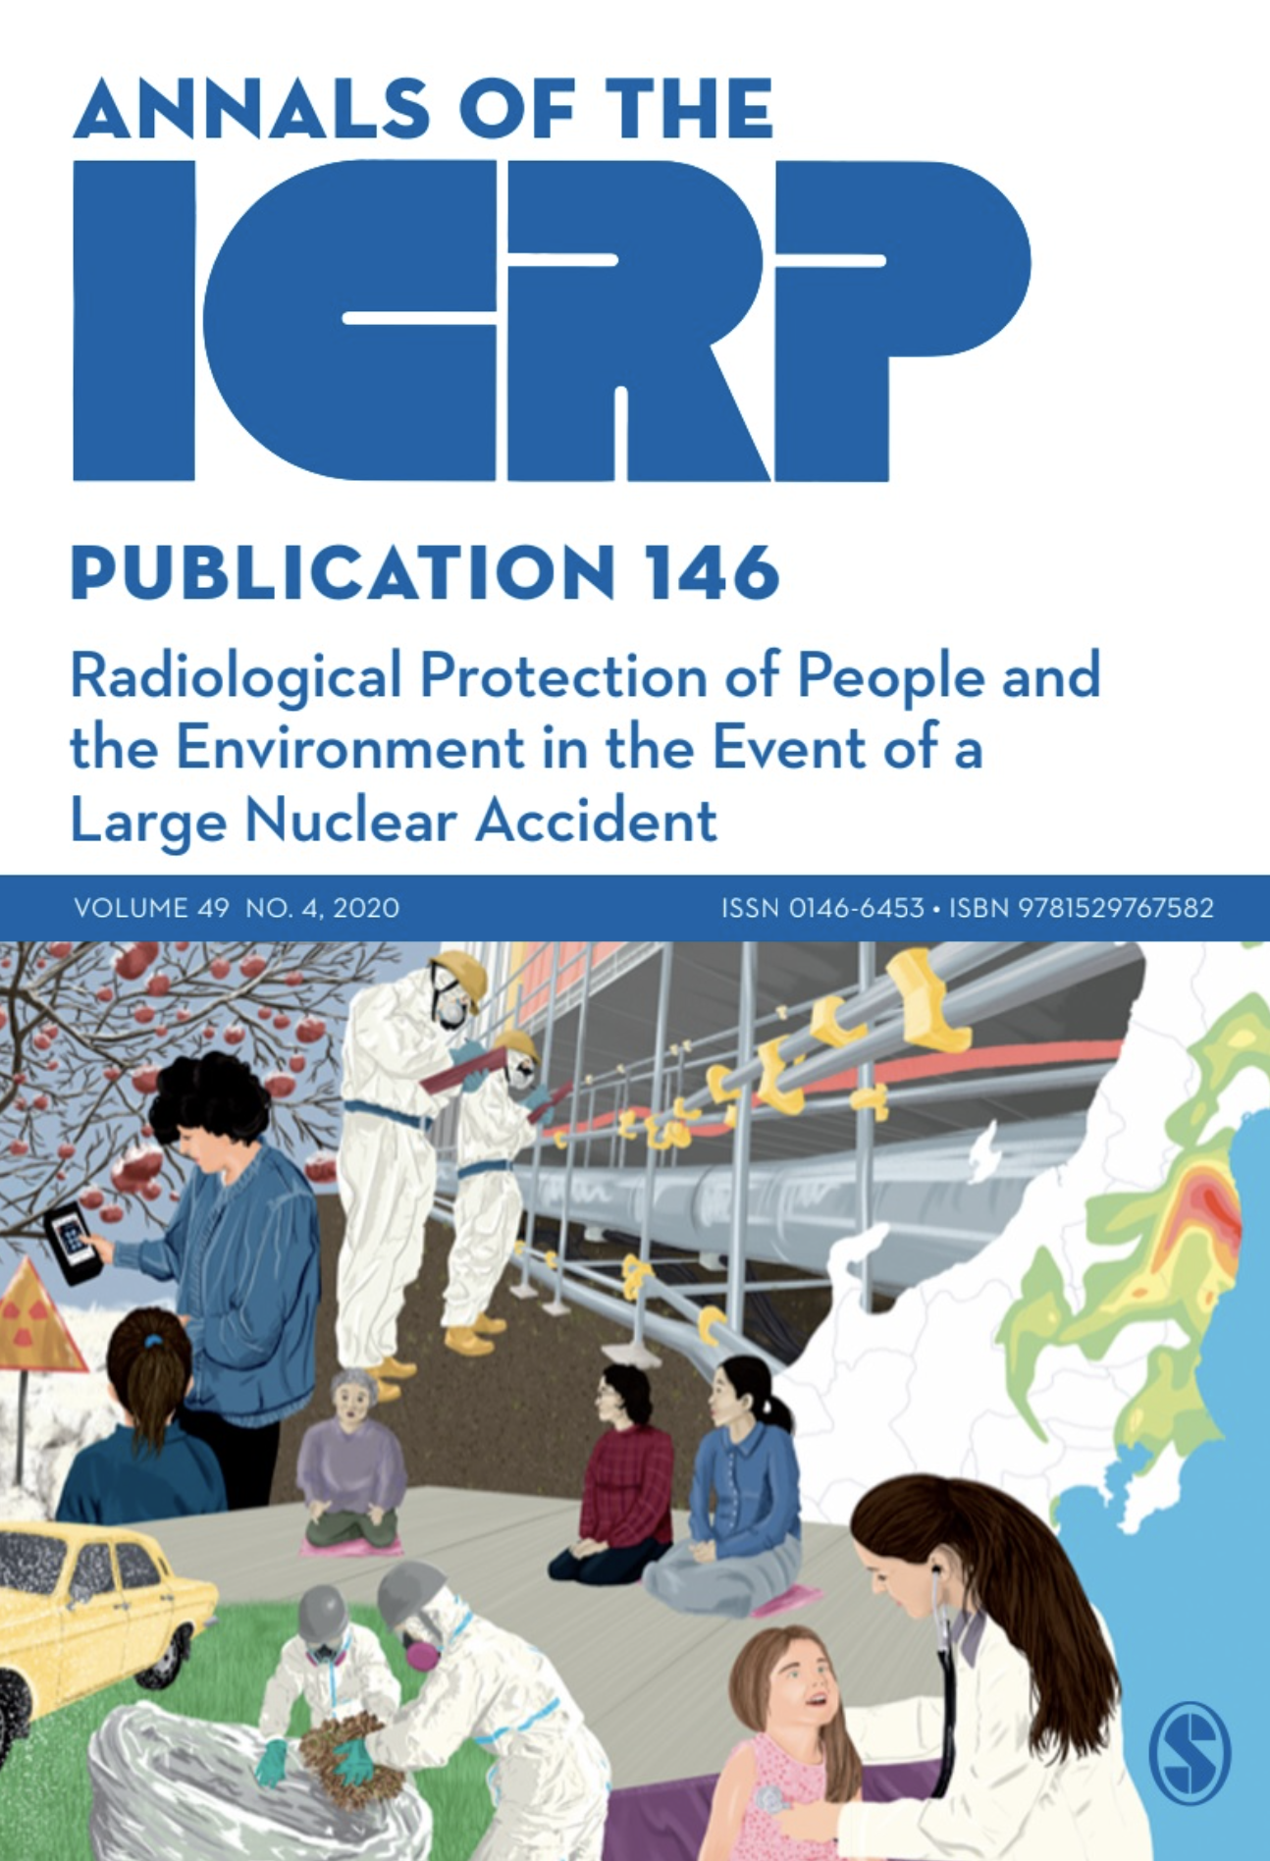
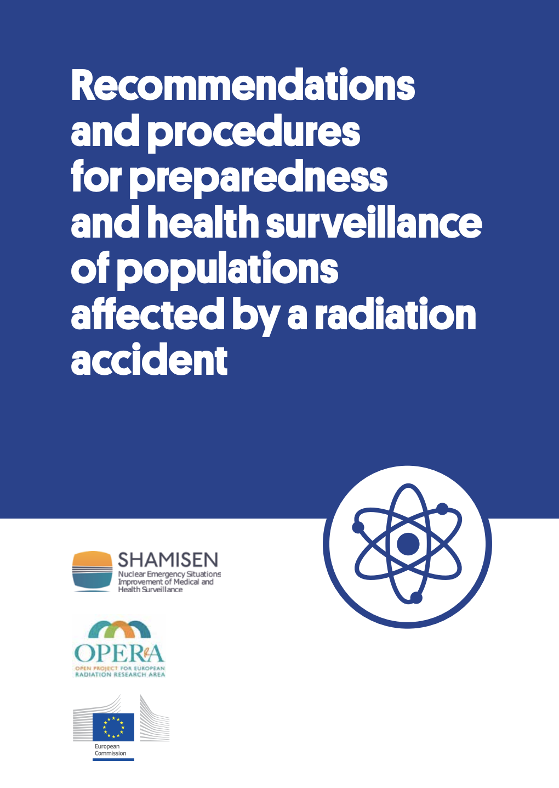
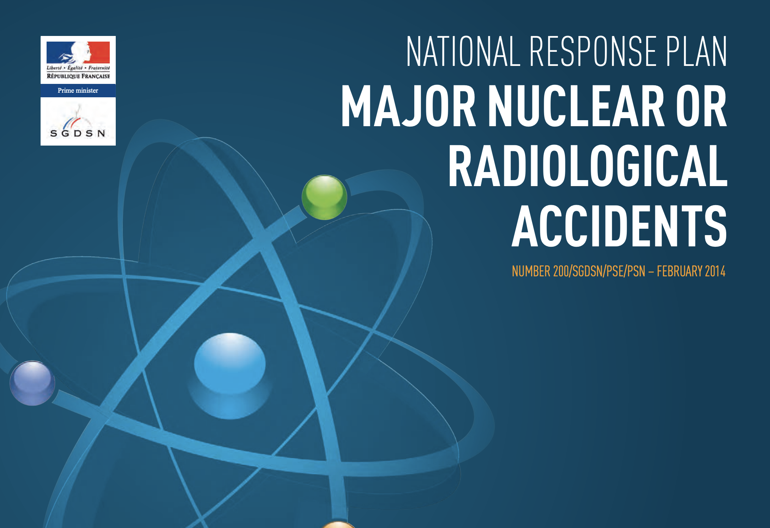
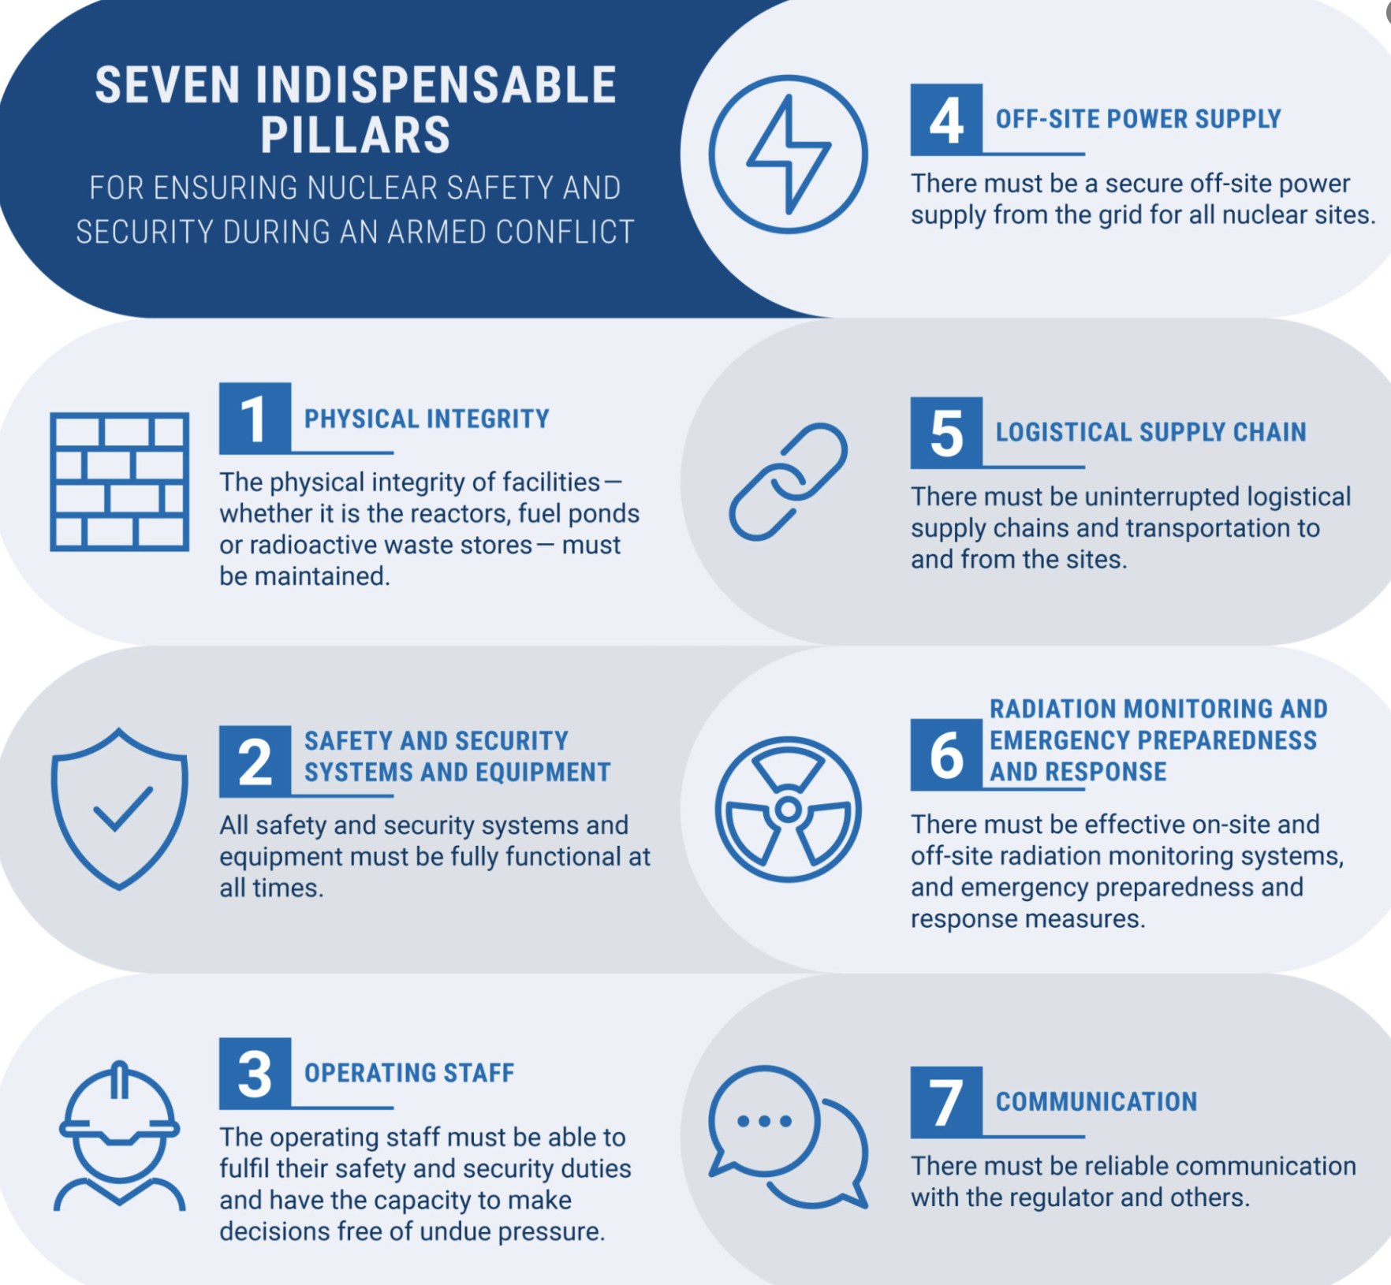
What are the specific challenges do we need
to prepare for?
  ITB distribution and efficiency?
  Sheltering and evacuation criteria and procedures?
  Essential infrastructures needed (stakeholders to be prepared)
  Impact modelling and monitoring capabilities (citizen monitoring)
  Feasibility of recovery countermeasures (e.g. recovery of lost/damaged radioactive sources)
  Obstacles to the return of distanced/evacuated/escaped populations (post-war welfare issues)
  Mental health issues (war trauma + fear of radioactivity)
  Specific information & communication strategies
What drives Resilience?
    Indentification of stakeholders’ roles during preparedness and response
    Adaptation of decision-aiding tools (incl. indicators of resilience)
    Sizing training needs (for first and second responders)
The EPR & R systems have been designed for peacetime contexts (i.e. essential infrastructures still in place, workers and institutions well organised and population living around in cohesion)
    Not necessarily adapted to an armed conflict or a war context!
Notes:
neither too alarmist nor too reassuring

Slide 5
WP0
COORDINATION, WEBSITE, DMP, CDP, PROJECT STAKEHOLDER GROUP
WP1
WAR SCENARIOS LEADING TO RADIOLOGICAL CONSEQUENCES
WP2
CHARACTERISATION (DIMENSIONS, ATTRIBUTES & INDICATORS), ANALYSIS AND ASSESMENT OF RESILIENCE (INCL. ANALYTICAL PLATFORM)
WP3
CASE STUDIES ON RESILIENCE IN PAST SITUATIONS (FIRST LINE RESPONDERS, AUTHORITIES, NGOs, LOCAL COMMUNITIES) : UKRAINE, CZECHIA, BALKANS, JAPAN
WP4
STRATEGIES FOR BUILDING RESILIENCE
(SCENARIO EXERCISES, TRAINING COURSE DESIGN, RECOMMENDATIONS)
WP5
ETHICAL CHALLENGES
(Workshop in Budweis - Report)
OBJECTIVES AND WPs
What are the resilience factors in the face of radiological events in a war situation?
How can resilience be improved?
This partnership has received funding from the European Union’s “EURATOM” research and innovation program under the 101061037 grant agreement

Slide 6

RRADEW STAKEHOLDER GROUP TO BE CONSTITUTED (ONTL ORGANISTIONS, NTL AUTHORITIES, MILITARY FORCES, FIREFIGHTERS AND OTHER RESPONDERS, etc.)
PIANOFORTE PROJECTS
PREDICT (NUCLEAR DETONATION), CITISTRA (CITIZEN MONITORING)
PIANOFORTE SAB AND PF STAKEHOLDERS
PROJECTS SELECTED IN HORIZON DISASTER RESILENT SOCIETY CLUSTER #3 (ON SAFETY AND SECURITY)
CBRN DEFENSE
RESILIENCE & COUNTERACT PROJECTS (ANTIDOTE RADIOPROTECTORS FOR FIRST RESPONDERS)
INTL ORGANISATIONS (IAEA, ICRP, WH0, NEA-CRPPH, HERCA, etc.)
Advisors and other stakeholders to consult on our work
This partnership has received funding from the European Union’s “EURATOM” research and innovation program under the 101061037 grant agreement

Slide 7

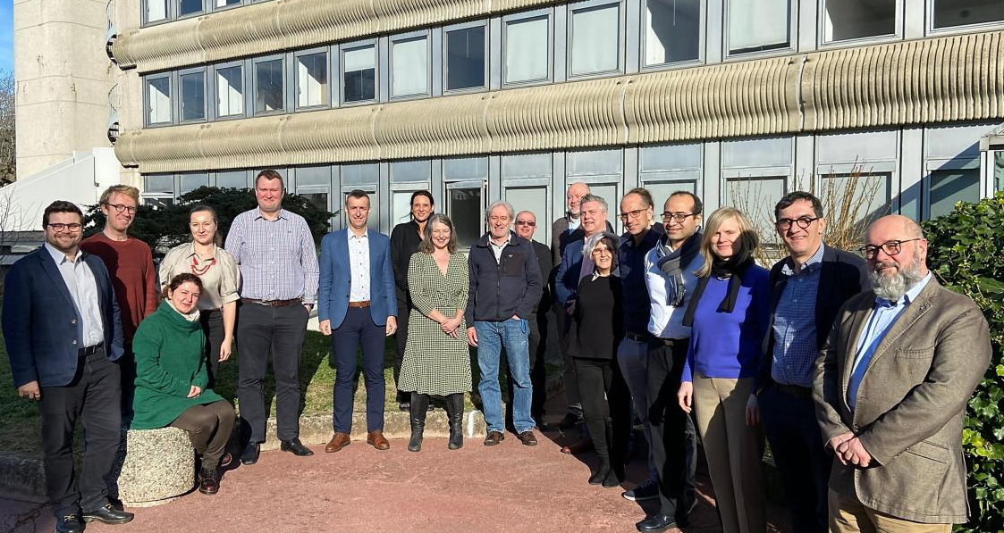
Thank you for your attention
RRADEW
On behalf of all the RRADEW team
and looking forward to the presentation of the results

