Slide 1

A new Framework for Mental Health and Psychological Support in Radiological and Nuclear Emergencies
Fahmy Hanna and Zhanat CARR Olvido Guzman Matthias Zahringer Wolfgang Weiss
WHO Headquarters NEA/OECD BfS, Germany Germany
The 5th NERIS Workshop – Roskilde, Denmark, 03-05 April 2019

Slide 2
No Health without Mental Health
Health is a state of complete physical, mental and social well-being and not merely the absence of disease or infirmity
(WHO definition, 1948)
Mental health is defined as a state of well-being in which every individual realizes his/her own potential, can cope with stressful situations, can work productively and fruitfully, and is able to make a contribution to her or his community.

Slide 3
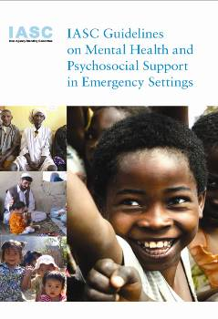
Global action on addressing Mental Health and Psychological Support in Emergencies
Since 1992, the Interagency Standing Committee (IASC) – a unique forum that has a primary role for coordination, policy development and decision-making with regard to humanitarian emergencies, involving the key UN and non-UN partners. The IASC launched a Mental Health Global Action Plan (mh-GAP)
IASC 2007 Guidelines on Mental Health and Psychologial Support (MHPSS) in Emergency Settings were developed with input from UN agencies, NGOs and academia. The Guidelines help to plan, establish and coordinate a set of minimum multi-sectoral responses to protect, support and improve people’s mental health and psychosocial wellbeing in the midst of an emergency.
https://interagencystandingcommittee.org/mental-health-and-psychosocial-support-emergency-settings

Slide 4
IASC Guidelines framework terminology
Conventional use of the term psychological support varies and implies different things for different users:
For health professionals: non-clinical interventions for people with mental disorders (including transient psychological conditions, outside of clinical psychiatry and mental disorders)
For others (civil protection, social/community services, etc): any non-clinical support for any person with/ without disorder (e.g. creating child friendly spaces)
Lack of common language => Confusion, misuse of guidance
IASC uses inclusive approach for a composite definition covering both aspects:
protecting or promoting psychosocial well-being through providing Psychological Support
and preventing or treating Mental Health disorders
MHPSS – a commonly used abbreviation by the IASC members and associated/relevant professional communities
MHPSS

Slide 5
Contributing factors to MHP consequences of nuclear emergencies
Fear of radiation due to the lack of knowledge and information
Exposure to stress related to the implementation of protective actions
Challenges of risk communication often under unclear circumstances
Social stigma and discrimination of the evacuees
Evacuation, relocation and long-term displacement
Social and economic consequences
Photo: Asahi Shimbun www.asahi.com

Slide 6
Psychosocial consequences of nuclear emergencies
Psychosocial impact may outweigh the radiological consequences of nuclear emergencies. It was found to be the largest after Chernobyl accident (WHO, 2006) and persisted for decades.
In 1986, the socio-economic impact of the accident itself was exacerbated by the disintegration of Soviet Union. In addition, the lack of proper risk communication, no access to information and to lack of community’s engagement in the decision making, as well as stigmatization of the affected persons and participants of the long-term medical monitoring, have contributed to the over-all anxiety of the affected population.
Medical follow-up was linked to small social benefits, but also reinforced the stigmatization and affected people's lives and contributing to the psycho-social consequences of the accident

Slide 7
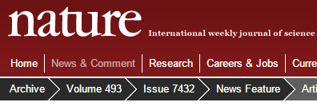
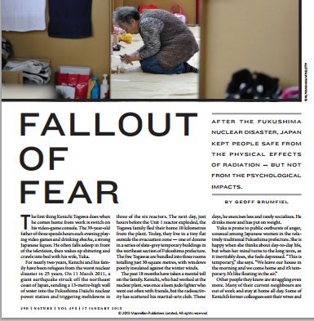
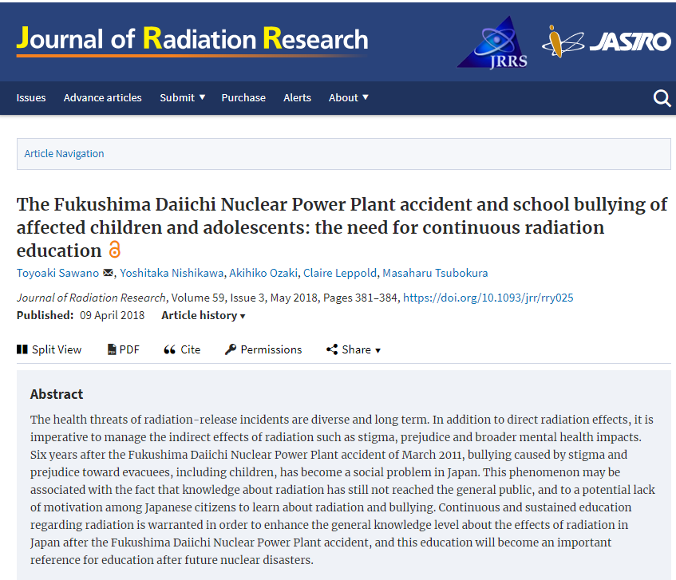
Psychosocial impact of 2011 Fukushima Daiichi NPP accident
Loss of homes, jobs, and the rupture of social fabric of the affected communities has caused a tremendous stress to the affected people.
In addition to the stress related to evacuation and relocation, a social stigma is attached to evacuees and residents of the affected areas.
Parents of affected children are reported to have recurring anxiety about the health and future of their children.
Evacuees, TEPCO workers, and public service personnel affected by the Fukushima nuclear accident were reported to have a high level of anxiety, depression, panic attacks, PTSD, burn out, higher incidence of suicide, etc.

Slide 8
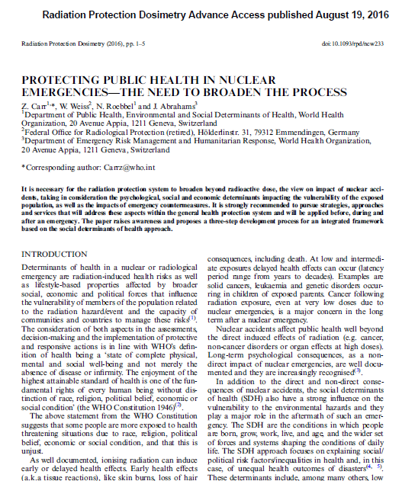
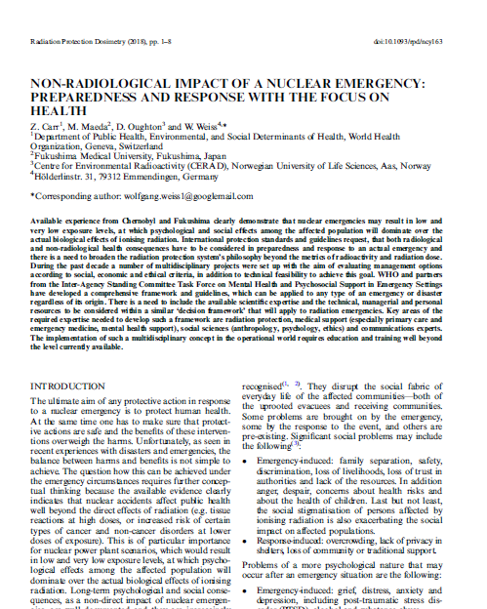
Non-radiological impact of RN emergencies on health - call for broadening the scope of preparedness
2018

Slide 9
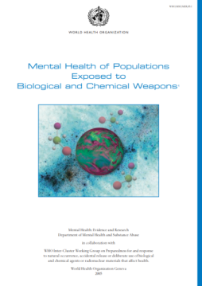
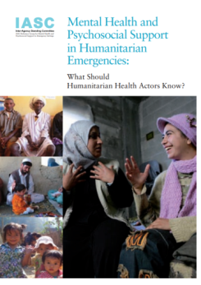
Mental Health impact of Chemical, Biological, and Nuclear emergencies
WHO report Mental health of populations exposed to biological and chemical weapons (2005) is undergoing revision
  https://goo.gl/Mo7LZE
  in addition, accompanying derivative information products are being developed
For nuclear emergencies, a similar approach is being followed in order to adopt the mhGAP guidelines to a nuclear emergency settings.

Slide 10

Intervention pyramid (IASC 2007)
Clinical mental health care by psychiatrists or primary health care specialists
Clinical
services
Basic emotional and practical
support to vulnerable groups, selected individuals and families by health care professionals
Targeted psychosocial support
Activating social networks, linking with community leaders and support groups
Community and family support
Advocacy for good humanitarian practice: basic services that are safe, socially appropriate
and that protect dignity
Social considerations in basic services and security
Notes:
10
Adapted with permission from the IASC Guidelines on Mental Health and Psychosocial Support (IASC, 2007)

Slide 11
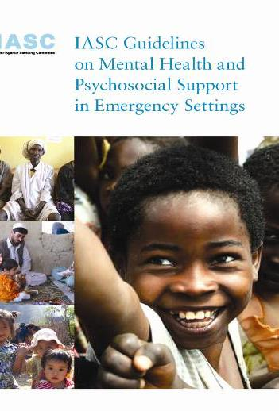
Integration of MHPS approach in nuclear emergencies preparedness and response (EPR)
preparedness
Public mental health policy and mapping of existing resources
Risks and vulnerability analysis
Coordination plan
Development of a MHPSS protocols and contingency plan for emergencies and disasters
Prepare for needs assessments, monitoring, and evaluation of response
Human resource management and staff support
Develop a communication strategy; including a media and a social media outreach strategy

Slide 12
Integration of MHPS approach in nuclear emergencies preparedness and response (EPR)
Emergency Phase
Communication and coordination between responding parties
Emergency risk communication
Support to evacuated and over-exposed
Arrangements for safe mourning for deceased (and for managing contaminated remains)
Community intervention and mobilization
Mental health interventions
MHPS for emergency responders

Slide 13
Integration of MHPS approach in nuclear emergencies preparedness and response (EPR)
Post Emergency Phase - Community Interventions
Self help groups
Community coping strategies
Rebuilding trust in social structures
Re-establishing cultural and religious events
Help to families and children to understand the risks
Individual case management
Mitigation of economic impact

Slide 14
Integration of MHPS approach in nuclear emergencies preparedness and response (EPR)
Post Emergency Phase – Mental Health Interventions
Building back through improved and adopted policies (lessons learnt)
Training general health workers and community workers and monitor results
Educating the affected communities
Establishing referral system
Ensuring treatment access for those with clinical mental health conditions
Linking mental health and social care services
Setting up long-term mental health effects research, if feasible

Slide 15

WHO-NEA cooperation on non-radiological health effects of radiation emergencies (1)
Working Party on Nuclear Emergency Matters (WPNEM) of the NEA/OECD and WHO agreed to develop a joint project addressing psycho-social impact on radiological and nuclear emergencies
A two-phase project started in 2018
  Year 1: Development of a policy framework document on application of WHO guidelines on mental health to radiation emergencies (WHO-led task)
  Year 2: Development of practical arrangements to support emergency response planners and managers to provide tools for efficient mitigation of psychosocial impact (WPNEM-led task)

Slide 16

WHO-NEA cooperation on non-radiological health effects of radiation emergencies (2)
Started in 2018 from the discussion at the WPNEM meeting in Paris
  Agreed on the roles, scope and time-frame
WHO Department of Mental Health and Brain Disorders developed the first draft by December 2018
Preliminary review done in Jan-March 2019
Peer-review to be done in April-June 2019 to get feedback of the relevant stakeholders, expert networks and professional societies
Draft will be finalized by Sept 2019 by WHO
Joint WHO-NEA-BfS workshop planning is on the way

Slide 17

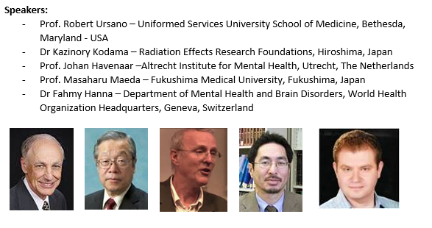
WHO-REMPAN Webinar on Mental
Health (MH) impact of Nuclear Emergencies
15 April 2019 – 13:00 to 14:30 (Paris time UTC+2)
MH and nuclear emergencies: what to expect, surveillance, triage and coordinating care (R. Ursano
MH sequelae in 1945 atomic bomb survivors in Hiroshima and Nagasaki (K. Kodama)
MH impact of the 1986 Chernobyl accident (J. Havenaar)
Psychological consequences of the 2011 Fukushima accident (M. Maeda)
WHO-IASC 2007 Guidelines on MH Psychosocial Support (MHPSS) in Emergency Settings and its application to nuclear emergency settings (F. Hanna)
To connect via Webex: https://goo.gl/MbNmT9

Slide 18

Summary
Non-radiological health consequences prevail over direct impact of radiation, mental health and psycho-social impact was reported to be largest among those affected by nuclear accidents in the past
Experiences from past nuclear accidents and other types of emergencies needs to be taken into account when developing policies an tools
Cross-sector multi-disciplinary policies and strategies and decision-support tools are needed to address MHPS needs of populations at all stages of an emergency: in planning, responding and recovering from an emergency.

