Slide 1
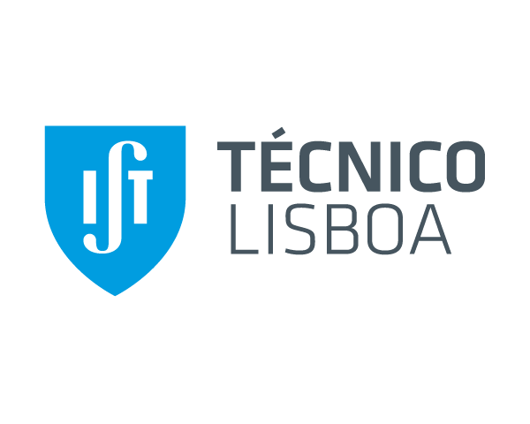
Study on optimization of the Portuguese Radiological Early Warning Network
Filipa Jerónimo⁽¹⁾, Luís Portugal⁽²⁾, Catarina Inácio⁽¹⁾, David Ferreira⁽¹⁾, Francisco Cardoso⁽²⁾, Mário Reis⁽¹⁾, João Oliveira Martins⁽²⁾
⁽¹⁾ Instituto Superior Técnico, Lisboa, fijeronimo@gmail.com
⁽²⁾ Agência Portuguesa do Ambiente (Portuguese Environment Agency), Amadora
5th NERIS WORKSHOP

Slide 2
Scope of the work
This work represents part of the master’s thesis of Filipa Jerónimo on Radiological Safety and Protection.
Chernobyl accident
Establish a national network capable of detecting radioactivity
DOT
Calculate and optimize the location of environmental radiological monitoring devices during nuclear emergencies
Uses simulations of potential radioactive plumes
Notes:
This work represents part of the master’s thesis.
With the Chernobyl accident, it was important to establish a national network capable of detecting and providing online data on radioactivity in the environment.
A tool was developed, in a European project, to calculate and optimize the location of environmental radiological monitoring devices during nuclear emergencies using simulations of potential radioactive plumes

Slide 3
GOALS
Analyze the network installed in Portugal and quantify its current detection efficiency and optimize it using DOT software
WHAT WE ACHIEVE AND WHAT IS NEXT?
The first results obtained are referring to the current network installed in Portugal and they are shown in the poster.
Yet there is still work to be done to achieve the best possible result.
Notes:
The goal is to analyze the network installed in Portugal and quantify its current detection efficiency and optimize it using DOT software
The first results obtained are referring to the current network installed in Portugal and they are shown in the poster.
Yet there is still work to be done to achieve the best possible result.

Slide 4
Thank you
5th NERIS WORKSHOP

