Slide 1
MODIFICATION OF THE REGULATORY FRAMEWORK FOR RADIOLOGICAL PROTECTION AND NUCLEAR SAFETY IN PORTUGAL
5th NERIS, Roskilde, Denmark
3-­5 April 2019
Márcia Farto
Regulatory Authority
marcia.farto@apambiente.pt

Slide 2
INTRODUCTION
In Portugal a new legislation was approved establishing a new legal regime for:
radiological protection;
nuclear safety and safe management of radioactive waste and spent fuel;
competencies of the regulatory authority and of the inspection authority for radiological protection and nuclear safety.
The new legislation transposes Directive 2013/59/Euratom of the EU Council of 5 December 2013;
The Portuguese Environment Agency will be the new regulatory authority;
The General Inspection for the Environment will be responsible for the inspections and enforcement.

Slide 3
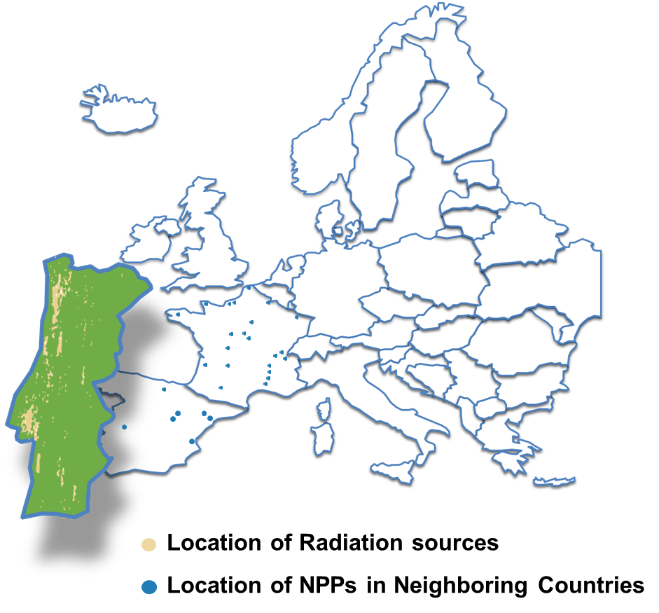
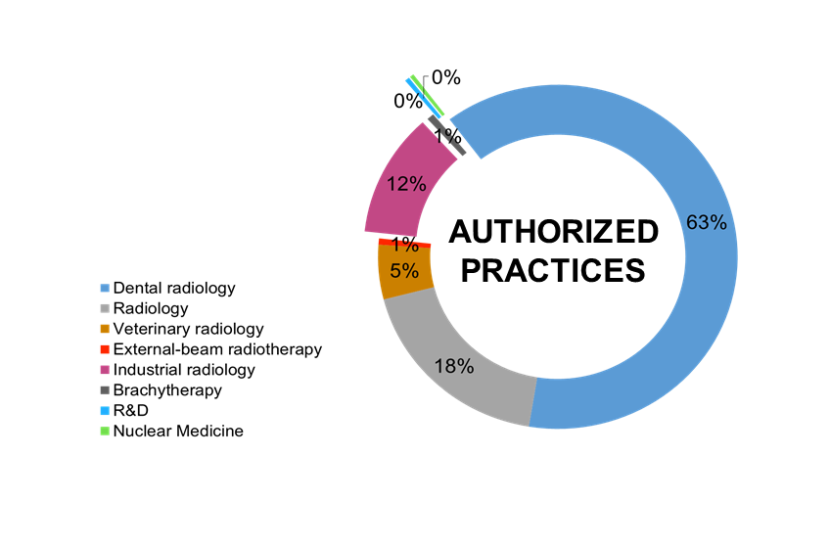
RADIOLOGICAL PORTUGAL
Around 10.000 authorized facilities that use radiation sources;
There is 1 Research Reactor;
(Currently in permanent shutdown);
Nuclear Power Plants in Neighboring Countries;
Foreign nuclear powered vessels;
Transport of radioactive sources;
Storage of uranium concentrate;
Radioactive waste disposal;
Radioactive sources;
Radiation sources.

Slide 4
PREVIOUS vs. NEW LEGAL FRAMEWORK
PREVIOUS vs. NEW LEGISLATION
PREVIOUS vs. NEW LEGISLATION
TECHNICAL INTERVENTION AUTHORITIES
CIVIL PROTECTION
REGULATORY AUTHORITY
AUTHORIZATION
INSPECTION
APA
DGS
IST
ANPC
APA
IGAMAOT
Medical facilities
DGS
ARS and Health Authorities
Radiological emergencies resulting or likely to be a risk to the population and environment (off-site)
Radiological emergencies in facilities
(on-site)
Radiological emergencies occurring in the transport of radioactive substances or due to the loss of sealed radioactive sources
Responsible for planning, coordinating and executing the national civil protection policy
IAPMEI
Industrial facilities
REGULATORY AUTHORITY
INSPECTION AUTHORITY
Research and teaching facilities
IST
Assumed the regulatory duties of DGS, IST and COMRSIN.
Assumed the inspection duties from COMRSIN, ARS’s, IAPMEI and IST.
Nuclear installations
COMRSIN
COMRSIN
Radioactive waste
IST
IST
Sealed sources
INSTITUTIONS INVOLVED IN RADIOLOGICAL AND NUCLEAR EMERGENCIES
INSTITUTIONS INVOLVED IN AUTHORIZATIONS AND INSPECTIONS
Notes:
APA - Portuguese Environment Agency (Agência Portuguesa do Ambiente); DGS - Directorate-General for Health (Direção-Geral da Saúde); IST - Instituto Superior Técnico; ANPC - National Civil Protection Authority (Autoridade Nacional de Proteção Civil); COMRSIN - Regulatory Commission for the Safety of Nuclear Installations (Comissão Reguladora para a Segurança das Instalações Nucleares); ARS’s - Regional Health Authorities (and their Regional Government counterparts) Administração Regional De Saúde; IAPMEI - Agency for Competitiveness and Innovation.

Slide 5
CONSIDERATIONS
PREVIOUS LEGISLATION
Competencies of regulatory authority were distributed by several institutions.
Some institutions accumulated both regulatory and operator roles.
Resources were shared with other tasks.
NEW LEGISLATION - Decree-Law No.108/2018 of 3 December 2018
Regulatory and Inspection competencies are being consolidated in APA and IGAMAOT respectively.
Carries out its competencies independently and functionally separated from any other organization related to the promotion or use of practices, with human, technical and financial resources needed for its functioning.
Resources allocated to regulatory functions.

Slide 6
Thank you very much

