Slide 1
Involvement of French stakeholders in the decision-making process in the context of uncertainties
NERIS Workshop 2019
3-5 April 2019
Roskilde, Denmark
Vanessa Durand, Mélanie Maître, Pascal Croüail, Sylvie Charron, Sylvain Andresz et Thierry Schneider

Slide 2
Objectives
CONFIDENCE WP4 – Task 4.2: Scenario-based Stakeholders engagement (national panel meeting: 9 European countries)
In the context of post-accident management (emergency and transition exposure situation):
Identify and evaluate the uncertainties which are part of the decision-making process
To analyse the implementation of the criteria proposed in the French post-accident doctrine in the decision-making process and identify the necessary data and the uncertainties that may arise and that should be considered;
To evaluate what are the uncertainties which are the most important – for local stakeholders and decision makers – and how they should be taken into account in the decision-making process in order to mitigate potential adverse consequences in the longer term.
More precisely, to assess if decision makers take into account :
uncertainty inherent to modelling in their decisions and if they do, to which extent;
other types of uncertainty in their decisions and if they do, to which extent.

Slide 3
Organisation of the French stakeholders panel
2 panel meetings:
June 12, 2018 - Work on the emergency phase
Understand and evaluate how a decision maker is taking decisions in such a context of uncertainty.
October 11, 2018 - Work on the transition phase
Assess the influence of decisions made during the emergency phase over the medium to long term. How could prior knowledge of these impacts have influenced the initial decision-making? What information would have been needed to precise their decision?
Focus on 2 protective actions: the evacuation and temporary relocation of populations and food restrictions (consumption / distribution)
A third meeting in June 2019 - Work on guidelines and recommendations

Slide 4
Composition of the French National panel
Experts of the institutional French organizations and authorities
Institute for Radioprotection and Nuclear Safety (IRSN)
Nuclear Safety Authority (ASN)
Directorate General for Food (DGAL)
Regional health agency (ARS)
Directorate General for Competition Policy, Consumer Affairs and Fraud Control (DGCCRF)
Departmental Directorate for the protection of population(DDPP)
Retired Prefect and retired mayor
Interdepartmental Civil Defense and Protection Service (SIDPC)
Chamber of agriculture
Firefighter forces
Local Liaison and Information Committe
Several decision makers at the national and local levels of the French post-emergency response system

Slide 5
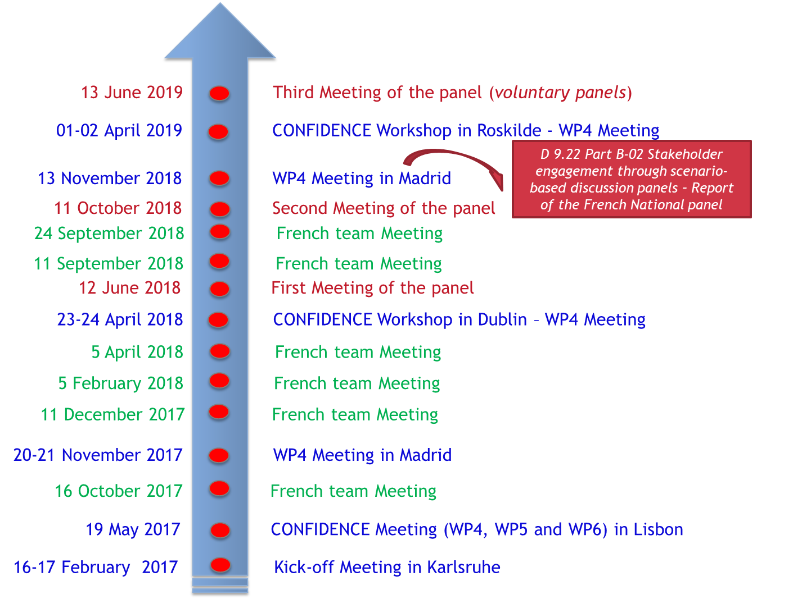
Calendar

Slide 6
Methodology
Taking into account inherent uncertainties about the real situation: direct links with CONFIDENCE WP1 to develop a basis of work for the panels meeting
For the first panels meeting, WP1 CONFIDENCE outputs allow to provide:
Maps of probability of threshold exceedance, for reference levels
Deterministic simulation: a single contour shows the impacted area
Ensemble of simulations: Probability maps of threshold exceedance = probability that a given zone is contaminated above a given level.
Maximum distance for a reference level +/- the uncertainty
For the second panels meeting, WP1 CONFIDENCE outputs allow to provide :
A synthetic map of “real measurement data” from simulated airborne monitoring used to show the difference between forecast data and measurement (overlaps, zones not initially included in the decision…)
For both panel meetings, preparation of maps representing the socio-economic issues of the affected territory :
Agricultural production;
Population density;
Public buildings (school, hospitals…).

Slide 7
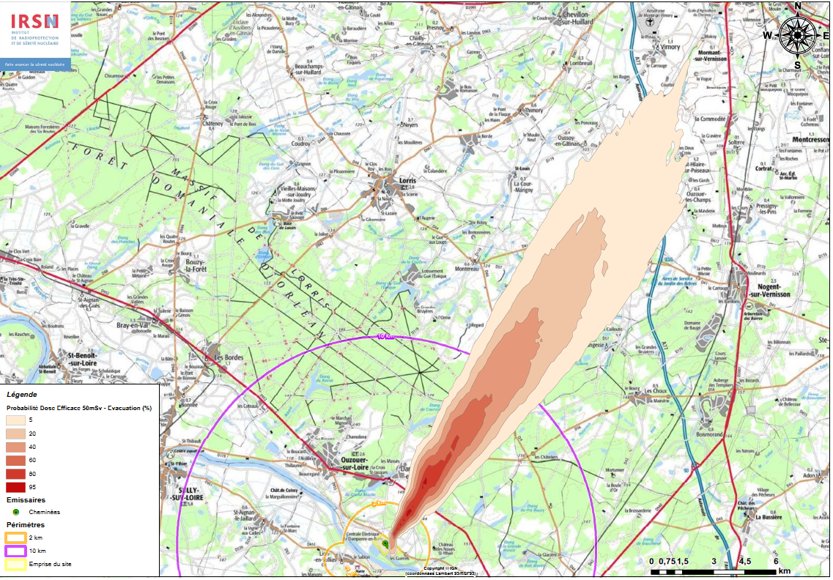
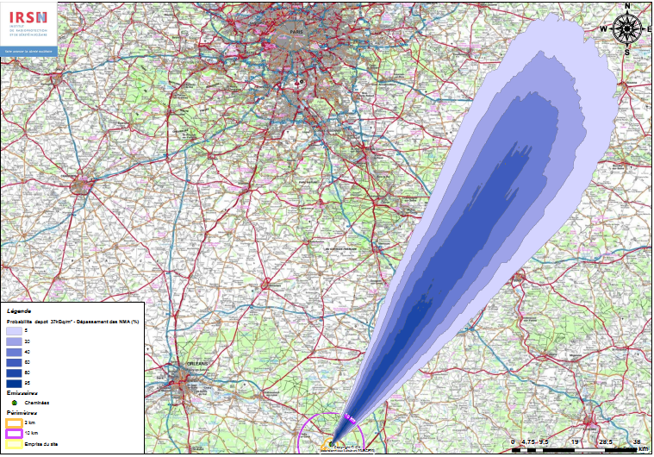
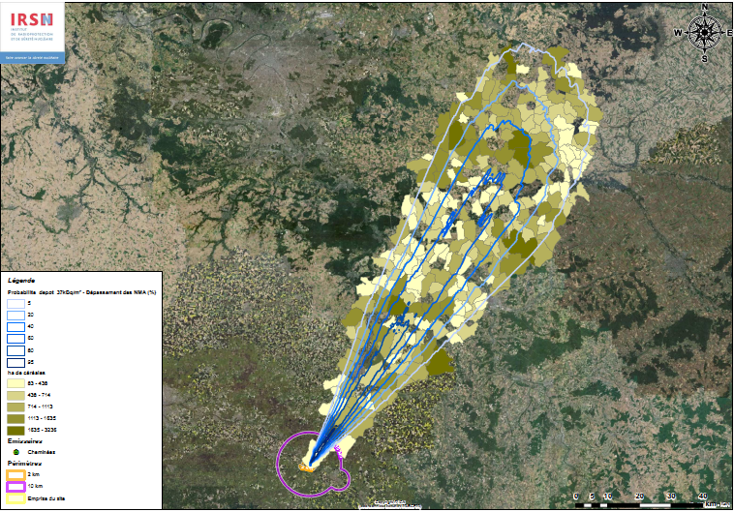
Case used (on Dampierre NPP sites) for the First panel meeting
Probability map for threshold of 50 mSv on the effective dose
Probability map for threshold of 37 kBq/m² on the ¹³⁷Cs deposition
Probability of threshold exceedance: computed by counting the number of simulation within the ensemble that predict a value above the given threshold at a certain point
Colored zones: areas where the simulation forecasts show a risk of exceeding the threshold
Probability map for threshold of 37 kBq/m² on the ¹³⁷Cs deposition with the area under cereals (vineyard, cows… also)
Notes:
Dark blue area: zone with the higher risk (80-100% probability of exceeding the threshold
With some issues,,,

Slide 8
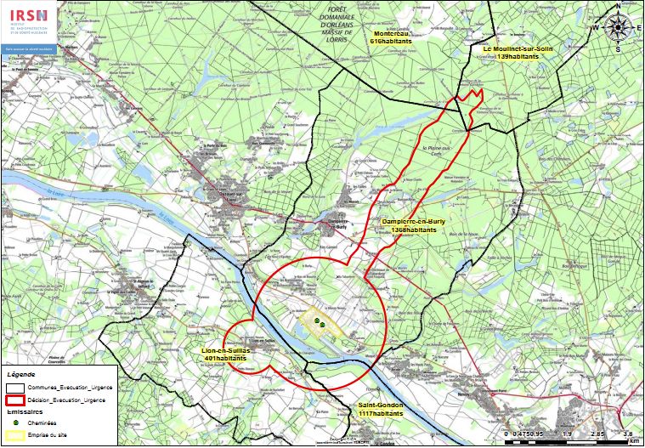
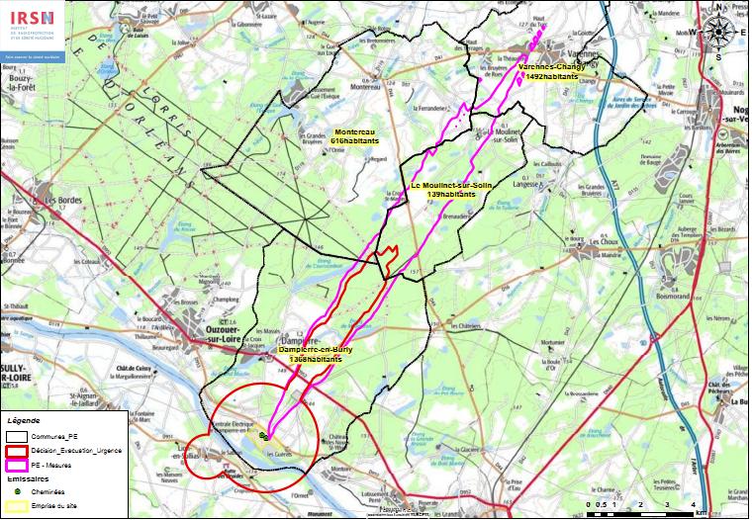
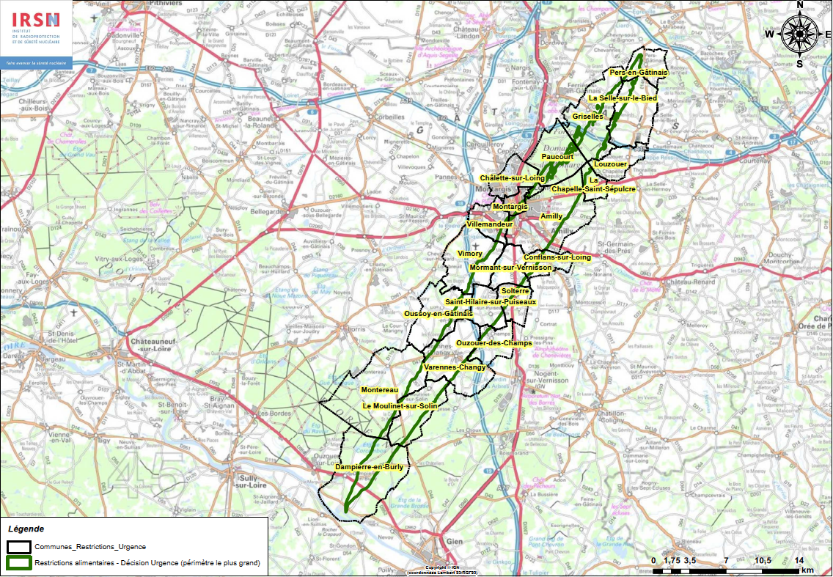
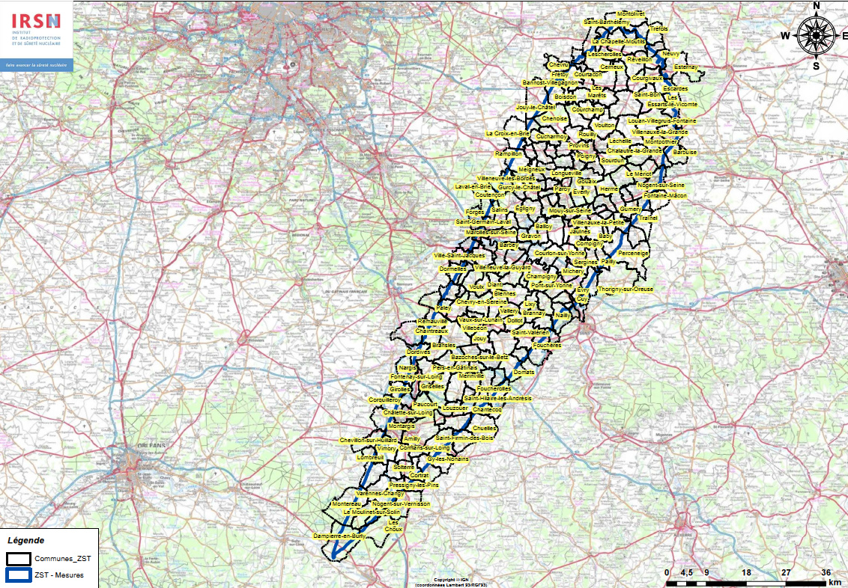
Case used (on Dampierre NPP sites) for the Second panel meeting
Emergency decision: evacuation of populations during the emergency phase (1800 people - Dampierre and Lion-en-Sullias municipalities + some people from neighboring municipalities)
Relocation of population at the end of releases (airborne measurements)
Emergency decision: restrictions on consumption of locally foodstuffs: 19 municipalities.
Municipalities concerned by the distribution restrictions at the end of the releases: 258 municipalities
Notes:
Dark blue area: zone with the higher risk (80-100% probability of exceeding the threshold
With some issues…
Issues associated with the decision to relocate the population:
Relocation population on all the municipalities concerned or only a part of the municipalities?
For the following cases: what information to disseminate? What accompanying measures to implement? How to handle situations?
Population evacuated but allowed to return;
Population evacuated and relocated;
Population not evacuated but relocated;
Self-evacuated population;
Population living in territory near the relocation perimeter.
What weight to radiological criteria? How do these criteria guide the decision?
How to organize the return?
Is there sufficient knowledge of the situation to manage it? What information would be needed? What uncertainties about the future?
Issues associated with the decision to restrict the consumption / distribution of products:
Restrict consumption on which perimeter? And based on what criteria?
How to lift distribution restrictions?
What weight to radiological criteria? How do these criteria guide decisions?

Slide 9
Results analysis and main identified issues (1/5)
~50 uncertainties for evacuation/relocation and ~30 for food restrictions
Analysis of the stakeholders’ questions to identify various issues raised by the panel members regarding evacuation/relocation and food restrictions;
Uncertainties have been classified depending on topics and the emergency / transition phase
Classification used: S. French et al., in The Various Meaning of Uncertainties.
From these findings, various types of uncertainties have emerged and can be classified in two main categories:
the external uncertainties to the decision-making process which generally speaking refer to uncertainties associated with the production of information (modelling, measurements, etc.);
the internal uncertainties to the decision-making process which are directly linked to the use of the information to take decision (reaction of decision-makers given the ambiguity, clarity of the situation, personal judgement, social reactions, economic impacts, etc.)
Notes:
External: In general, these uncertainties refer to physical randomness (stochastic / aleatory uncertainties), reliability of the models (modelling uncertainties), lack of scientific knowledge (epistemological uncertainties), errors in calculations (computational uncertainties), setting of default values or parameters in models on the basis of personal knowledge (judgmental uncertainties), etc. In the case of nuclear accident management, these various uncertainties are mainly found in the process of producing data and information (e.g. producing contamination maps from modelling, from field measurements, etc.) which will be used as basis and support for the decision-making process. As a result, for our analysis, external uncertainties are directly related to the production of information.
Internal: In general, these uncertainties can take various forms and are difficult to apprehend and assess. For instance, internal uncertainties can be related to the decision maker's behaviour given the ambiguity or the lack of clarity of the situation, his understanding of the situation, his personal judgments, etc. Moreover, the way how the decision is formulated, disseminated and subsequently understood and implemented can also generate a lot of uncertainties (reactions of inhabitants, socio-economic impacts, etc.) which are also considered as ‘internal uncertainties’.

Slide 10
Results analysis and main identified issues (2/5)
1/ Uncertainties associated with the production of information (external uncertainties)
Stochastic, epistemological, judgmental, computational, modelling uncertainties
“What is the level of reliability of the probability maps?
What if the release occurs during a longer time frame?
How do you consider the meteorological forecast (wind)?
What is the level of reliability of the measurements? What is the level of conservatism?”
2/ Uncertainties associated with the use of information (internal information)
Uncertainties related to the decision itself – how to shape the strategy given the available information
“When should we communicate about relocation? Is it when the results of the model are available or after a few days when the zoning is well established based on field measurements?”
“Should we not wait for the first map of contamination based on field measurements?”
“Should we consider other criteria (geographical, socio-economic) in addition to the radiological ones? How to put into balance these different criteria?”
“Should we make a distinction between consumption and commercialization or link both?
Where to put the higher protection: on food intended for commercialization or food intended for self-consumption?
Which strategy to adopt? Create an extended restriction zone to be reduced progressively according to on-the-field measurements (“from big to small” approach) or instead, a small restriction zone that could be expanded if necessary (“step by step” approach)?”
Notes:
Although the participants of the French panel didn’t focus so much on these types of uncertainties, some questions were raised and referred directly to stochastic, epistemological, modelling or computational uncertainties. For instance…during the panel meeting, panel members questioned the probability maps and measurement maps which were given to them to take their decision.
These external uncertainties, directly related with the production of information, can have direct impacts on decisions and their evolution in the long-term phase. it should be highlighted that these types of uncertainties do not constitute real brakes for them to take their decisions. In fact, these uncertainties are outside their direct area of responsibility. Indeed, in the case of an emergency, decision-makers will have to take decision on the basis of this information, whether they are tainted by uncertainties or not.

Slide 11
Results analysis and main identified issues (3/5)
2/ Uncertainties associated with the use of information (internal information)
Uncertainties related to the governance
“Taking into account the “Safety Contingency Plan” at communal level, is it possible that mayors decide evacuation by themselves?
Will this strategy for evacuation, decided at local level, be validated by higher authorities?
Will higher institutional actors/decision-makers change this strategy and implement a new one?
Will this zoning for food restrictions be agreed and validated by higher authorities?”
Uncertainties related to communication issues
“Will prior communication (by social media, traditional media, etc.) able to broadcast the “right” messages and prevent panic?
Besides traditional media (TV, radio), what can be done to limit the spread of rumours and broadcast reliable information on the social media?
When should we communicate about relocation? When the results of the model are available or after a few days when the zoning is well established based on field measurements?”
“What are the best messages given the circumstances?
To what extend does the population understand the evacuation procedures and the doctrine?
How will the messages be understood?
What information is clear and concrete enough to reassure on the effectiveness of protective actions and provide support to the individuals according to their situation?”
Notes:
Another topic which appeared several times during the debates is the question of governance of the decision-making process, and the real weight of local decision-makers (mayors, prefect) facing a national or even international crisis.
For instance, in the case of evacuation, the existence of “Safety Contingency Plan” gives the possibility to mayors to evacuate its population, regardless the local decisions. Therefore, during the debate on the evacuation, none of the participants underestimated the consequences of a possible incoherence between the decisions taken by (i) local elected people, (ii) the prefect of the affected territory, or even (iii) the national government. This highlights a strong uncertainty about the decision process itself, but also on the way to balance local, national and international interests. These elements were reflected by the following participants’ questions:
During the emergency and transition phase, communication about decisions taken or about to be taken is a major lever of success for the management of the situation. During the debates, the timing at which communication shall be done about decisions (population protection, food restrictions…) appeared to be important. Any delay or lack of communication would be understood as a lack of capability to handle the situation and would result in a global mistrust towards the decision itself and beyond the authorities. The same mistrust would appear if the communication is done in advance compared to the implementation of the decision, giving time for other (legitimate) stakeholders to propose alternatives to the decision or to challenge the effectiveness of the decision. The speed at which information is broadcasted through social media imposes to decision-makers to communicate accurate information in limited time and in order to anticipate any false information. These issues were tackled by participants as we can see with their followings questions:
The ability of the decision makers to explain in plain language, simple terms the situation actually faced seems also an important issue.

Slide 12
Results analysis and main identified issues (4/5)
2/ Uncertainties associated with the use of information (end)
Social acceptance – behaviours and reactions
“What to do if the bus drivers use their right to withdrawal?
Will the military or police forces be able to contain any potential panic?
What are the options at our disposal if some first responders/actors (e.g. bus drivers) use their right of withdrawal?”
“How to outreach the general population and the hosting territories in particular, and not generate stigmatization of the relocated individuals and affected territories?
To what extent will the messages be understood? In particular for the individuals living outside the zoning borders?”
Economical and other side-effects uncertainties
“What will be the socio-economic impacts on the affected territories? How to maintain an activity in theses territories over the long term?”
“What about the brand damage/loss for the products and for the (affected) territories? How can we evaluate the impacts?
What will be the situation for the affected territories?
What will be the socio-economic impacts on each production sectors (considering the added value of the sector and the actors)?
What are the economic losses for each food production sectors if they are « stigmatized »?
Notes:
Other uncertainties emerged several times during the debates related to reactions and behaviours of the various stakeholders (e.g. local inhabitants living in the affected territory, responders, economic actors, inhabitants living outside the evacuation/food restriction zones) following the implementation of the decision. These various uncertainties can be named ‘social uncertainties’.
There is uncertainty about the behavior of the inhabitants (How will they react?)
The decision maker does not have a clear view on this subject. It would be important to be able collect/evaluate information about behavior of loacl population but not easy to obtain.
In fact, discussions of the French panel revealed that decision-makers do not have a clear vision on social uncertainties and do not know how to cope with such aspects. According to the participants, it would be important to collect/assess data focused on the possible reactions and behaviours of local residents and other stakeholders, trying notably to identify criteria which could make sense for them and foster their understanding. Unfortunately, these data are not easy to obtain objectively, which again, constitutes real uncertainties.
During the emergency phase, decisions are made according to several criteria (radiation protection and feasibility) but the economic factor is not taken into account. This was confirmed by the debates at the first meeting on the emergency phase: there has been very little issues about the economic aspects.
Otherwise, during the transition phase and more, in the recovery process, the economic dimension is progressively introduced although it was not the main criterion at the time of the decision was taken. Thus the economic impact of a decision is usually measured after taking the latter which is often irreversible. Concerning the debates, some participants asked about the economic impact of the long term relocation strategy on the affected territory:

Slide 13
Results analysis and main identified issues (5/5)
3/ Uncertainties related to the evolution of the situation over time
“What will be the evolution of the situation in the next hours?
Is it possible to anticipate now the zonings at far distance from the nuclear plant that will be concerned by relocation?”
“What will be the evolution of the radiological situation?
What will be the evolution of the zoning for relocation in the next months?
What is the level of reliability of this evolution?”
“How to adjust the strategy for relocation (and the protective actions) according to the evolution of the radiological condition?
How to link the evolution of the restrictions with the calendars of harvest and effective consumption of the products?”
4/ What information and support of information should be produced?
“What is the sociological profile of the population? What is the level of self-sufficiency of the population (consumption of the food produced in garden, harvest in forest, hunting, etc.)?
What are the products that have the higher impact (dose) when it comes to ingestion?”
“What is the reliability of the boundaries proposed for the relocation zone?
What will be the radiological measurements performed at the boundaries of the zoning for relocation?
How to ensure that the boundaries of the zoning for relocation actually protect the individuals living nearby?”
Notes:
From the first panel meeting dedicated to the emergency phase, participants wondered about the evolution of the situation over time:
Indeed, even if these projections are tainted of uncertainties (external), it appears that decision-makers need them to guide their decisions.
So, the panel members expressed the need to have elements allowing them to anticipate the evolution of the situation with time, especially to assess the influence of the decisions which could be taken at the beginning of the recovery phase on the longer term phases.
It will be also interesting to get feedback on the effectiveness of the decisions taken (from the radiological protection point of view on the relevance for the various actors). What criteria to evaluate this effectiveness and make this information available to decision-makers? How to take into account the temporal evolution? How to anticipate this at the moment of the decision?
What information?
During the two meetings, discussions of the French panel clearly emphasised the importance of providing to decision-makers various information which are not only focusing on radiological aspects. Moreover, the French panel highlighted several times the need to produce support of information which can reflect external uncertainties, as much as it can be done.
how to reflect the various issues of a territory (beyond the potential radiological contamination) to make an informed decision?
In the case of evacuation: data related to the socio-economic issues in the territory could present added value to take the decision. How to collect these data ?

Slide 14
Conclusions and next steps
Overall, these two meetings raised the following findings:
The temporal dimension (evolution of zoning over time) is confirmed as very useful for decision-makers;
The importance of diverse information, not only focused on radiological impacts, to help decision-making: geographic information, socio-economic issues of the territories, etc.;
The fact that the transition from emergency to post-accident phases is a challenging period (for all decision-makers);
The decisions taken during the emergency/post-accident phases could be political and might be taken over at high levels (but on a common basis).
For now, key points which come out are the need to:
Improve the robustness of dosimetric and radiological data and the way this information can be provided to decision-makers by reflecting clearly the remaining uncertainties;
Collect and propose contextual information related to the concerned population, the affected territory and the local situation which could help decisions-makers;
Further analyse how this contextual information comes into play in the decision-making process considering the various points of view, the time evolution, etc.;
Prepare in advance messages associated with the decision to be understood by the population.
Next meeting: identify lessons learned and recommendations for improving preparedness

Slide 15
Thank you for your attention!

