Slide 1
Source term assessment under severe accidents conditions
April3, 2019
NERIS workshop
K.Chevalier-Jabet, F.Cousin
IRSN

Slide 2
Contents
Severe Nuclear accidents
  Phenomenology
  Source term assessment
  Uncertainties
FASTNET and CONFIDENCE PROJECTS
Conclusion
TITRE DE LA PRESENTATION - DATE DE LA PRESENTATION
2

Slide 3
Contents
Severe Nuclear accidents
  Phenomenology
  Source term assessment
  Uncertainties
FASTNET and CONFIDENCE PROJECTS
Conclusion
TITRE DE LA PRESENTATION - DATE DE LA PRESENTATION
3

Slide 4
Severe accident
Dewatering of the core to such an extent that fuel degradation can occur and result in the release of radioactive species
Important physical phenomena :
Core degradation
Containment pressure build up
Ex-vessel radioactive release
Vessel rupture
Molten corium concrete interaction
4

Slide 5
Safety systems
Safety injection (SI)
containment spray system (CSS)
Containment venting system
Venting and filtration systems
Ultimate Safety systems
Passive sumps alkalinisation
Additional cooling systems
5

Slide 6
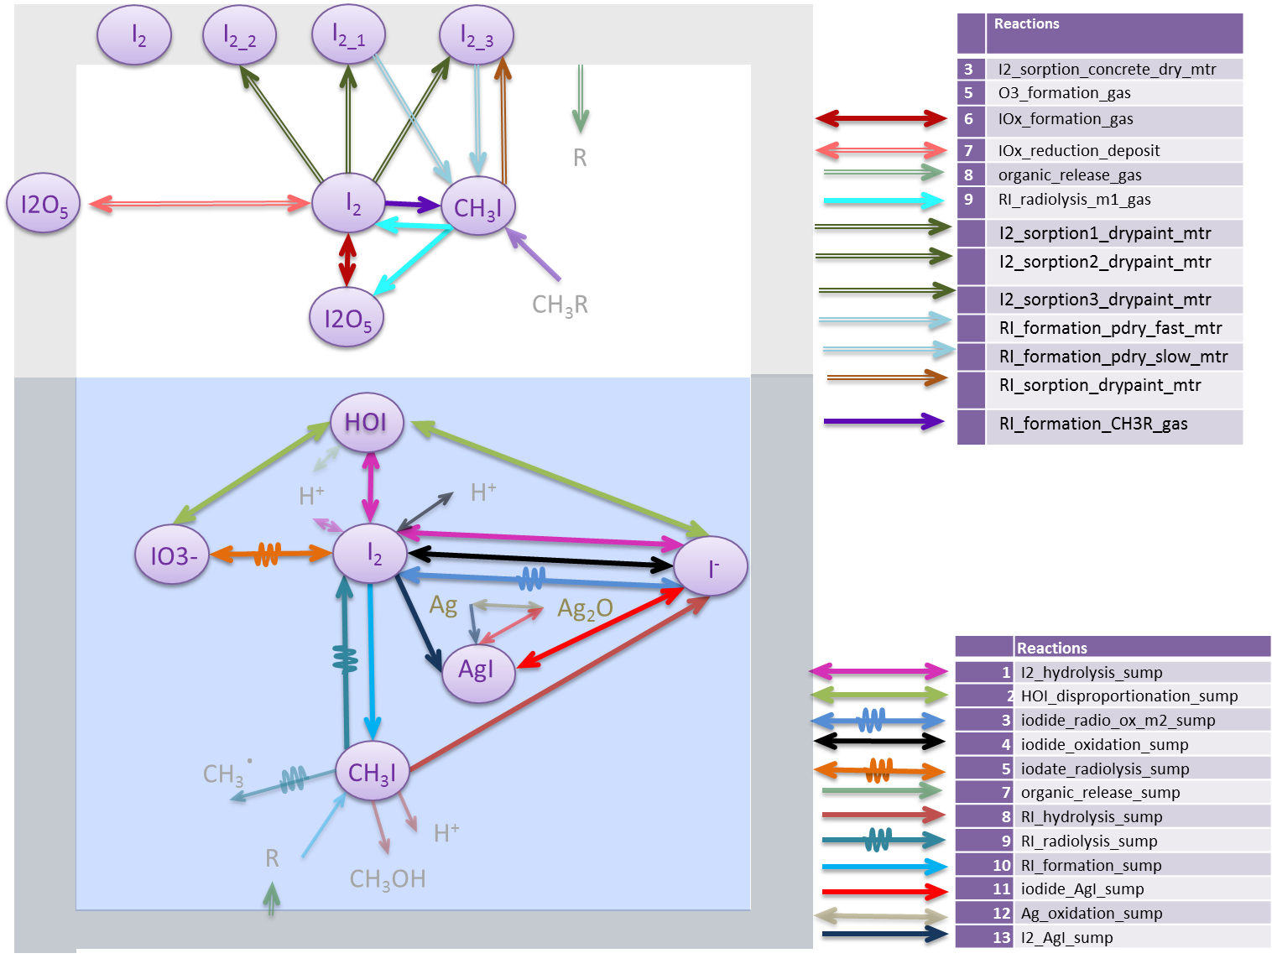
Iodine related phenomenology (containment)
6

Slide 7
The source term to the environment
Assessing a radioactive source term amounts to assess
  the ongoing situation and the status of the different parts of the plant (vessel, containment, availability of water supplies, electrical power,…),
  their consequences on the release of radioactive species to the environment.
It also amounts to understand
  the nature of the radioactive species in the containment building
  the whereabouts of the radioactive species in the containment building
7

Slide 8
The source term to the environment
Nearly all the aspects of the severe accidents phenomenology could be described as uncertain, so that in the end, assessing a source term comes to assessing an ongoing situation given
  The information we can get about the damaged power plant
  the lack of knowledge we have about the phenomenology that will affect or no the evolution of the situation.
Classes of uncertainties
  Aleatory : random, or variability that can not be fully be reduced : scenario related or safety systems related
  Epistemic : lack of knowledge
Tools : ASTEC code
  Embeds up to date knowledge about severe accident phenomena
  Models the safety systems behaviour
  Uncertainty propagation available
8

Slide 9
Contents
Severe Nuclear accidents
  Phenomenology
  Source term assessment
  Uncertainties
FASTNET and CONFIDENCE PROJECTS
Conclusion
TITRE DE LA PRESENTATION - DATE DE LA PRESENTATION
9

Slide 10
FASTNET and CONFIDENCE projects
FASTNET project : european project dedicated to allow
  the emergence of harmonised approaches to manage future nuclear emergencies among European entities in charge of this management
  the sharing of knowledge on fundamentals on severe accidents phenomenology and on expertise methodologies for the operational management of nuclear/radiological emergencies
WP 1: the production of a best estimate calculation grid specified according to :
  The initiator : Station BlackOut, Loss Of Cooland Accidents, Loss of Feedwater od Steam generators…
  The safety systems failure instants
  IRSN contribution : 57 sequences, calculated with ASTEC tool
10

Slide 11
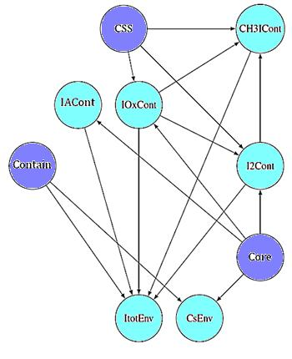
FASTNET and CONFIDENCE projects
WP2 and WP3 workpackages
  demonstrate that Bayesian Networks (BN) approaches can be efficient and relevant to be implemented in emergency centers
  IRSN contribution : build BN based on machine learning techniques
Learn the structure of the BN
Learn the parameters of the structure
Scenario specification
ASTEC
Simulations
DataBase
Data Learning
Validation
11

Slide 12
FASTNET and CONFIDENCE projects
Calculation grid specification
The input deck models a French PWR 900 MW
Scenario variables
  LOCA accidents ; size spans continuously from a fraction of an inch to 12 inches, and the break place can be either on cold or hot leg
  systems :
    no safety injection available
    CSS, can be working or not at the initiator time, and if not working, we assume there is no reparation.
  leak rate of the containment building, release routes.
  At vessel rupture, mass of the corium slump
12

Slide 13
FASTNET and CONFIDENCE projects
Calculation grid specification
epistemic uncertainties
  FP release : addresses the feedback of IRSN experimental database ; addresses intact rod (not melted) or fuel magma configuration for volatile, semi-volatile, low volatiles FP families
  Iodine behavior: related to kinetics of the various reactions, gaseous fraction at the break, fraction of oxidized silver in the sumps
  Molten corium concrete interaction : uncertainties for properties such as emissivities, thermal properties of the corium/concrete, debris layer porosity, residual power partition between elements…
13

Slide 14
FASTNET and CONFIDENCE projects
Resulting example bns and performances
inference for Vessel Status:
  Validation dataset
    The unknown is the vessel integrity, ((« VESSELSTATUS ») ;
    the other variables are used to build the query in the BN :
      For example : CSSAVAIL=[TRUE] and TGasC02=[302,329]…
    The BN computes the most probable « VESSELSTATUS » according to the query
    If the result corresponds to the value in the validation dataset, → successs
Percentage of success for this type of inference :
  For all times of the accident, the lowest performance is 80% success
  Most of the times : 100% of success
14

Slide 15
CONFIDENCE project
WP 1 : Guidelines ranking uncertainties for atmospheric dispersion
provide an assessment of the ability of the ensemble weather prediction systems to provide sufficient uncertainty information for dispersion
Same input deck as FASTNET, same epistemic uncertainties
Four initiators (size +/- 1 inch)
  break of 3 inches occurring on hot leg
  break of 3 inches occurring on cold leg
  break of eleven inches occurring on hot leg
  break of eleven inches occurring on cold leg
15

Slide 16
CONFIDENCE project
global release rate of the containment ranges in [1; 10] times the best-estimate amount
best-estimate distribution of the leak rate to the various containment buildings [1; 2] times the best-estimate value.
16

Slide 17
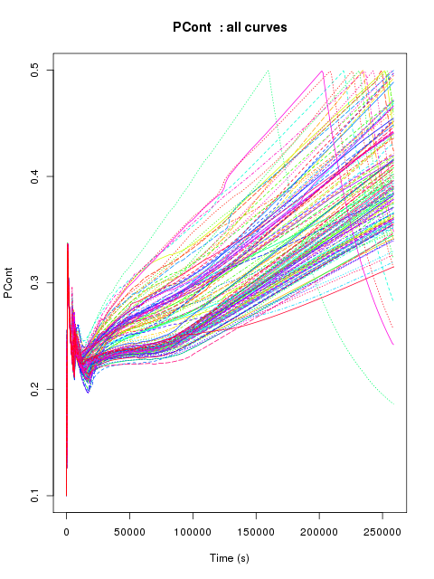
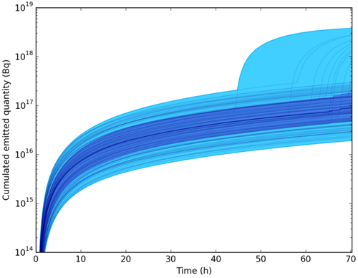
CONFIDENCE project results of the source term calculations
Pressure in containment building
Sand bed filter activation
Xe 133 release
little uncertainty on the first release time
11 inches, cold leg
17

Slide 18
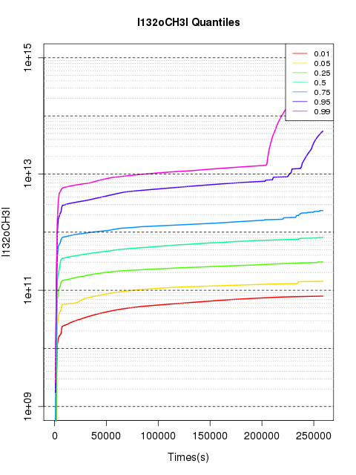
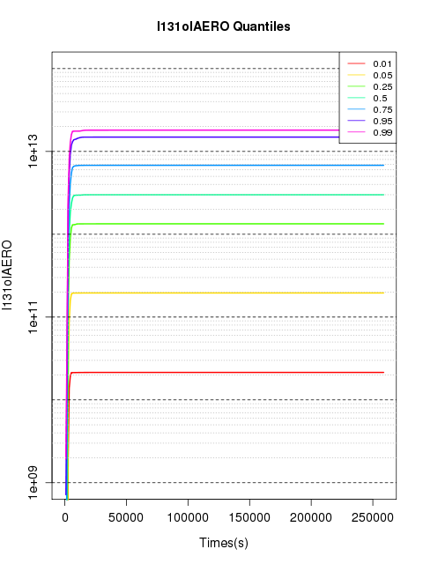
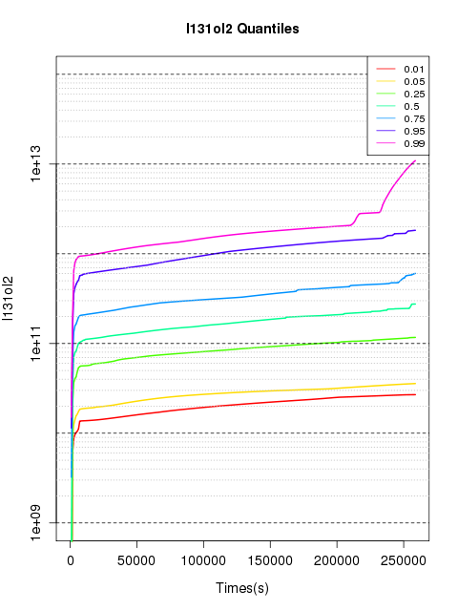
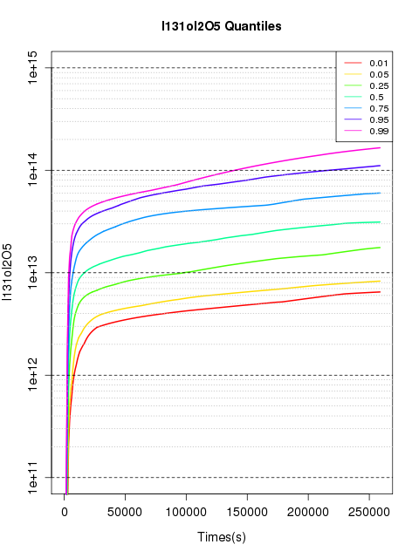
CONFIDENCE project results of the source term calculations
organic
aerosols
Iodine species (here I131)
Release uncertainties on
timing of events for gaseous species
Order of magnitude, due to speciation uncertainties
molecular
oxides
18

Slide 19
Contents
Severe Nuclear accidents
  Phenomenology
  Source term assessment
  Uncertainties
FASTNET and CONFIDENCE PROJECTS
Conclusion
TITRE DE LA PRESENTATION - DATE DE LA PRESENTATION
19

Slide 20
Conclusion
Source term assessment : best estimate + uncertainties
  Uncertainties taken into account
    Related to scenario
    Related to epistemic uncertainties
  Not all uncertainties taken into account
    Filtration efficiencies
    Unknown behaviour (lacking models)
Allows reasonable diagnosis of the situation according to the best of our knowldge (FASTNET)
Provides variability ranges in timing and order of magnitude for dispersion and radiological consequences (CONFIDENCE)
  See IRSN friday presentation (Irene Korsakissok) for details on how the calculated source term were used for the elaboration of the guidelines describing source term uncertainties
20

Slide 21
Thank you for your attention
21

