Slide 1



NERIS Workshop - Roskilde, Denmark - April 3-5 2019
Source term estimation of xenon releases from medical isotope production:
a test case for near-range atmospheric dispersion modelling
J. Camps¹, C. Gueibe¹, J. Rutten¹, T. Vidmar¹, F. Menneson², A. Delcloo³ and B. Deconninck⁴
¹ Belgian Nuclear Research Centre (SCK•CEN), Mol, Belgium
²Federal Agency for Nuclear Control (FANC-AFCN), Brussels, Belgium
³Royal Meteorological Institute of Belgium (RMI), Uccle, Belgium
⁴Institute for Radioelements (IRE), Fleurus, Belgium
johan.camps@sckcen.be

Slide 2
Outline
Measurement campaign in the close vicinity of a MIPF (IRE)
Forward atmospheric dispersion modelling
The backward problem and source term estimation
Conclusions and outlook

Slide 3
Measurement campaign
One-week measurement campaign in the close vicinity (off-site) of a large Medical Isotope Production Facility (IRE- Institute of RadioElements, Fleurus, Belgium)
Main objectives:
  Observation of the specific signature of xenon releases
  Focus on real-time data collection: in-situ spectroscopy and ambient dose rate measurements
  Collecting a complete data set for near-range model validation: environmental measurements, stack monitoring, meteorological data
  Explore the potential for source term estimation based on off-site, near-range monitoring

Slide 4
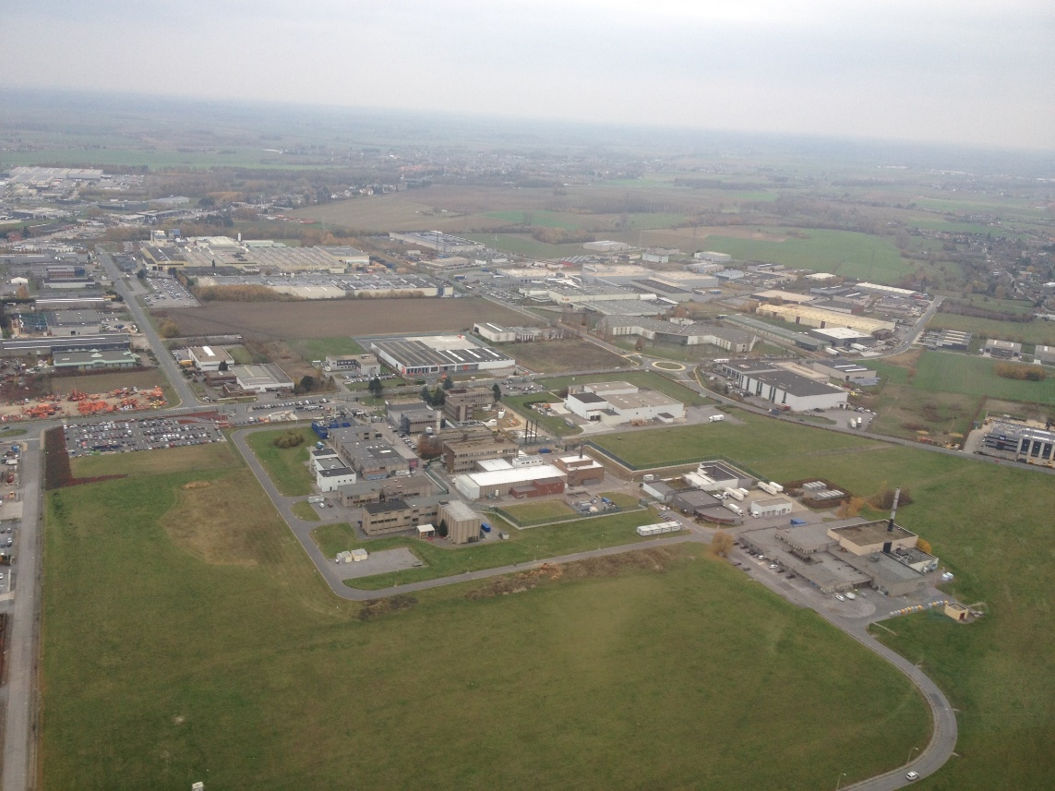
Measurement campaign
Collaborative project: combining tools and expertise
  SCK•CEN: in-situ monitoring, atmospheric dispersion modelling (near-range);
  FANC-AFCN: early-warning detector stations (TELERAD): fixed and mobile and meteorological data from met-mast
  RMI: prognostic weather data for selection of locations
  IRE: detailed stack release data based on HPGe
In addition during same measurement campaign
  BfS, Germany: both in-situ monitoring & sampling
  University Bern, Switzerland: Ar-37 sampling
IRE
Collaborative project defined in context of IAEA CRP →

Slide 5
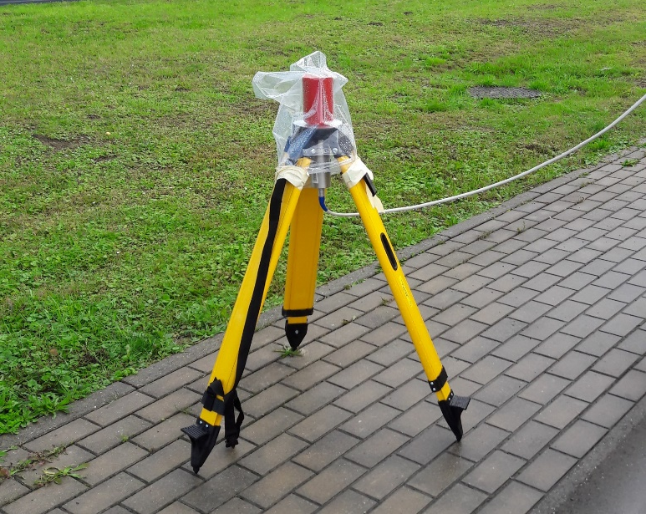
Data collected
Mainly data collected during 3 days (12, 13 and 15 Sept. 2017):
Data from fixed TELERAD stations(= Belgian early warning network) stations (ring stations: 1.5”x1.5” NaI)
5 mobile TELERAD stations (1.5”x1.5” NaI)
Additional spectroscopic and dose rate detectors:
  NaI: large volume (4 liter), 3”x3”, 1.5”x1.5”
  LaBr: 1.5”x1.5”
  CsI: 1”x1”x2”, as test for VTOL drone
  AdB: 3”x3” plastic scintillator coupled to app for plume search
Numerical Weather data for definition of detector locations
Meteorological data from 30 m high met-mast on-site (operated by FANC-AFCN)
HPGe stack data by IRE
Time resolution data: 1 minute – 1 hour (most data on 10/15 minute basis)

Slide 6
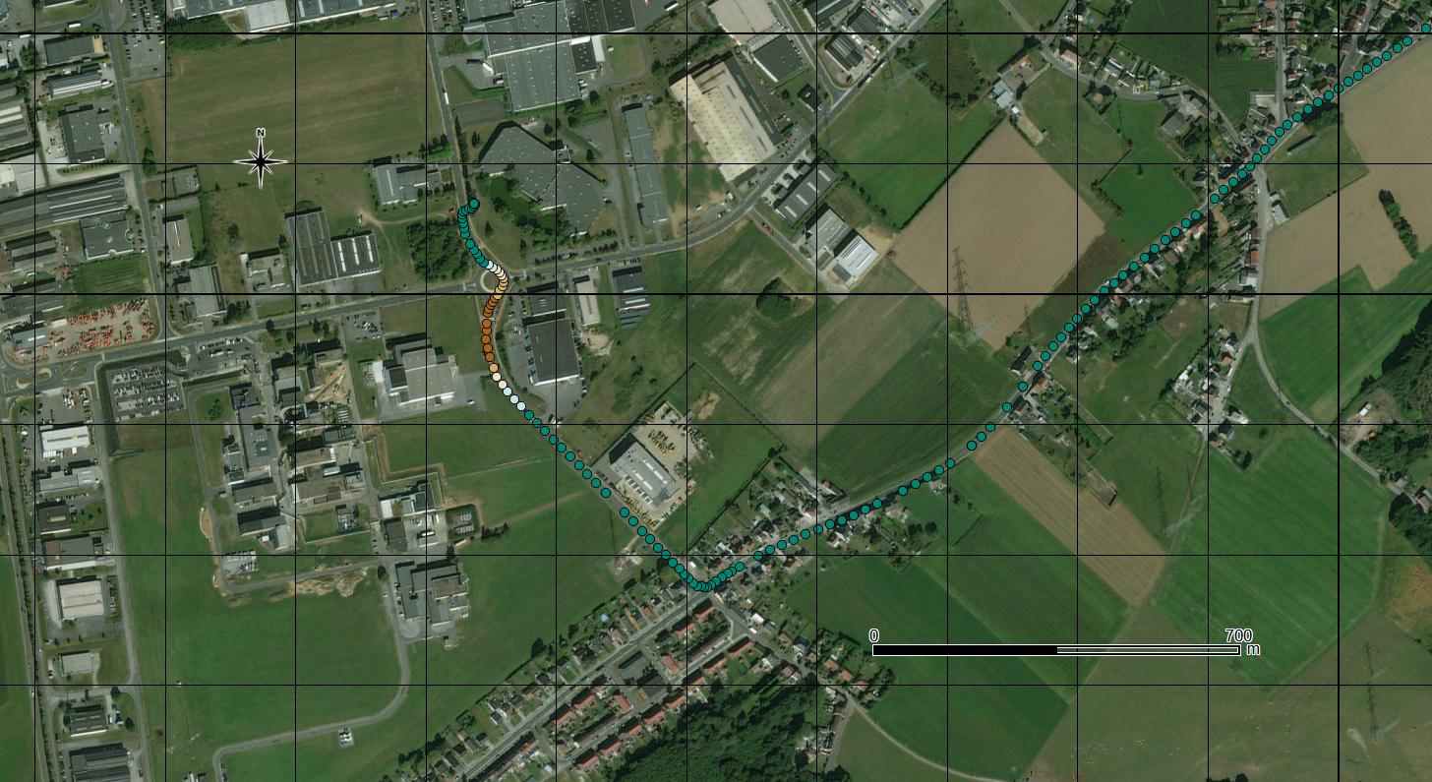
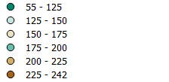
Plume survey
12/09/2017
08:40-08:50 (UTC)
3”x3” plastic scintillator coupled to GPS
Data recorded every second
STACK
Wind field 242° / 5.9 m/s
Narrow plume
Dose rate (nSv/h)

Slide 7
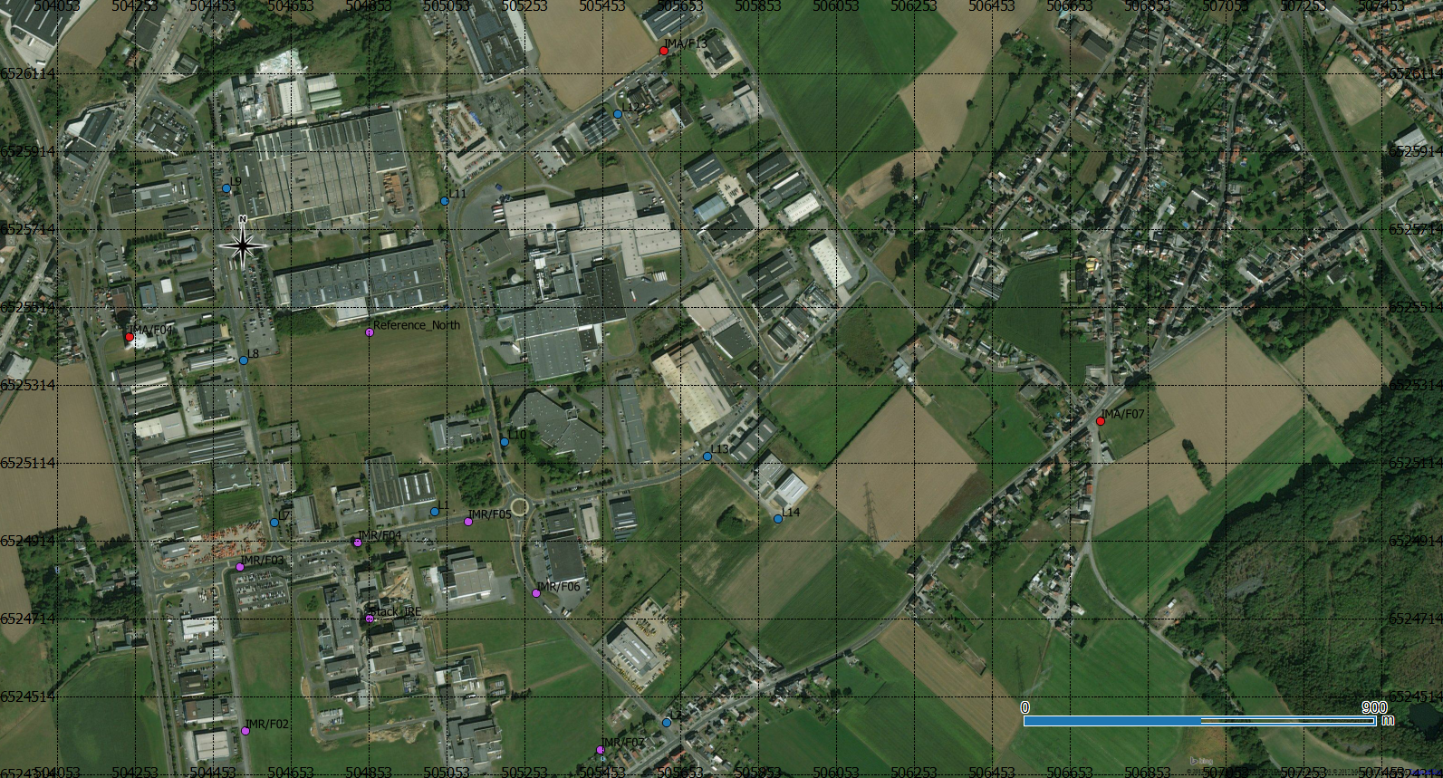
Measurement locations
Range:
130 m -
680 m
Most detectors in cone of 45°

Slide 8
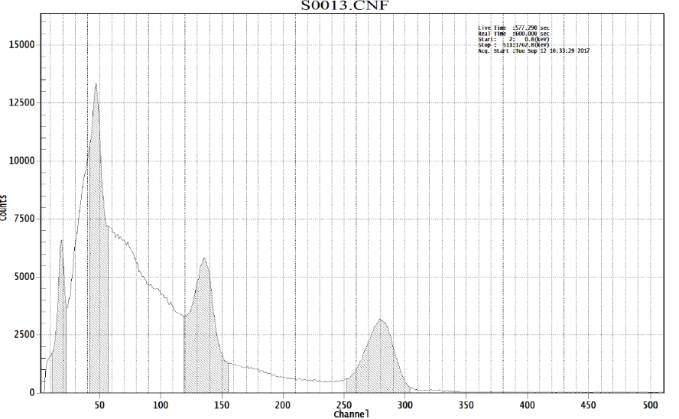
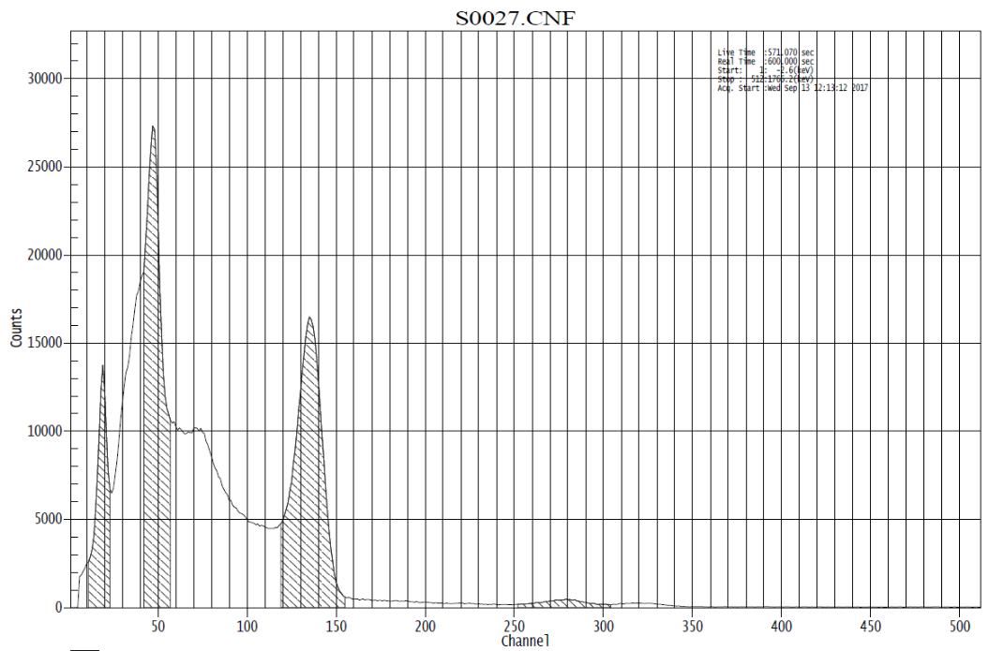
Some results
3”x3” NaI
10 minute spectrum
12/09/2017 – 08:33 UTC
3”x3” NaI
10 minute spectrum
13/09/2017 10:13 UTC
Xe-133
Xe-133
X-rays
X-rays
Xe-135
Xe-135
Xe-135m
Xe-135m

Slide 9
Forward atmospheric dispersion modelling
Plume
Based on HPGe stack emission data (15’): radioxenon release rate (Bq/h)
Performed at 10’ intervals
  Measurement data
  Meteorological data from met-tower: wind direction, wind speed, temperature and atmospheric stability
Use of Bi-Gaussian ADM developed at SCK•CEN¹
  Use of momentum plume rise from stack
  Calculations at exact detector locations
  Calculation of effective dose from external gamma radiation based on finite plume geometry
  Conversion of effective dose towards ambient dose rate as measured by TELERAD stations based on ICRP74 and ICRP116
Detector
Stack
¹See for example: J. Camps et al./ The ‘NOODPLAN’ early phase nuclear emergency models: an evaluation. Proceedings of Third IRPA Congress, Helsinki, Finland, June 2010

Slide 10
Results forward modelling (12/09/2017)
  Xe-135 and Xe-135m have considerable higher dose contribution compared to Xe-133

Slide 11
Results forward modelling (13/09/2017)

Slide 12
Results forward modelling (13/09/2017)

Slide 13
Results forward modelling (13/09/2017)
Mobile station
Fixed ring station
Continuous data for many years

Slide 14
Results forward modelling (13/09/2017)

Slide 15
The backward problem and source term estimation
Based on forward modelling results: ADM not main challenge for backward problem in the studied cases
However:
Dose rate alone does not give enough information (many radionuclide combinations can give same dose rate)
Spectroscopic information required
  How are isotopic ratios of stack measurements and environmental detections related?

Slide 16
Source term estimation
3”x3” NaI
10 minute spectrum
12/09/2017 – 08:33 UTC
Xe-133
X-rays
Xe-135
Xe-135m
Ratio released in
peak area:
Xe-133/Xe-135≈1
 | Estimated | Stack data
Xe-133 | 1.3e12 Bq | 1.7e12 Bq
Xe-135 | 1.2e12 Bq | 1.3e12 Bq
Estimated source term matches very well, but uncertainty at least factor 2 or 3
  81 keV peak (Xe-133) on top of background shoulder (relative large error on net count)
  More complex spectra in real emergencies (more radionuclides released)

Slide 17
Conclusions and outlook
Very good agreement of ADM calculations based on detailed stack data and direct measurements obtained during campaign
The estimated source term as estimated here based on in-situ calibrated detectors fits very well with the one from stack monitoring
For use in emergency situations, calibration of detectors for airborne radioactivity is essential part (coupling ADM and fluency rate model): not incorporated in current models → work to be done (Study by University of Florida: ADM coupled to MCNP)

Slide 18
Thank you
Questions?

Slide 19
Copyright © 2018 - SCK•CEN
PLEASE NOTE!
This presentation contains data, information and formats for dedicated use only and may not be communicated, copied, reproduced, distributed or cited without the explicit written permission of SCK•CEN.
If this explicit written permission has been obtained, please reference the author, followed by ‘by courtesy of SCK•CEN’.
Any infringement to this rule is illegal and entitles to claim damages from the infringer, without prejudice to any other right in case of granting a patent or registration in the field of intellectual property.
SCK•CEN
Studiecentrum voor Kernenergie
Centre d'Etude de l'Energie Nucléaire
Belgian Nuclear Research Centre
Stichting van Openbaar Nut
Fondation d'Utilité Publique
Foundation of Public Utility
Registered Office: Avenue Herrmann-Debrouxlaan 40 – BE-1160 BRUSSELS
Operational Office: Boeretang 200 – BE-2400 MOL

